Slide 1
Applying Transformation & Extinction to Magnitude Estimates –
How Much Does It Improve Results?
BAA – AAVSO Joint Variable Star Meeting
July 8, 2018
University of Warwick
Gordon Myers
Ken Menzies

Slide 2
Objective
The Goal
  Consistent magnitude measurements across wide variety of equipment
The Questions:
  How much do transforms change results?
  Are changes accurate?
  Is it worth the effort to implement transforms?
  What role does extinction have in differential photometry?
  What tools are available to make transformation easier?

Slide 3
Outline
Transformation theory
Quantifying transformation magnitude changes
Test results from four different amateur systems
Extinction – how much does it impact differential photometry?
Best Practices – Key before Transform/Extinction
Tools available for generating your telescope’s transforms and applying them to observations

Slide 4
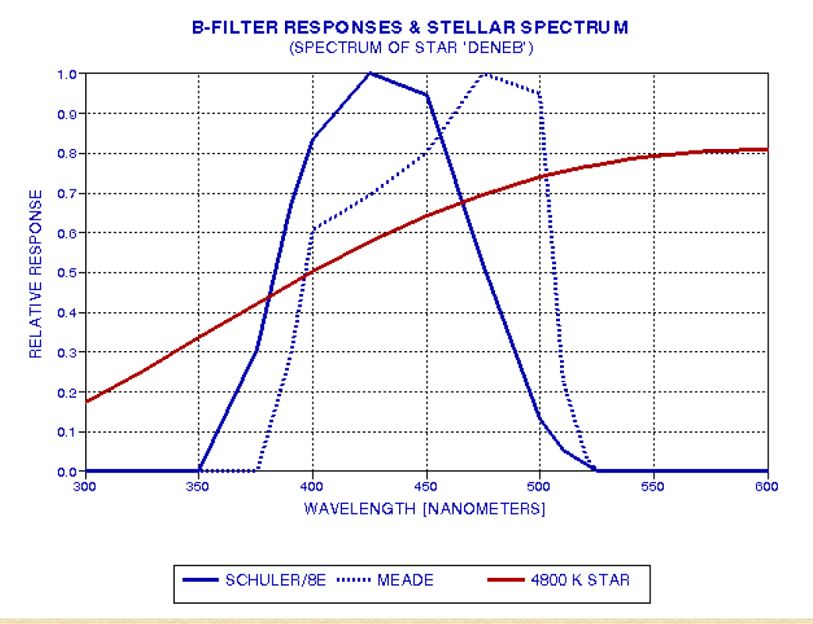
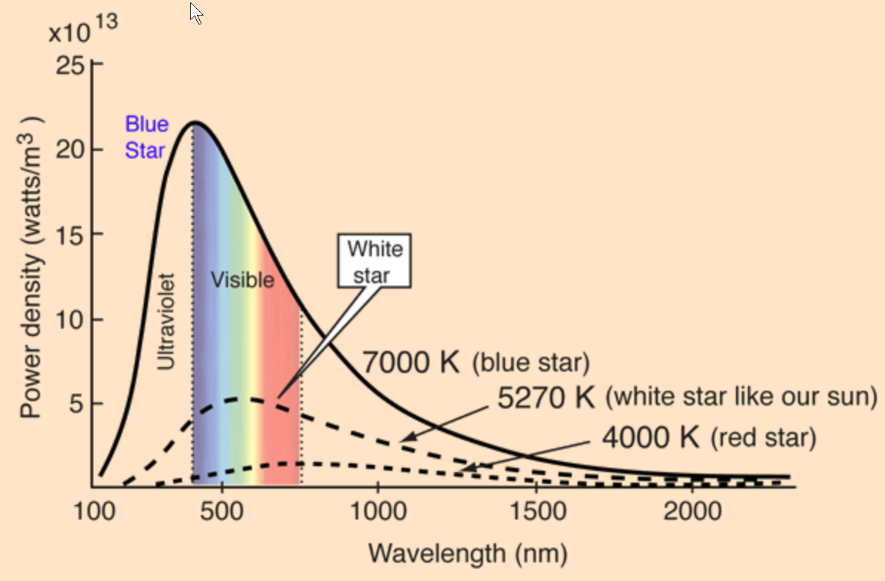
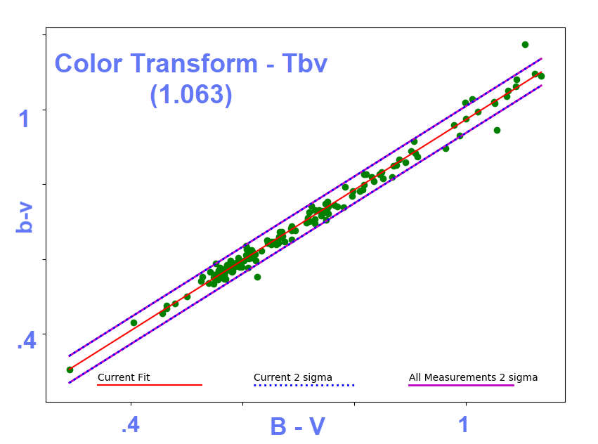
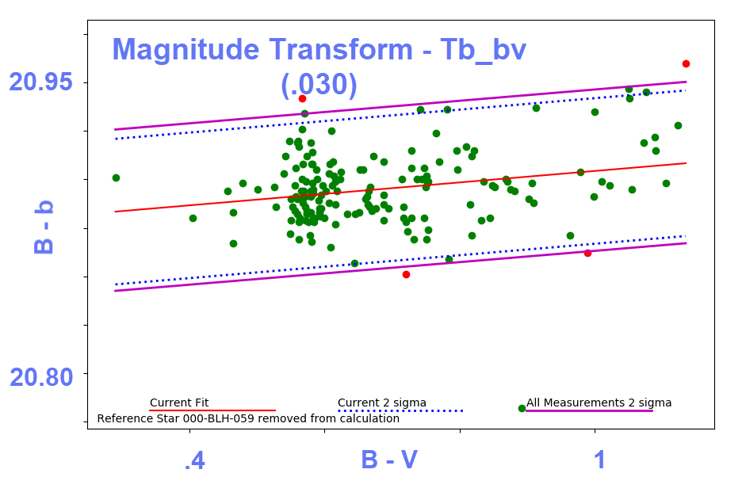
Transformation corrects -
  Observing equipment differences from “standard”
  Temperature difference (color) between target and comparison stars

Slide 5
Transformation Equation
Basic Equations:
V_{var} = V_{comp} + ∆ v + T_{v_bv} * ∆(B-V) where ∆(B-V) = T_{bv}* ((b-v)_{tgt} – (b-v)_{comp})
Combining and re-arranging:
V_{var} – (V_{comp} + ∆ v) = T_{v_bv} * T_{bv}((b-v)_{tgt} – (b-v)_{comp})
Predicted Magnitude Difference =
- T_{v_bv} * T_{bv}* ((b-v)_{tgt} – (b-v)_{comp})
Define “Transform Calibration Factor” = T_{v_bv} * T_{bv}
Lower case letters are instrument magnitudes, Upper case are standard reference magnitudes

Slide 6
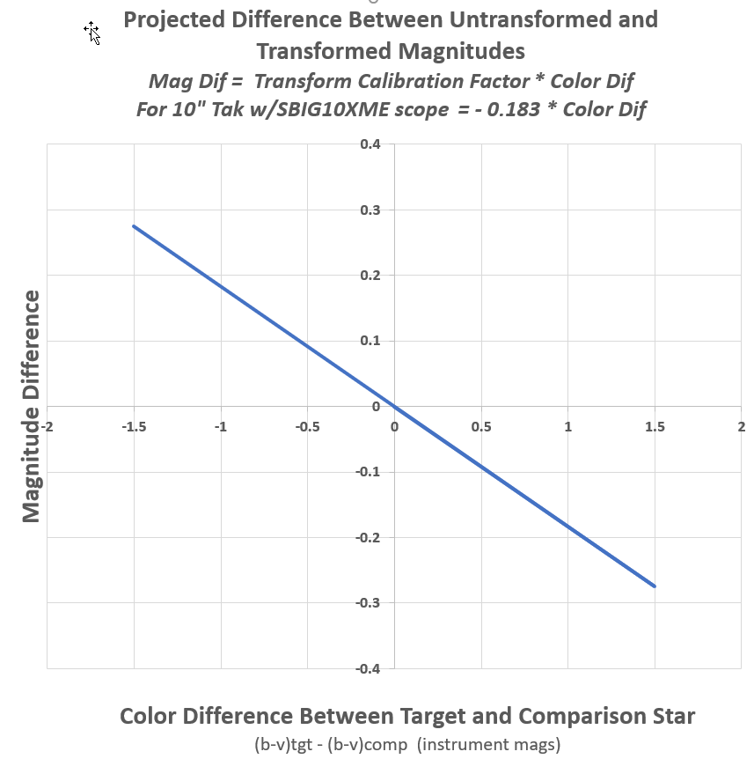
Example Magnitude Correction Plot
Plot quantifies magnitude of correction
Slope (the Transform Calibration factor) is crucial
Plot allows -
  estimate of error correction
  a way to test transforms.
Slope = Tbv*Tb_bv

Slide 7
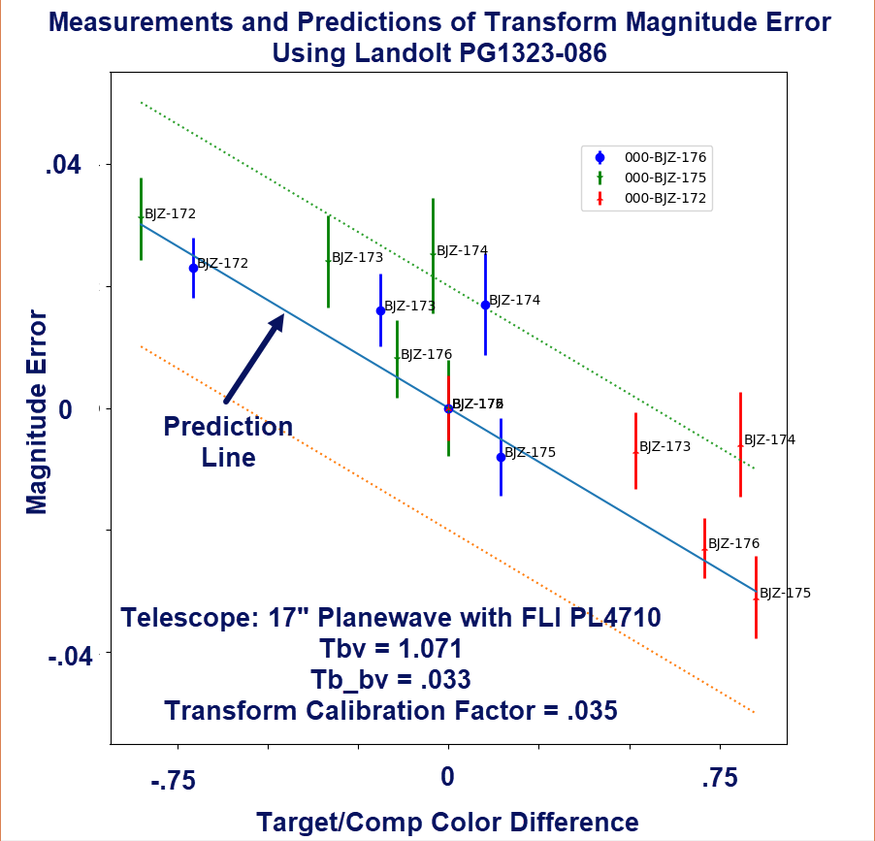
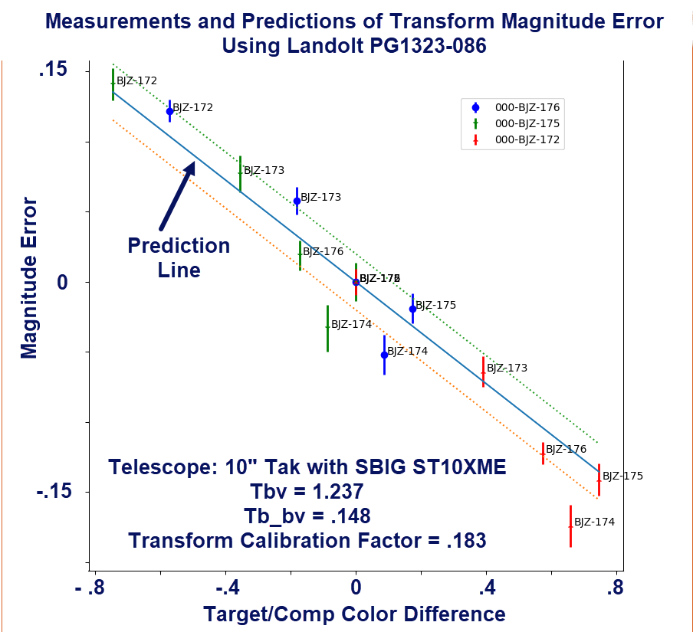
CCD Transform Test Using Landolt Field - (PG1323-086)
(5 stars in field)
  Tests are consistent with predictions
  Significant Improvement using Transforms - particularly with scopes having larger calibration factor values and/or large target/comp color differences

Slide 8
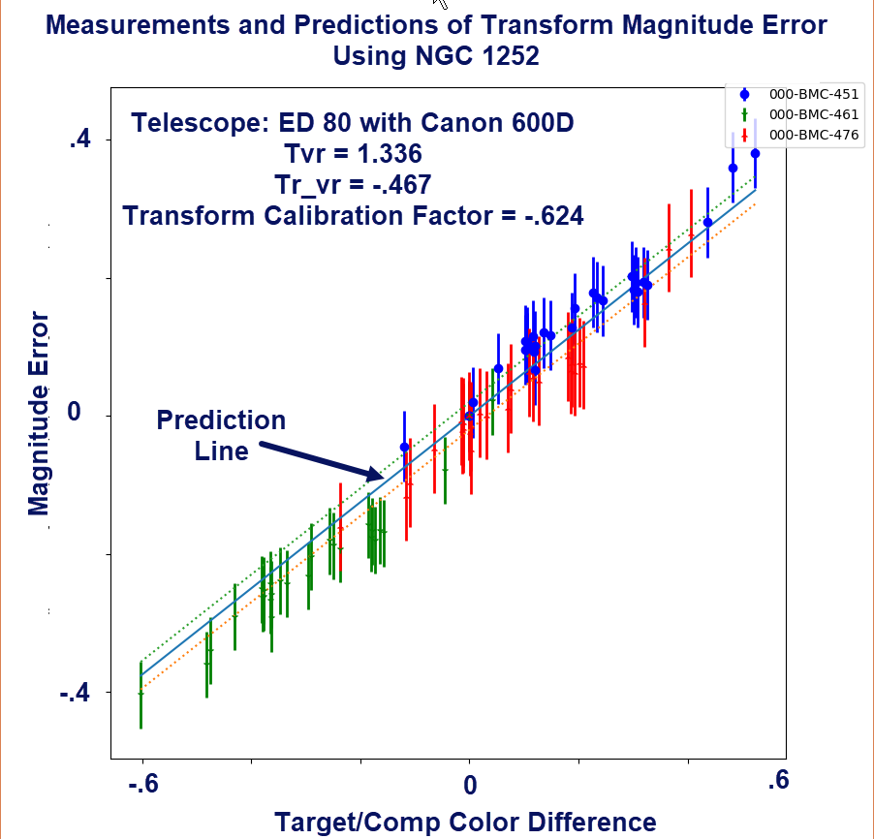
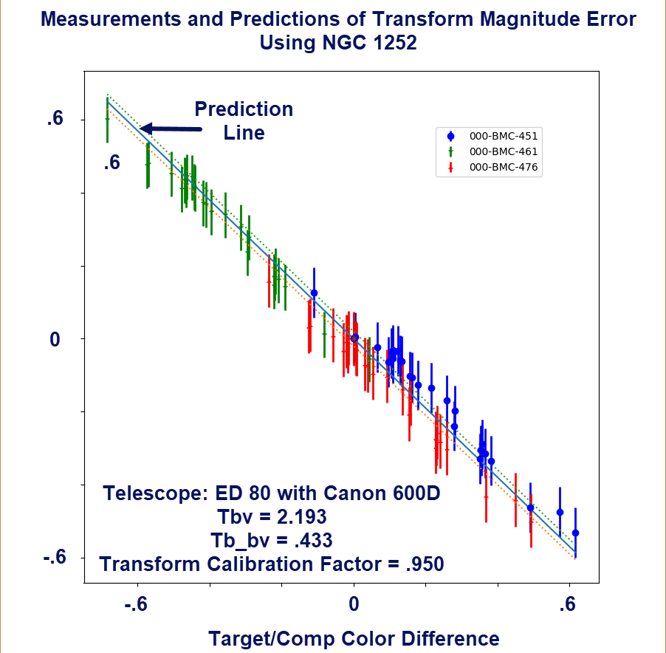
DSLR Transform Test Results Using NGC 1252
(28 stars in field)

Slide 9
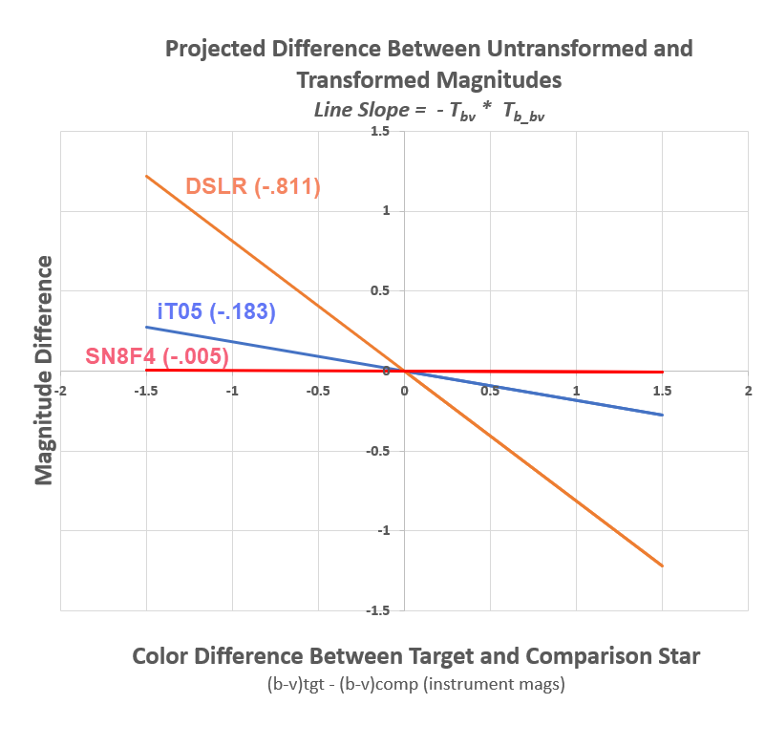
Comparison of Three Scopes

Slide 10
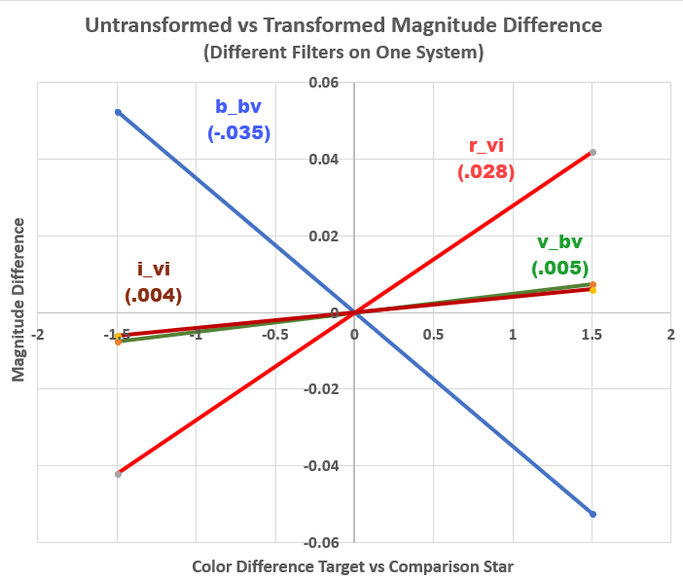
Evaluating Your Own System – a sample…

Slide 11
Extinction Equation w/Transformation
Basic Equation:
B_{var} – (B_{comp} + Δb) = T_{b_bv} * T_{b}*Δ(b-v)
- k’_{b} * ΔX - k’’_{b} * [X_{var}(b-v)_{var} – X_{comp}(b-v)_{comp}]
(1st and 2nd order extinction terms in red)
where:
  Δb = b_{var}-b_{comp} (Instrumental Mag Difference)
  ΔX = X_{var} – X_{comp} (Airmass Difference)
  (B-V)_{var} = T_{bv} * (b-v)_{var}
Typical values:
  k’_{b} = 0.4, k’_{v} = 0.2, k’_{r}= 0.1, k’_{i}= 0.08 (mean default)
  k’’_{b} = -0.03, others ~0

Slide 12
Order of Extinction & Transformation
Step | Correction | Shift | Variables
1A | 1st order extinction | m→m₀ | Function(X)
1B | 2nd order extinction | m→m₀ | Function(X;f₁-f₂)
2 | Transformation | m₀→M₀ | Function(F;F₁-F₂)
m=Instrumental Mag (u,b,v,r,i) at scope
m₀=Instrumental Mag (u,b,v,r,i) above atmosphere
M₀=Standard Mag (U,B,V,R,I) above atmosphere
X=Airmass
f₁-f₂=Instrumental Color (u,b,v,r,i)
F₁-F₂=Standard Color (U,B,V,R,I)

Slide 13
Cause & Remedy of Extinction & Transformation
Correction | Cause | Remedy
1st order extinction | More scattering in increasing atmosphere; More scattering of blue light than red light | Correct to exo-atmosphere m→m₀
2nd order extinction | Different scattering across filter bandwidth; More scattering difference for extreme colors | m→m₀
Transformation | Different formulation/mfg from Standard filter | Generate/apply T_{x}; T_{xy}

Slide 14
First Order Extinction
Target-Comp Separation
Small across typical CCD comp/target separation (across 10 arc minute separation, extinction difference at 30 degrees ~0.01)
Large across DSLR if comp/target separation is wide - (across 5 degree separation, extinction difference at 30 degrees ~ 0.15)

Slide 15
First Order Extinction
(BVI Filters)
CCD ∆mag ~0.005-0.02
DSLR ∆mag ~0.05-0.25

Slide 16
Second Order Extinction
(B Filter)
CCD ∆mag ~0.07
(B-V)comp ~0.7
DSLR ∆mag ~0.07
(B-V)comp ~0.7

Slide 17
Is it worthwhile to apply transformations and extinction?
Benefits vary significantly depending on
  equipment
  target/comp star color difference
  separation angle
It’s critical to test equipment
  DSLR’s require both transformation and extinction
  CCD’s measurements critically depend on the
  Transform Calibration Factor (Tx_yz * Tyz)
What’s your objective - .005?, .01? .02? .05? .1?
Recommendation – QUANTIFY the benefits for transformation and extinction by calibrating your equipment (NOT hard – tools available).
Decide for yourself. Tools make the process much easier. Why not always apply??

Slide 18
Use Best Practices
BEFORE Transformation and Extinction
Read AAVSO CCD & DSLR Guides
Look at your Images (Don’t Trust a “blackbox”)
Check the following:
  Correct Target or Comparison (not just in crowded fields!)
  Comp Selection Criteria
    Location (< 15’ from Target-Comp, <0.005 ∆mag)
    Magnitude (comp< +2.5) if SNR >100
    Color (∆b-v < 0.5, ideal ~0, 0-1.5)
    No Companion (none in Aperture, adjust aperture, 2-3xFWHM)
    No Saturation (linear range)
    Good Comp Error (APASS ~0.02 mag)
    Multi-Catalog bias ~0.1 mag

Slide 19
Evaluate your Equipment
Test your Equipment
  Check CCD Linearity
  Calibrate (Bias, Dark, Flat) Images
  Measure Transform Coefficients
  Measure Extinction Coefficients (or use default?)
  Measure Field of View
Measure Transform and Extinction Coefficients
  Generate Coefficients
  Test Coefficients
  Apply Coefficients
  Use TG and TA

Slide 20
Tools Make Doing Transformation Much Easier
(no more giant spreadsheets!)
VPHOT – enables easy star selection and measurement of standard cluster star fields (M67, NGC7790, M11, NGC1252*, NGC3532, Melotte*)
Transform Generator (TG) – processes VPHOT files to generate all needed transform coefficients
Transform Applier (TA) – takes standard AAVSO report file and applies transforms/extinction loaded from TG
(*Useful for DSLR)

Slide 21
Magnitude Corrections
(Two CCD and One DSLR Examples)
System and Target/Comp Separation | Transform ∆ Mag (Color ∆ = .5, B filter) | 1st Extinction ∆ Mag (Elevation = 30, B filter) | 2nd Extinction ∆ Mag (Elevation = 30, B filter, Color ∆ = 0.5)
DSLR/Camera Lens (10 deg sep) | 0.41 | 0.38 | 0.03
DSLR/Scope (1 deg sep) | 0.41 | 0.025 | 0.03
CCD/Scope (10 arcmin sep) | 0.003 - 0.09 | 0.004 | 0.03
CCD/Scope (30 arcmin sep) | 0.003 - 0.09 | 0.012 | 0.03
CCD/Camera Lens (10 deg sep) | 0.003 - 0.09 | 0.38 | 0.03
  If large tgt-comp color difference (e.g., Color ∆ = 1.5) increases ∆mag x3
  Decrease extinction ∆mag if
    Higher elevation angle
    VRI filters

Slide 22
Conclusions
Assess your Equipment Transformations/Extinction with TG
Apply Transform and Extinction with TA
Significant for CCD; Critical for DSLR
Achieve Standard Magnitudes (<0.01 mag from “true” magnitude)
Helps reduce the scatter in LCG
Makes data more useful to Astronomers

Slide 23
Is it worth the effort?
No, if ~0.1 mag error is acceptable,
Yes, if ~0.01 mag error is desired.
Questions?

Slide 24
Standard Clusters
Std Field | RA | DEC | Mag Range | Diameter (arcmin)
NGC 7790 | 23:58:23 | +61:12:25 | 10 – 20 | 7
Melotte | 12:22:30 | +25:51:00 | 5 – 10 | 450
M67 | 08:51:18 | +11:48:00 | 7 – 16 | 74
M11 | 18:51:05 | -06:16:12 | 8.5 – 17 | 20
NGC 1252 | 03:10:49 | -57:46:00 | 8 - 15 | 300
NGC 3532 | 11:05:39 | -58:45:12 | 8 – 13.5 | 30

Slide 25
Sample Transform Values
Scope | T50 | iT05 | SN8F4 | Hyperion | DSLR
 | 17” CDK FLI PL4710 | 10” Takahashi SBIG ST10XME | 8” SN LXD55 SBIG ST7XME | 12.5” Hyperion SBIG STL6303 | ED80 Refractor Canon 600D
Tbv | 1.071 | 1.237 | 1.023 | 1.052 | 2.037
Tvr | .993 | NA | 1.067 | 1.119 | 1.336
Tvi | .979 | .995 | 1.027 | 1.071 | NA
Tb_bv | .033 | .148 | -.005 | .082 | .398
Tv_bv | -.005 | -.043 | -.024 | .034 | -.111
Tr_vr | -.035 | NA | -.090 | -.039 | -.467
Tv_vi | -.025 | -.043 | -.025 | .035 | NA
Tb_bv*Tbv | .035 | .183 | -.005 | .086 | .811
Tv_bv*Tbv | -.005 | -.053 | -.025 | .036 | -.226
Scope 3 Scope 4

