Slide 1
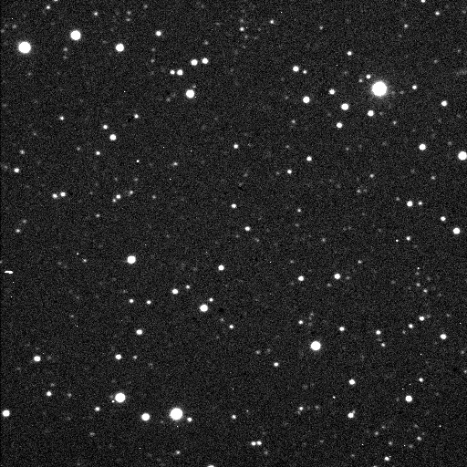
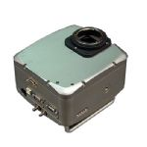
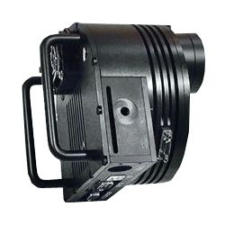
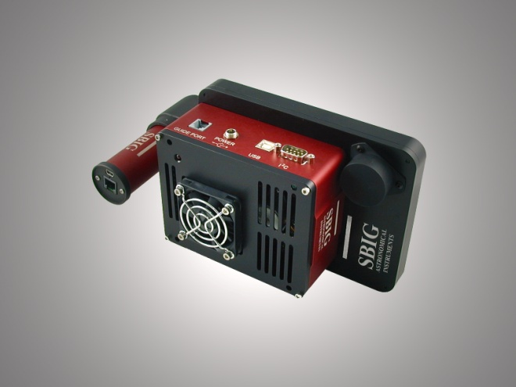
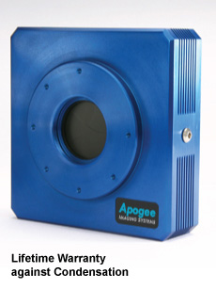
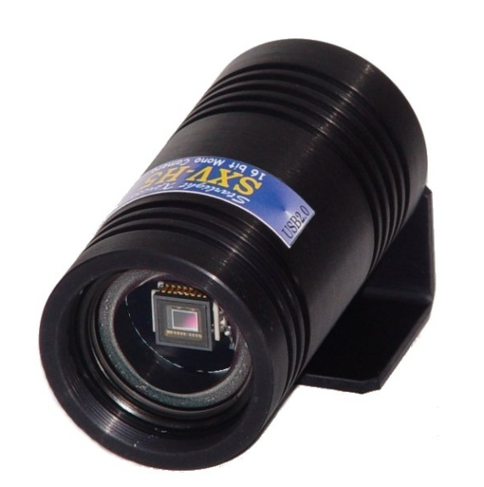
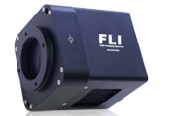
Variable Star Observing With CCD’s

Slide 2
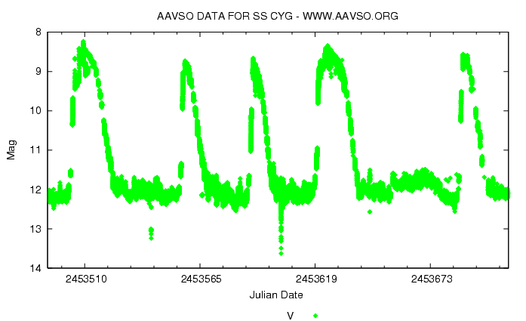
What Are Variable Stars?
Stars That Simply Vary Their Light
Output Over Time
They May Be Part Of A Double Star
System Or They May Be A Single Star

Slide 3
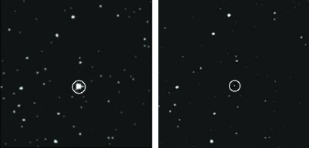
The Variable Star U Gem
In Its Bright State (Left)
And Its Faint State (Right)
~ Magnitude 9
~ Magnitude 15

Slide 4
The Brightness Changes Of These Stars
Can Range From A Thousandth Of A
Magnitude To As Much As Twenty
Magnitudes
Changes Occur Over Periods Of A Fraction
Of A Second To Years, Depending On The
Type Of Variable Star.
Over 100,000 Variable Stars Are Known And
Catalogued.

Slide 5
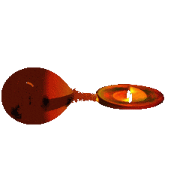
There Are A Number Of Reasons Why Variable Stars Change Their Brightness. Pulsating Variables, For Example, Swell And Shrink Due To Internal Forces.
An Eclipsing Binary Will Dim When It Is Eclipsed By A Faint Companion, And Then Brighten When The Occulting Star Moves Out Of The Way.
Some Variable Stars Are Actually Extremely Close Pairs Of Stars, Exchanging Mass As One Star Strips The Atmosphere From The Other.
Visualization by Andy Beardmore

Slide 6

There Are Various Classifications for
Variable Stars. A Few Examples:
Cepheids: Period ~ 1 - 70 Days, Vary ~ .1 -2.0 Magnitudes
RR Lyrae Stars: Period ~ .2 - 1 Day, Vary ~ .3 – 2.0 Magnitudes
Long Period Variables: Period ~ 80-1000 Days, Vary ~ 2.5 – 5 Magnitudes

Slide 7
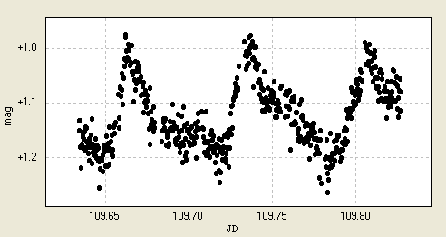
V368 Peg
Super Outburst
With Humping
10/05/09
Su Ursae Majoris Types of Cataclysmic
Variables: Frequent & Short Outbursts
Lasting ~ 1 - 2 Days. Occasionally Super
Outbursts Lasting ~ 10 – 20 Days With
Small Periodic Modulations Called
Superhumps.

Slide 8
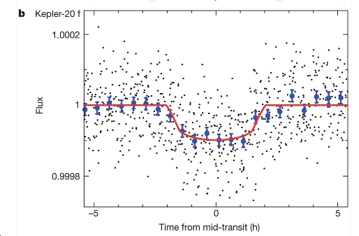
Planet Transits
Nature (2011) doi:10.1038/nature10780

Slide 9
Why Observe Variable Stars?
The Data Is Very Important to
Astronomers & Astrophysicists
Variable Star Research
Data, Dependent Upon Star Type, Can Be Used To Determine: Mass, Radius, luminosity, Temperature, Composition, Period, Rotation Rate and Distance.

Slide 10

There Is Also a Critical Need
For Us To Understand & Monitor The More Nasty High Energy Eruptive Variables Such As GRB’s (Gamma Ray Bursts), Supernovae & BL Lac Objects (Blazars).
These Objects, If Nearby,
Would Be A Threat To Life
On Our Planet

Slide 11
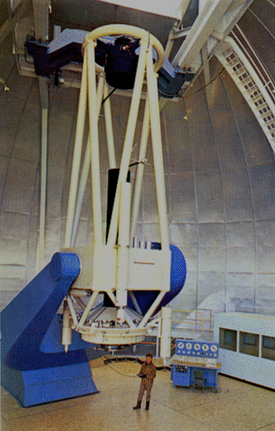
The ~ 260 Big “Scopes” Are Over Whelmed With Requests For Their Limited Time
& The Humongous
Size Of Our
Universe With So
Many Variable Stars
1.55 Meter USNO

Slide 12

The American Association Of
Variable Star Observers
WWW.AAVSO.org
Celebrated it’s 100th
Birthday In 2011
Has The Tools & Data
Bases For Variable Star Observers
You Do Not Have to Be a Member
To Submit Observations.

Slide 13
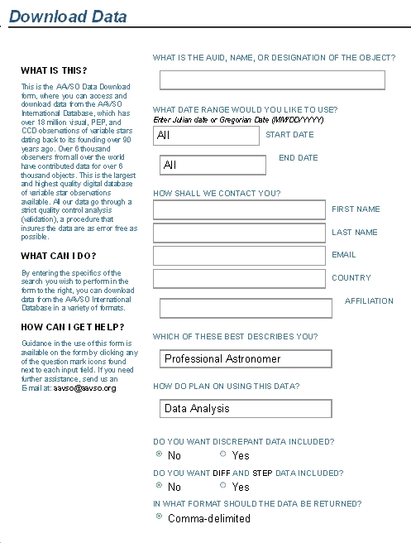
The AAVSO Receives Frequent
Requests From Professional
Astronomers For Photometry
Data as
Well as
Educators,
Students,
& Other
Amateurs

Slide 14
The AAVSO Can Supply
A Weekly Report Of
“Requests” For Your Data
Date Star name # obs. User Purpose
---------------------------------------------------------------------------
2011-11-28 SN 2011FE 260 Pro Analysis
2011-11-28 SN 2009IG 6 Pro Analysis
2011-11-29 SN 2011FE 260 Pro Analysis
2011-11-29 AG DRA 40 Pro Analysis
2011-12-01 SN 2011FE 260 Am Figure
2011-12-01 TU CAS 2238 Stu Analysis
2011-12-02 R AND 2 Am Analysis
2011-12-02 AX AND 4 Am Analysis

Slide 15
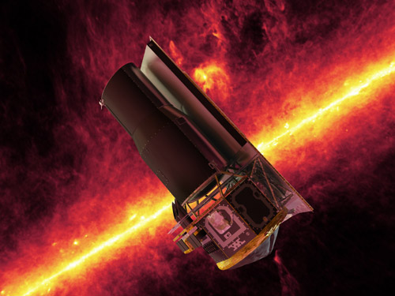

AAVSO Members & Observers Are Often Asked To Support Scientific Projects By
Professional Astronomers,
Whether Using Land
or Space Based Equipment, To Make Observations Of Specific Targets

Slide 16
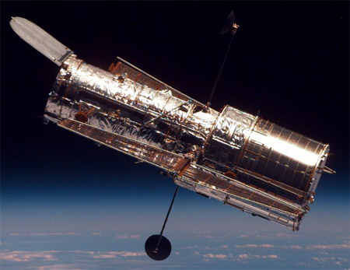
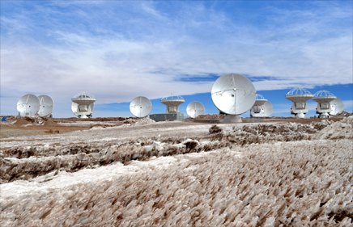
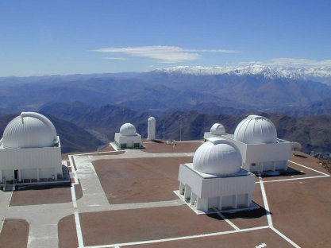
Three Request Examples From Fall 2011
Monitor V455 And In Support Of Hubble Observations For
Dr. Paula Szkody, University of Washington
Monitor SS Cyg In Support Of
European VLBI Radio Observing
Pgm For Dr. James Miller-Jones,
Curtin University, Perth, Australia
Monitor Multiple AGN Targets
In Support Of SMARTS 1.5 Meter
Telescope, Chile, For Dr. Misty
Bentz, Georgia State University

Slide 17
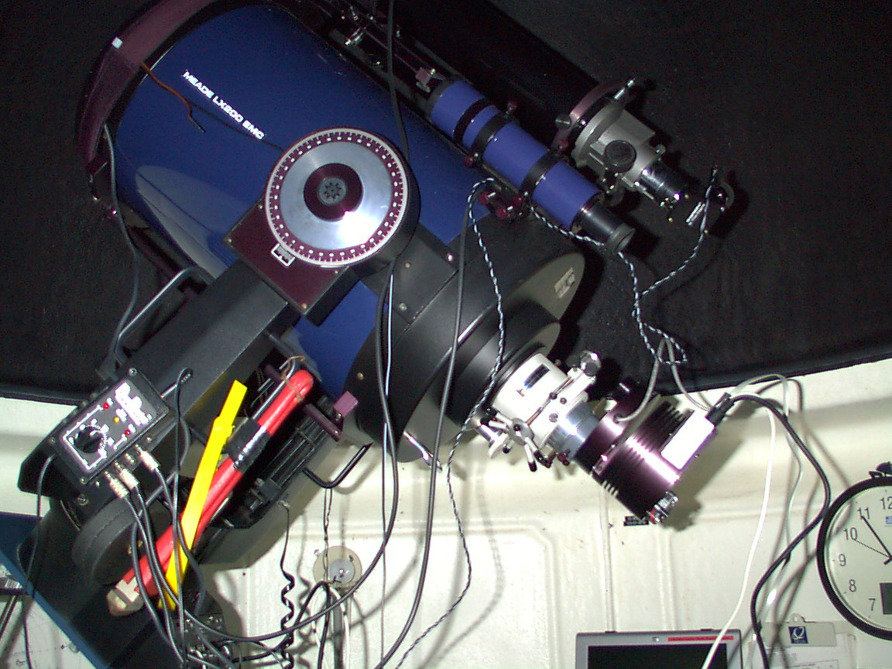
Therefore, Amateur’s Are Very Important to The Data
Gathering Process
We Play a Critical
Role Observing
Variable Stars With
CCD’s.

Slide 18

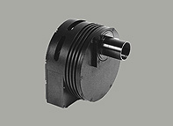
Observing Requires A CCD Camera - Preferably One
Designed For Photometry, i.e.
NAB (non Anti-Blooming),
Monochrome & Cooling Ability
ST-402ME
ST-7/8/9/10XME
STF Series

Slide 19
A Lot Of Potential Variable Star
Observers Already Own AB (anti-
Blooming) CCD’s – ‘taint no thang
We Can Work With That: Either Turn AB Off, Keep
Exposures to
½ Full Well
Capacity Or
Plot the
Linearity
A[pg

Slide 20
RED ALERT
Avoid Image Saturation
Know Your Full Well Capacity In ADU’s
~ = Full Well Capacity(e-)/A/D Gain(e-/ADU)
The Maxium ADU Count With A 16 Bit CCD
= 65,535 ADU
Imaging Software Will Provide
Maximum Pixel Values (ADU)

Slide 21
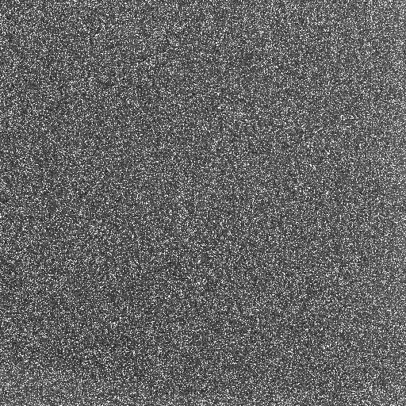
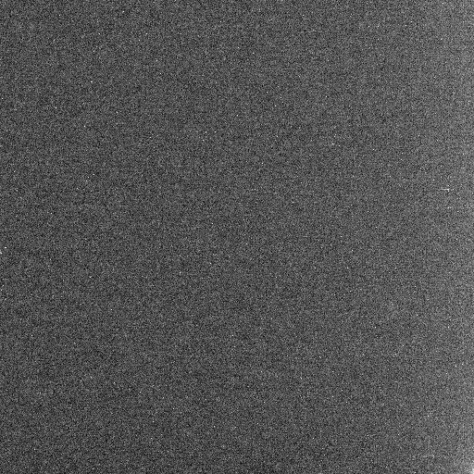
CCD’s Need To Be Cooled
+ 25C Dark Image
- 25C Dark Image
Notice How Much More Random Noise Is In The Hotter Image

Slide 22
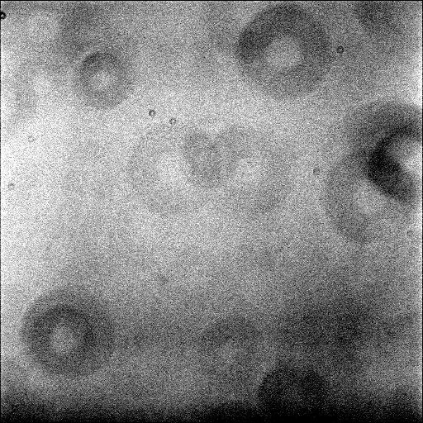
While Mentioning Darks
Photometry Requires That Images Be Calibrated: Subtract Darks & Flats!
Darks Contain The Random Electronic
Noise Inherent Within The CCD.
Flats Contain Light Path“Artifacts” Within The Optical “Train.”

Slide 23
RED ALERT
Calibrate Images (Darks & Flats) ONLY
NO OTHER IMAGE
MANIPULATION
Keep Your Paws Off Your Pretty Picture Software
Image Manipulation Will Bugger Your Photometry

Slide 24
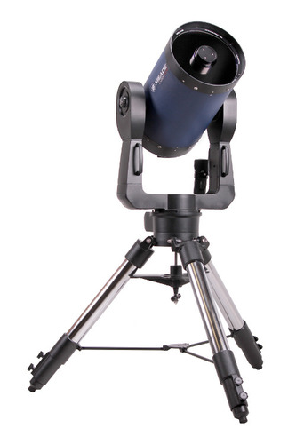
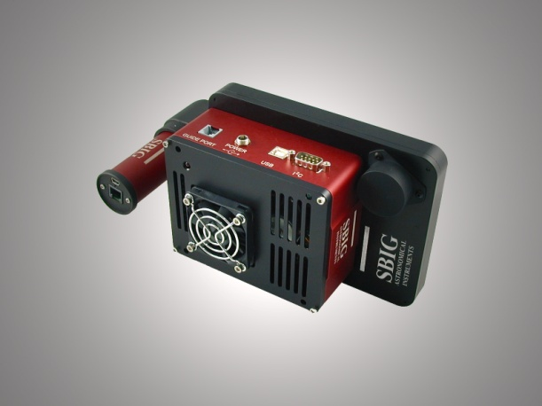
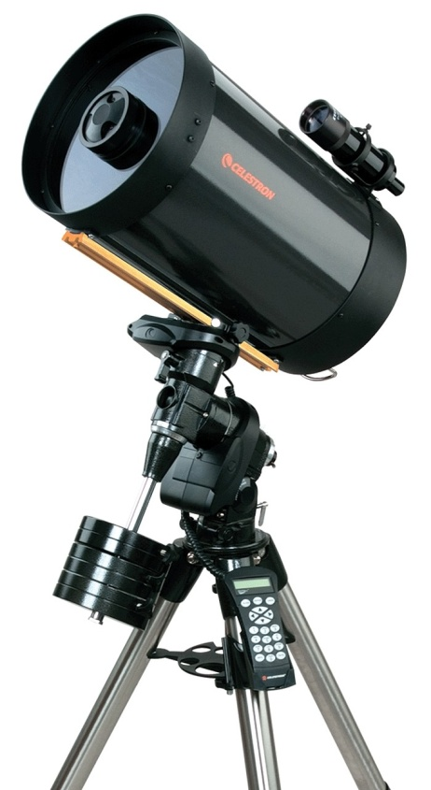
RED ALERT
You Need To Match Your Equipment & Your Local Seeing (Arcsecs ) So That Your Image Scale (Arcsec/Pixel) Spreads The Light Over 2-3 Pixels (More is OK-BUT NOT LESS: Under Sampling Will Bugger Your Photometry)

Slide 25
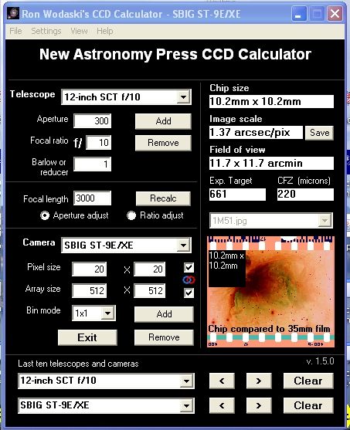
Determining
Image Scale
Google
“CCD Calculator”
Let It Do The Work
It’s A Freebie

Slide 26
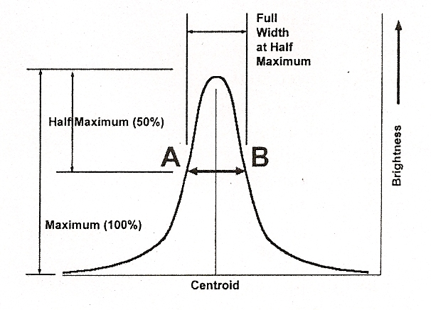
Determining Local “Seeing”
Best Initial Way Is To Ask Another Local Astronomer
Or Work It Out
Seeing = FWHM* Image Scale
Your Photometry PGM Should Calculate FWHM
FWHM Is The Diameter Of A Star
On Your Image At one-Half Of It’s
Maximum Pixel
Value
Ron Wodaski

Slide 27

With The Objective of A System That Will Spread
Seeing Out Over 2-3 Pixels:
Divide Seeing (Arcsec) by Image Scale (Arcsec/Pixel)
Image Scale Objective
Seeing (ArcSec) Range-Arcsec/Pixel
2 Pixels 3 Pixels
5 2.5 1.66
4 2.0 1.33
3 1.5 1.00
2 1.0 .66
1 .5 .33

Slide 28
Option If Under Sampled
If You Find Yourself With
This Equipment Setup &
Excellent Seeing Of 2
Arcsec Then You Would
Be Under Sampled With
the Seeing Spread Out
Only Over ~ 1.46 Pixels
(2 Arcsec/1.37 Arcsec/Pixel).
Work Around: Defocus
& Spread Seeing Out
Over More Pixels

Slide 29
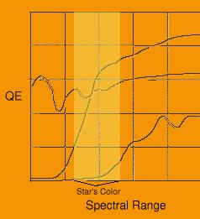
Different Models of CCD Chips Have Different Spectral Responses
Each Of The Three Popular
Chips Shown Has A Different
Spectral Response In The
Region Of A Star’s Light.
If Unfiltered Observations
Were Made With Each Then
The Reported Magnitudes
Would Be Wildly Different

Slide 30
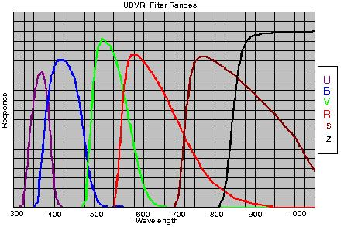
One Of The Strengths Of CCD’s Is That When We Use The “Right” Filter We Can Equalize The Passbands Of The Various Types Of Ccd’s.
Observe With “V” Filter!
The Johnson-Cousins
Filter
Standard System

Slide 31
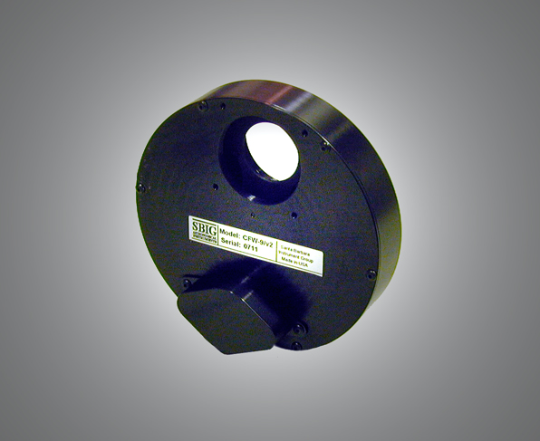
If You Want to Do “Advanced” Observing Then Add A Filter Wheel
V Filter Is The Minimum
Complete The Johnson/Cousins
Filter Set By Adding the B R & I Photometric Filters

Slide 32

Two Most Frequently Asked Questions
What Should I Observe
How Long Should My
Exposure Be
The Short Answer Is That both Questions Are mutually Dependent

Slide 33
The Comfortable Approach is to Start
With Targets Whose Magnitudes Will
Allow You to Achieve Uncertainties
(photometry pgm) ~ .01 Magnitude In
Your Measurements With 30 Second
Exposures.
Most Equipment Configurations Will
Allow Tracking For This Period Of Time.
Never Expose
< 10 Seconds

Slide 34
30 Second Exposure
V Filter
Range of ~.001-.01 Uncertainty
Scope Size Magnitude Range
V Filter
8” ~ 8.5 -11.0
12” ~ 9.0 -12.5

Slide 35
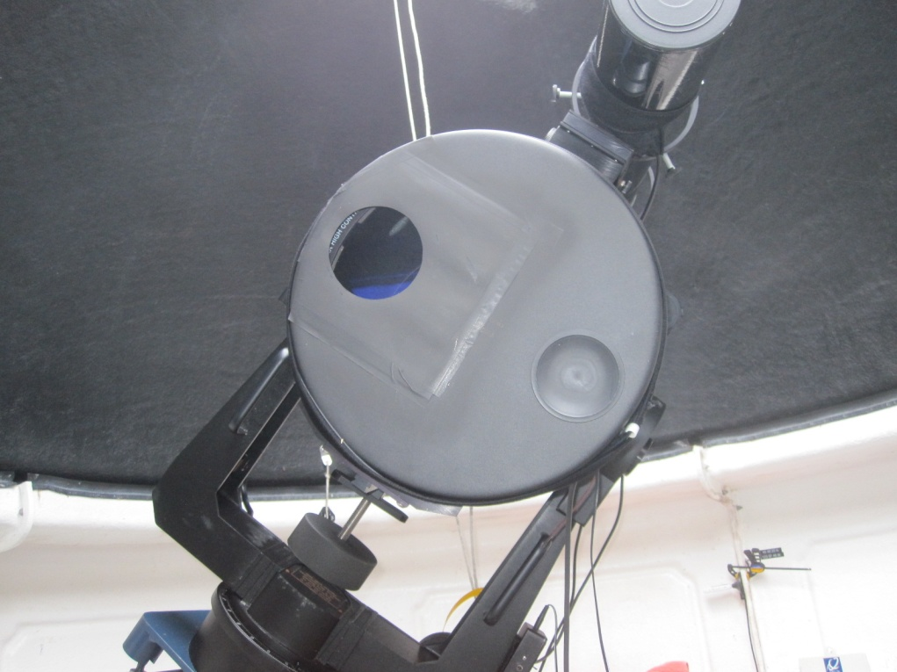
For Bright Targets (~ 5 - 8 magnitude)
Use A “Mask” To Reduce Scope Size
12” Scope Reduced
To ~ 3.5” Scope
(Used A 2 hole
Hartman Focus Mask)
Originally Used To Observe ~ 5.5 V Mag Target

Slide 36
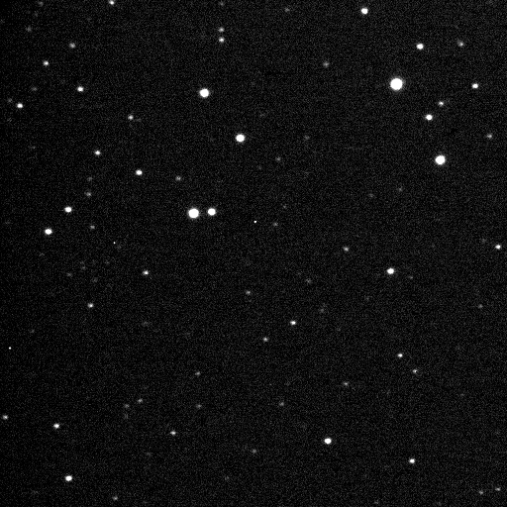
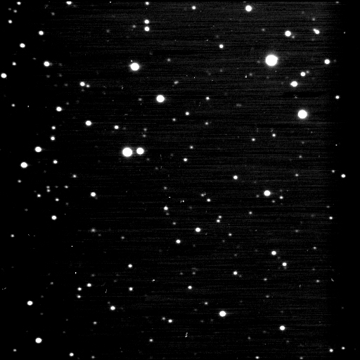
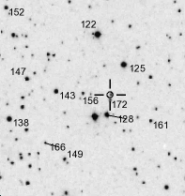
For Fainter Targets
Stack Multiple 30 Second Images
V391 Lyr
V391 Lyr
AAVSO Chart

Slide 37
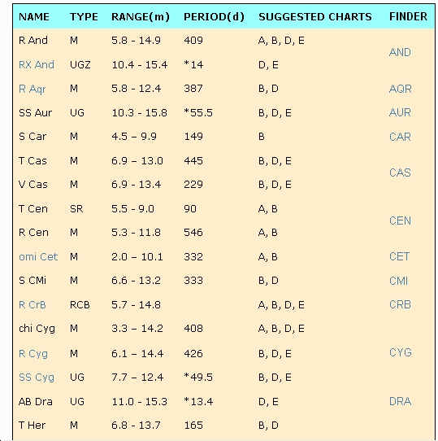

Observing Options
http://www.aavso.org/easy-stars
Stars Easy
to Observe
Partial Listing

Slide 38
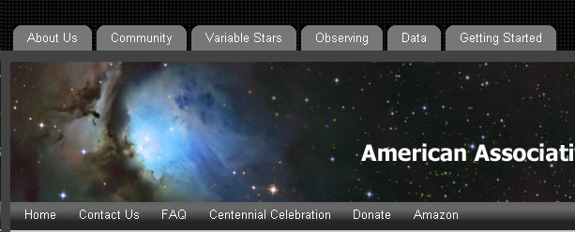
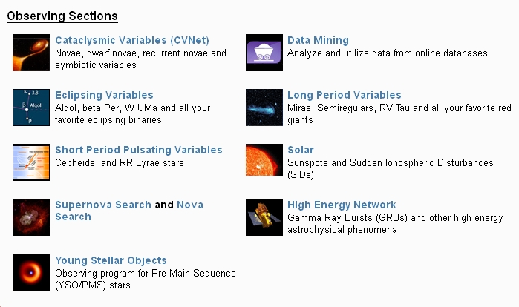
www.AAVSO.org

Slide 39
www.AAVSO.org
Alerts & Special Notices
(Sign Up To Receive These)
Observing Campaigns

Slide 40
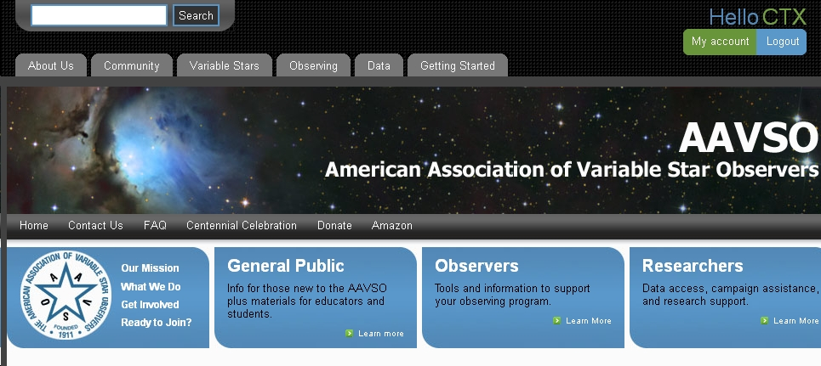
To Find A Chart For The
FOV You Are Going To Observe
WWW.AAVSO.ORG
Then Select Variable Star Charts Then Variable
Star Plotter (VSP)
Enter Target Name Here To Find The VSP

Slide 41
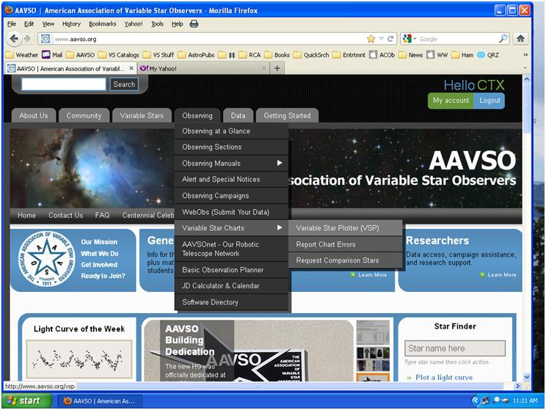
To Find A Chart For The
FOV You Are Going To Observe
WWW.AAVSO.ORG
Then Select Variable Star Charts Then Variable
Star Plotter (VSP)
Enter Target Name Here To Find The VSP

Slide 42
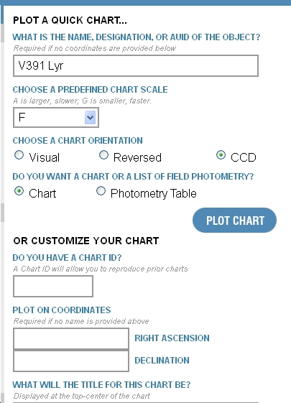
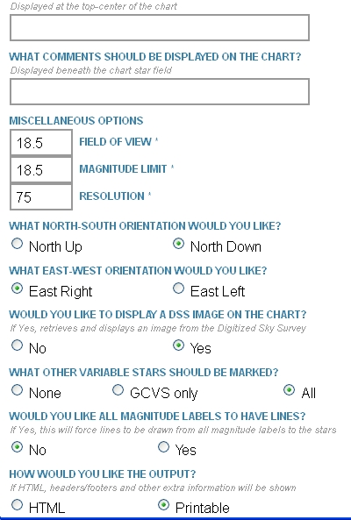
Can Also Enter
Target’s Coordinates

Slide 43
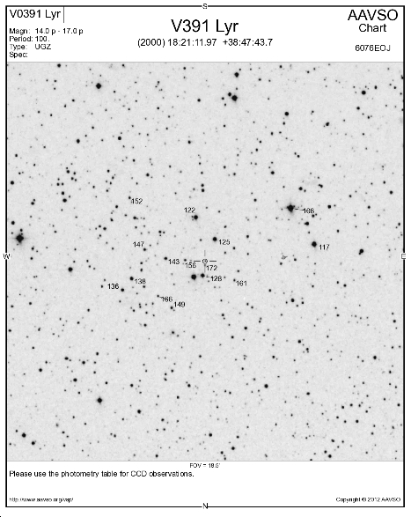
The Magnitudes
Shown On The
Charts Are Visual
Values
Target Name
FOV Scale
For CCD Values
Choose The
“Photometry Table”
Option From The
Main VSP Page
FOV Scale In Arc Minutes
Magnitude Limit
FOV Orientation
Use DSS Image

Slide 44
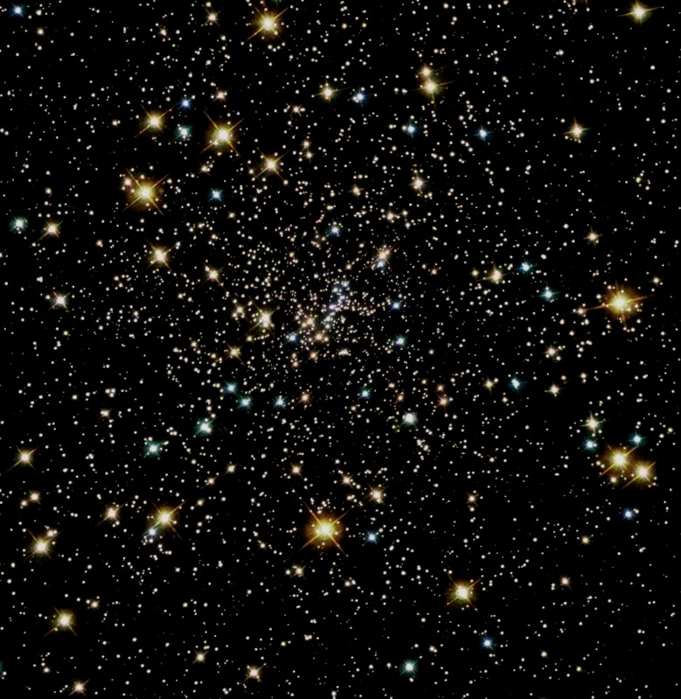
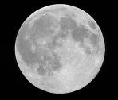
Best Kept Secret OF
Variable
Star
Observing
You Can Do CCD Observing In
Spite Of Mr. Moon!

Slide 45
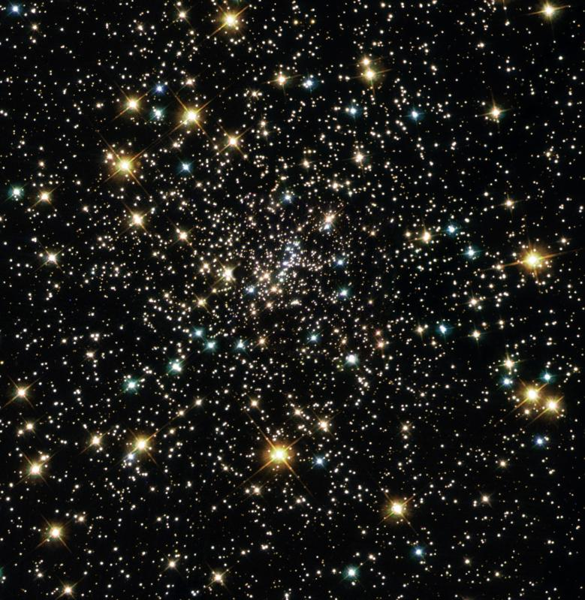
Logo
Contribute
To Science By Observing
Variable
Stars!

Slide 46
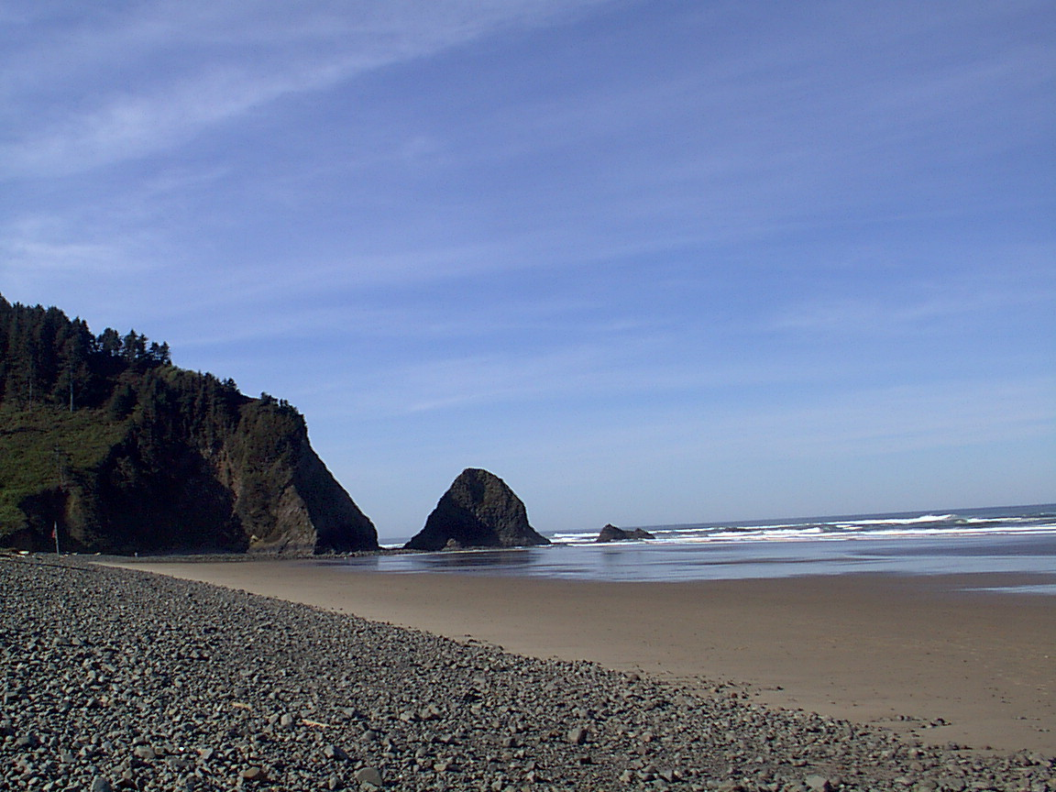
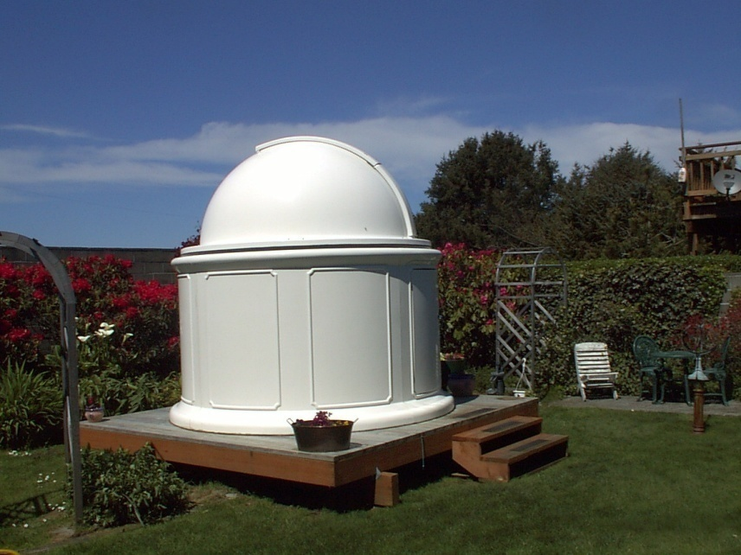
Oregon
Arch Cape
Observatory
Presentation
Tim R Crawford - CTX
www.arch-cape.com
tcarchcape@yahoo.com

