Slide 1
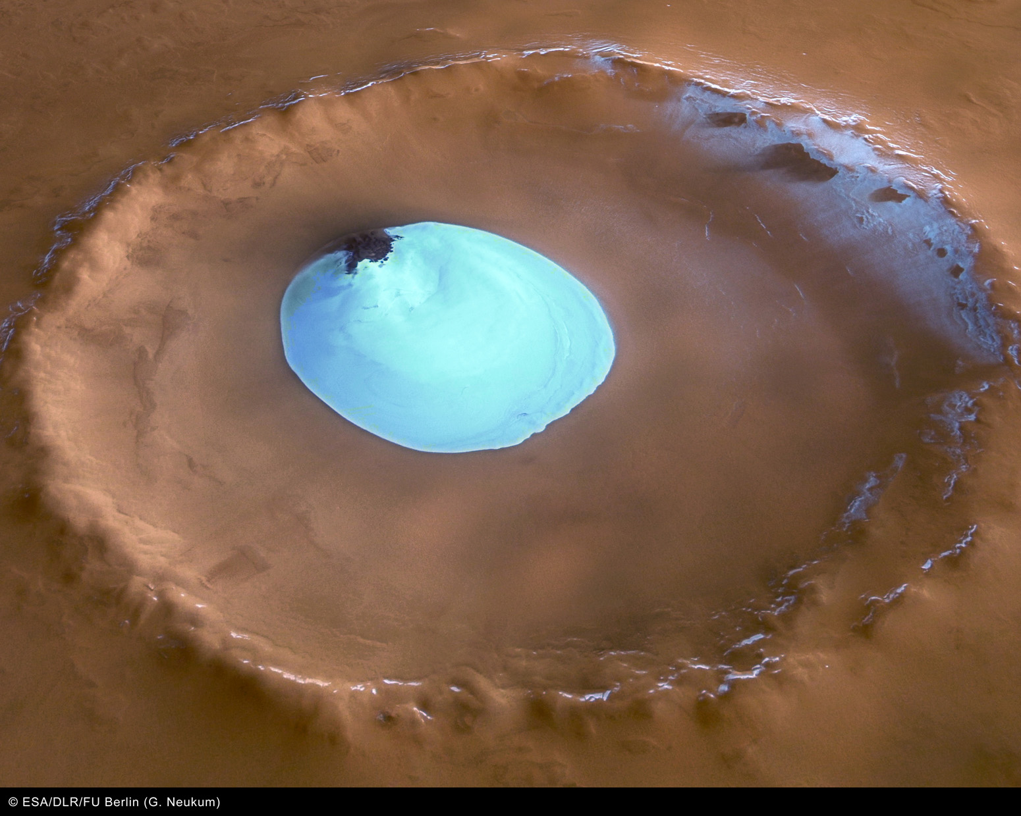
National Science Olympiad
Solar System B Event 2015
Planetary Science

Slide 2
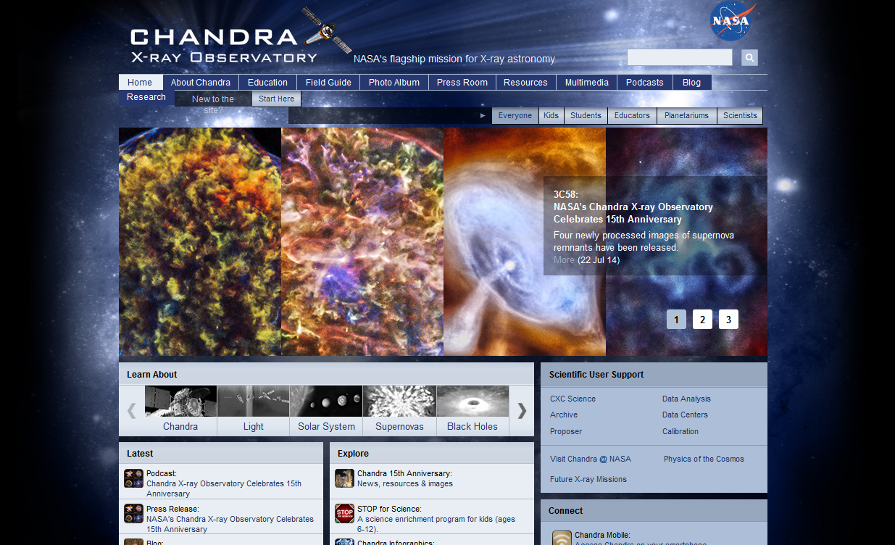
Chandra X-Ray E/PO Office
Donna L Young, NSO Astronomy Event Supervisor – donna@aavso.org
Dusty Schroeder, NSO Solar System Event Supervisor – dschroed@gmail.com

Slide 3
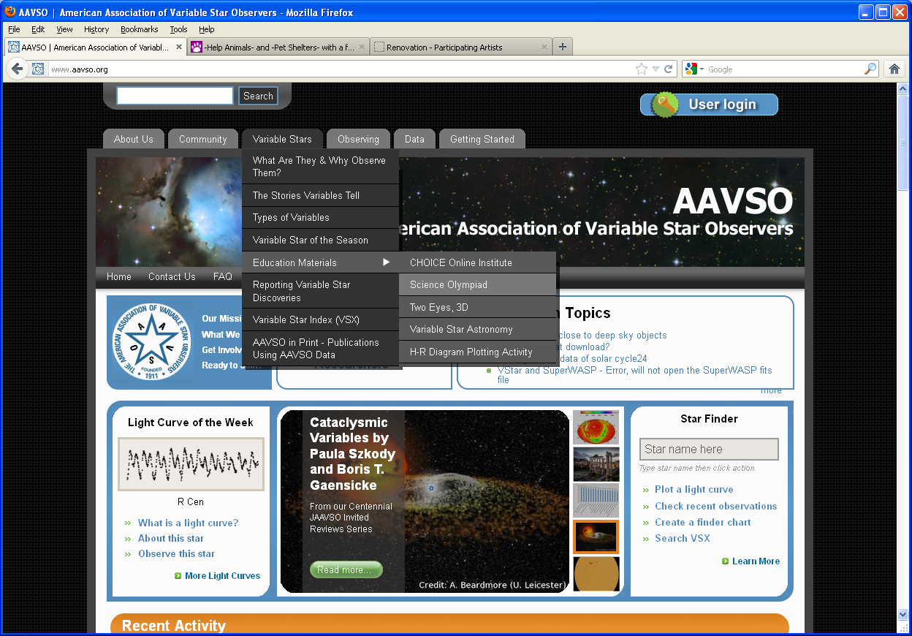
The American Association of Variable Observers
aavso.org

Slide 4
SOLAR SYSTEM, DIVISION B: Planetary Science
DESCRIPTION: Students will demonstrate an understanding and knowledge of the properties and evolution of extraterrestrial ice and water in the solar system.
A TEAM OF UP TO: 2 APPROXIMATE
TIME: 50 minutes
EVENT PARAMETERS: Each team may bring only two 8.5” x 11” two-sided
pages of information in any form from any source.
THE COMPETITION: This event is divided into two parts. Notes may be used during both parts.

Slide 5
Part I: Participants may be asked to identify planets, moons, and features
included in the lists below as they appear on maps or imagery and
must be knowledgeable about the history and processes involving
ice and water for the objects below.
(1) Mars: North & South Polar Ice Caps, Equatorial Glaciers, Permafrost
(2) Europa: Thrace Macula, Thera Macula, Conamara Chaos, Ridges,
Cycloids, Plains, Ocean
(3) Enceladus: Plumes, Tiger Stripes
(4) Iapetus, Titan, Triton, Ceres,
(5) Comets, The Kuiper Belt, The Oort Cloud
Part II: Participants will be asked to complete one or more hands-on or
interpretive tasks selected from the following topics:
i: The history and process of formation for specific features
ii: The use of remote sensing, imagery, and satellite measurements of objects
and features
iii: The physical, thermal, and chemical properties of potential habitats for life
iv: Past, current, and planned future missions to explore these objects

Slide 6
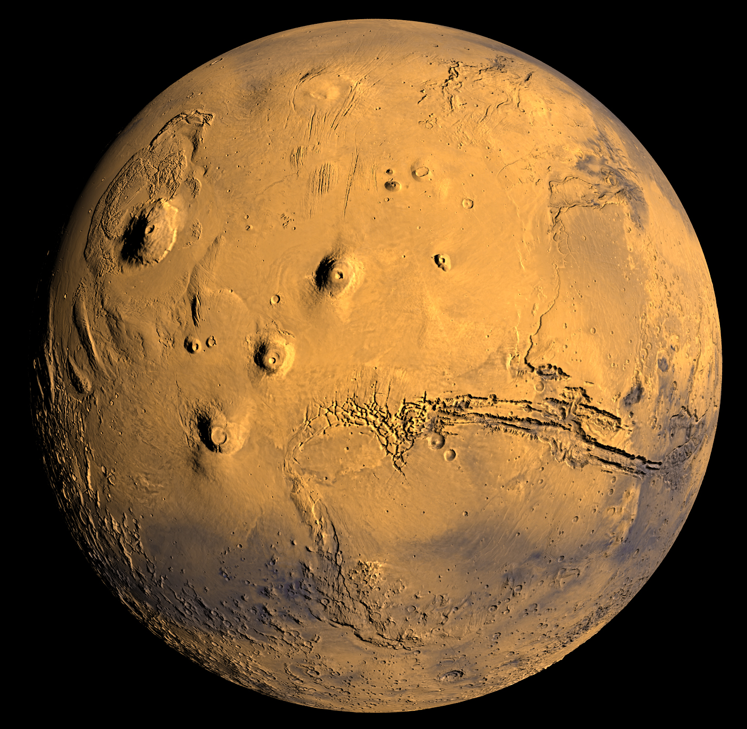
Part I: Identification
Mars

Slide 7
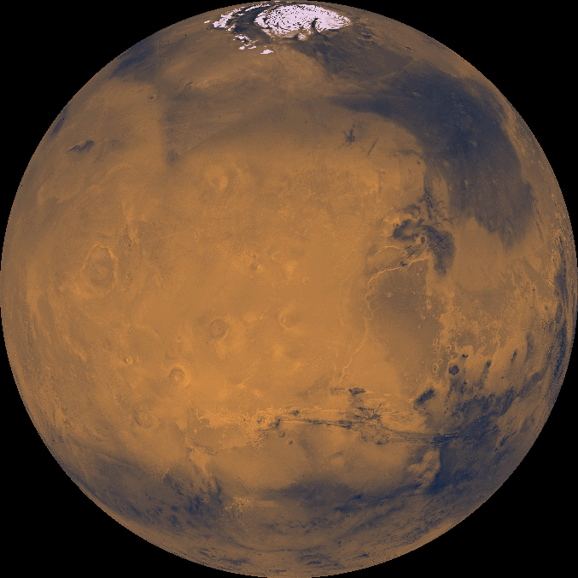
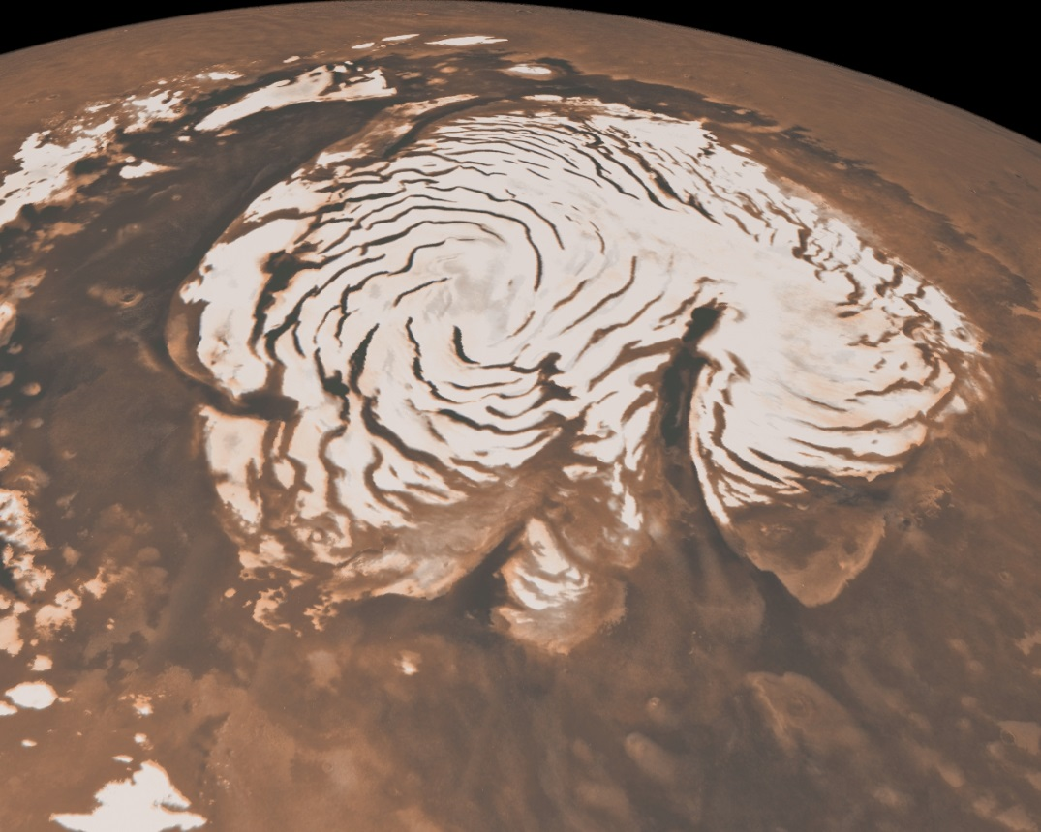
North Polar Ice Cap

Slide 8
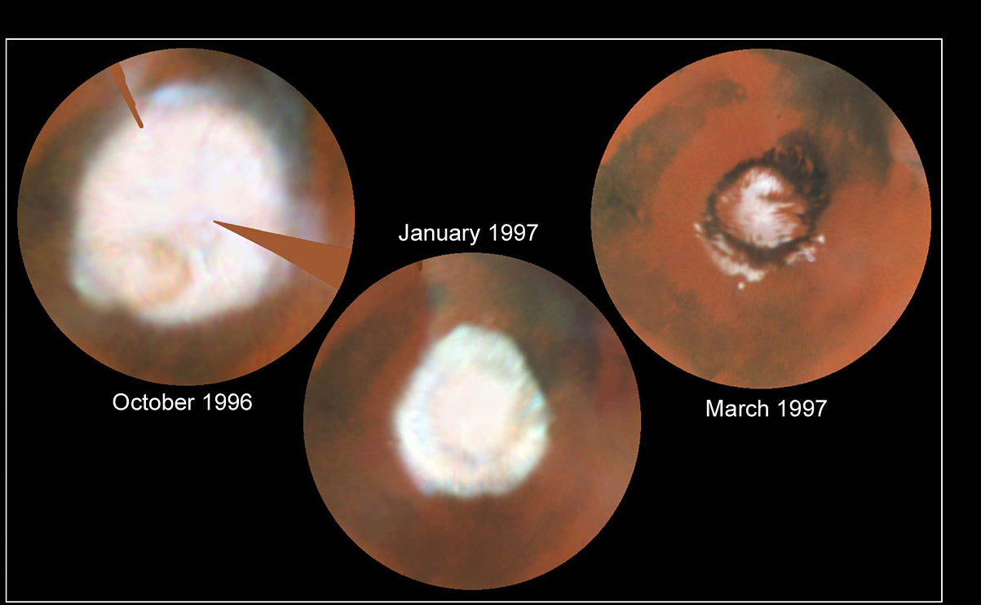
Seasonal Changes

Slide 9
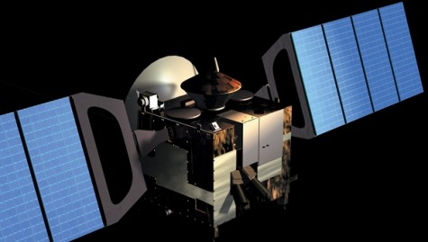
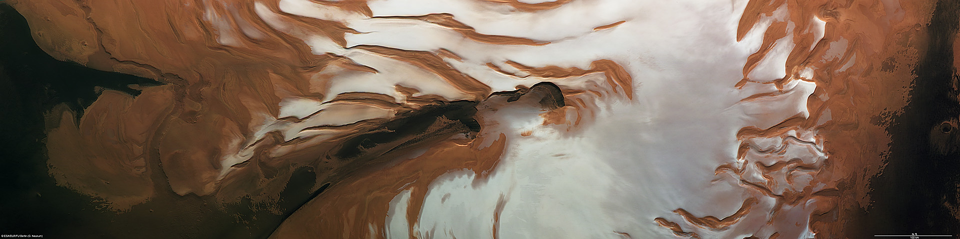
ESA Mars Express - 2003
Summer Solstice Transition
Infrared Mineralogical Mapping Spectrometer (OMEGA) – phyllosilicates
High Resolution Stereo Camera (HRSC) – volcanism
Planetary Fourier Spectrometer (PFS) – Methane

Slide 10
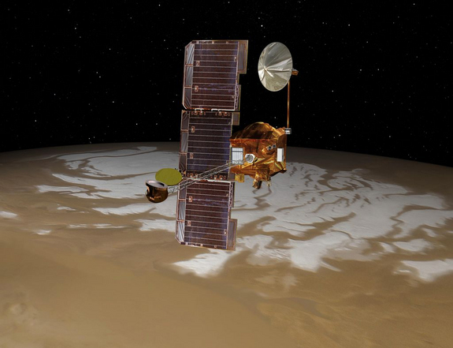
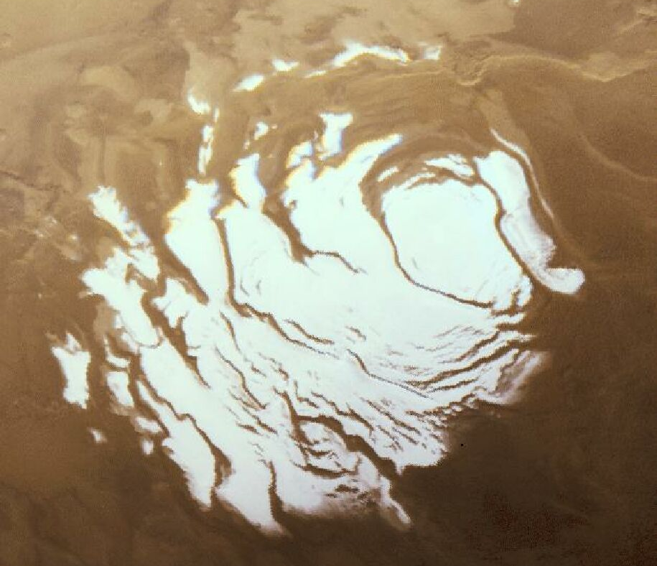
South Polar Ice Cap – Mars Odyssey Mission

Slide 11
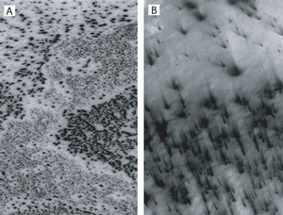
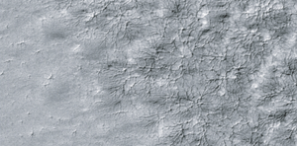
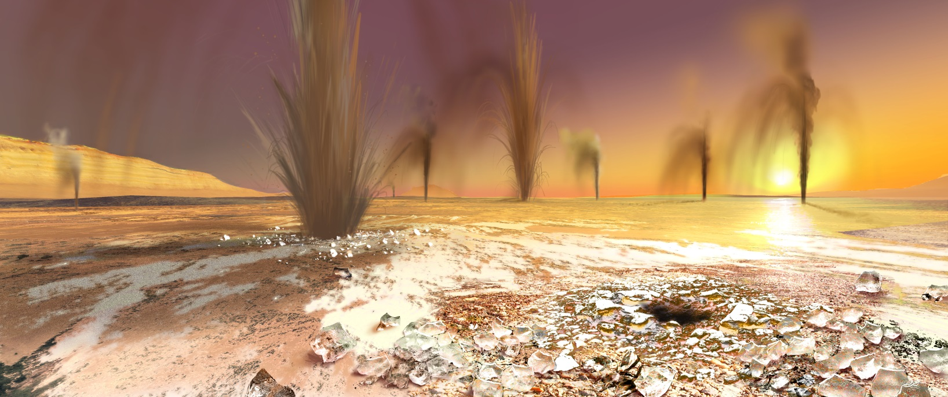
Sand Jets – spring thaw
Thermal Emission Imaging System (THEMIS)

Slide 12
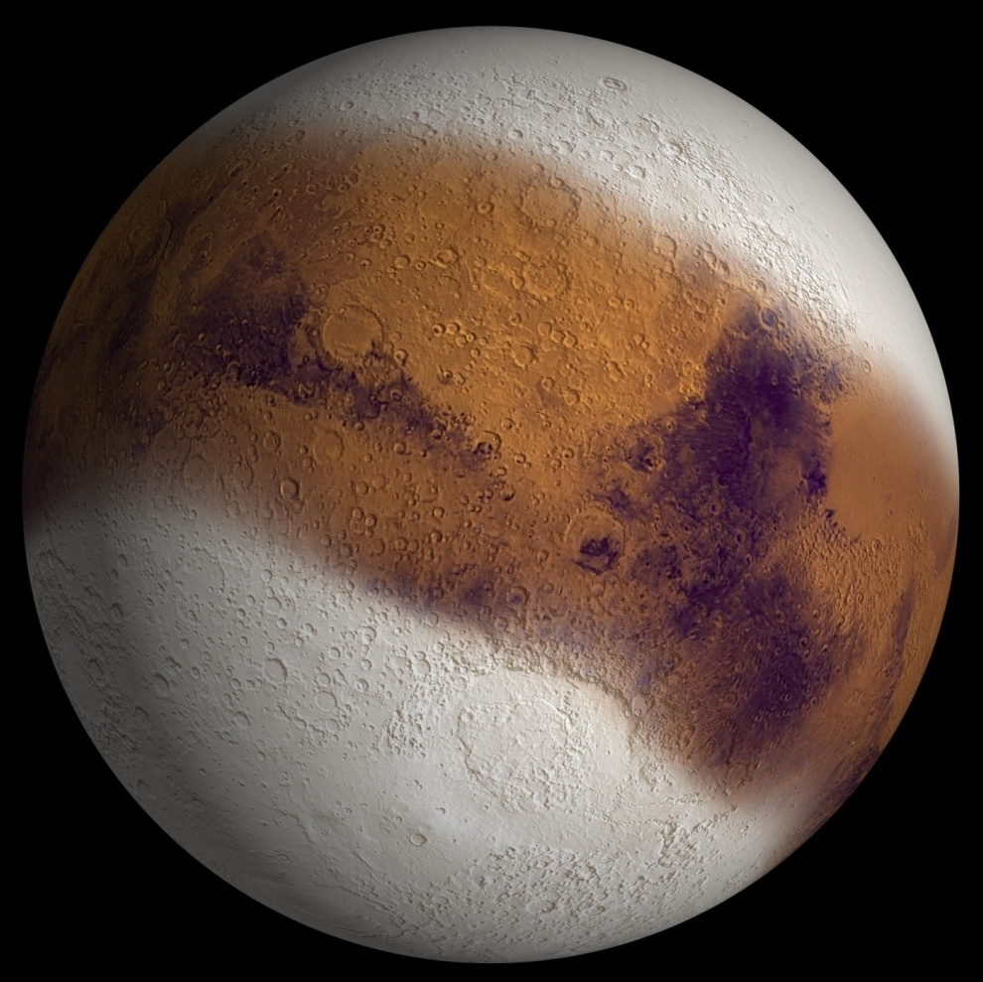
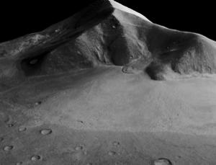
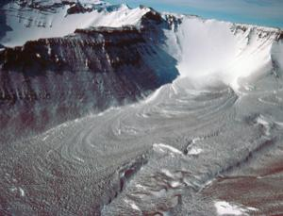
Equatorial Glaciers
Mars Reconnaissance Orbiter

Slide 13
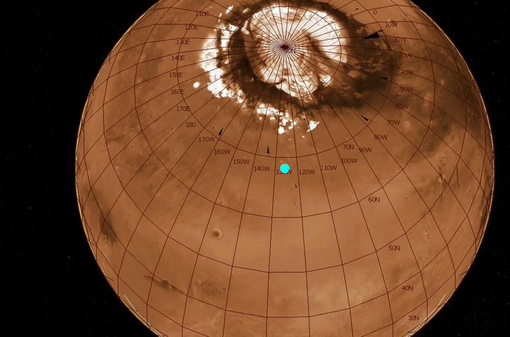
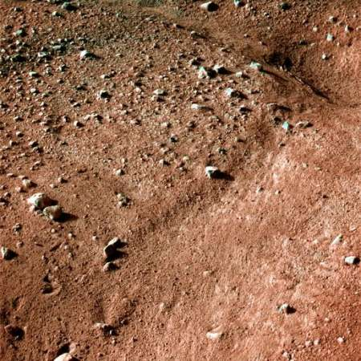
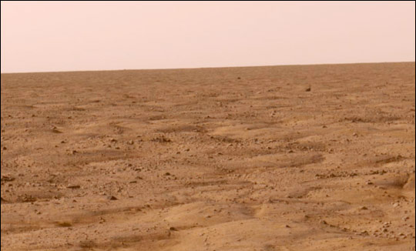

The Phoenix Mission
permafrost – polygons

Slide 14
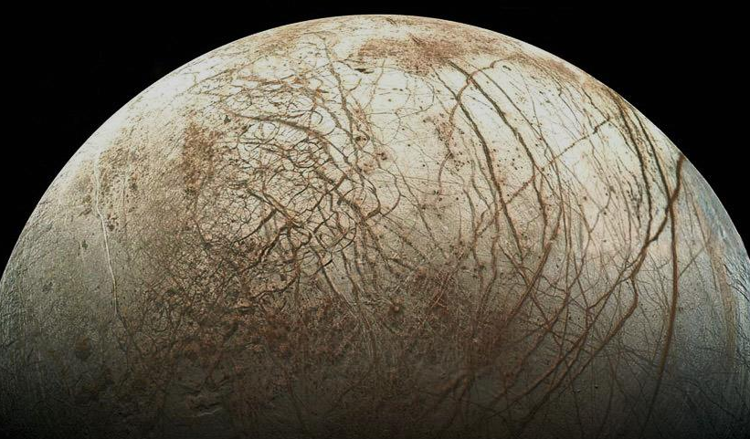
Europa

Slide 15
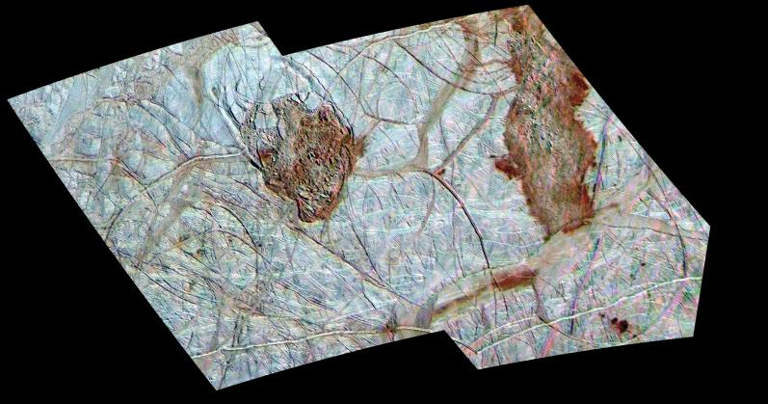
Thera Macula & Thrace Macula

Slide 16
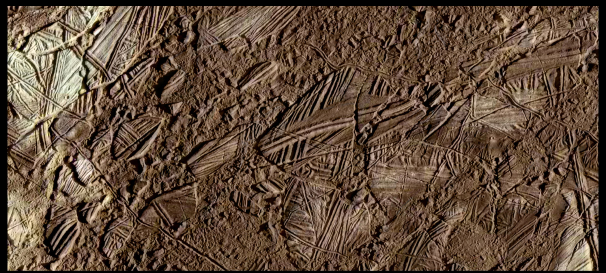
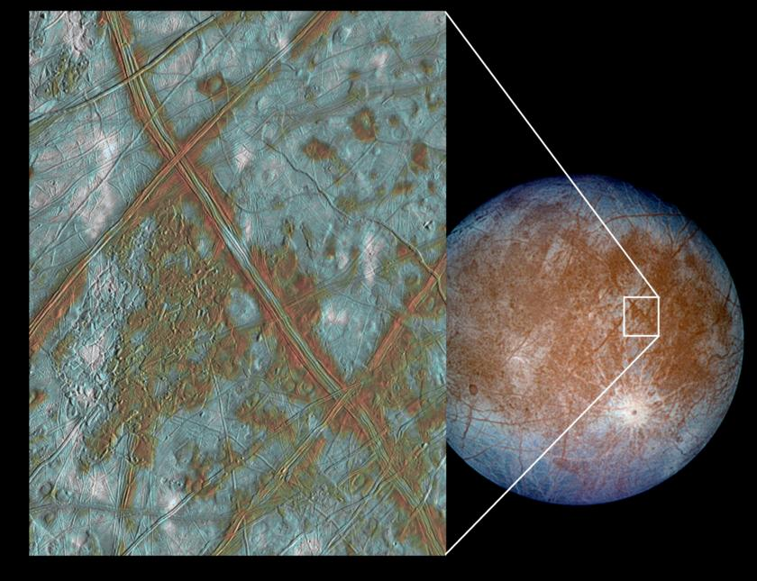
Conamara Chaos

Slide 17
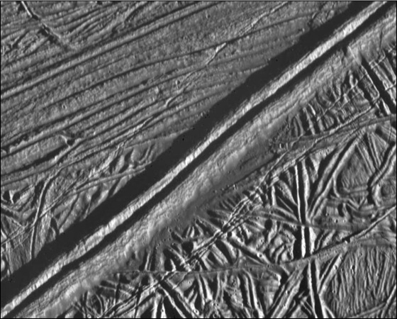
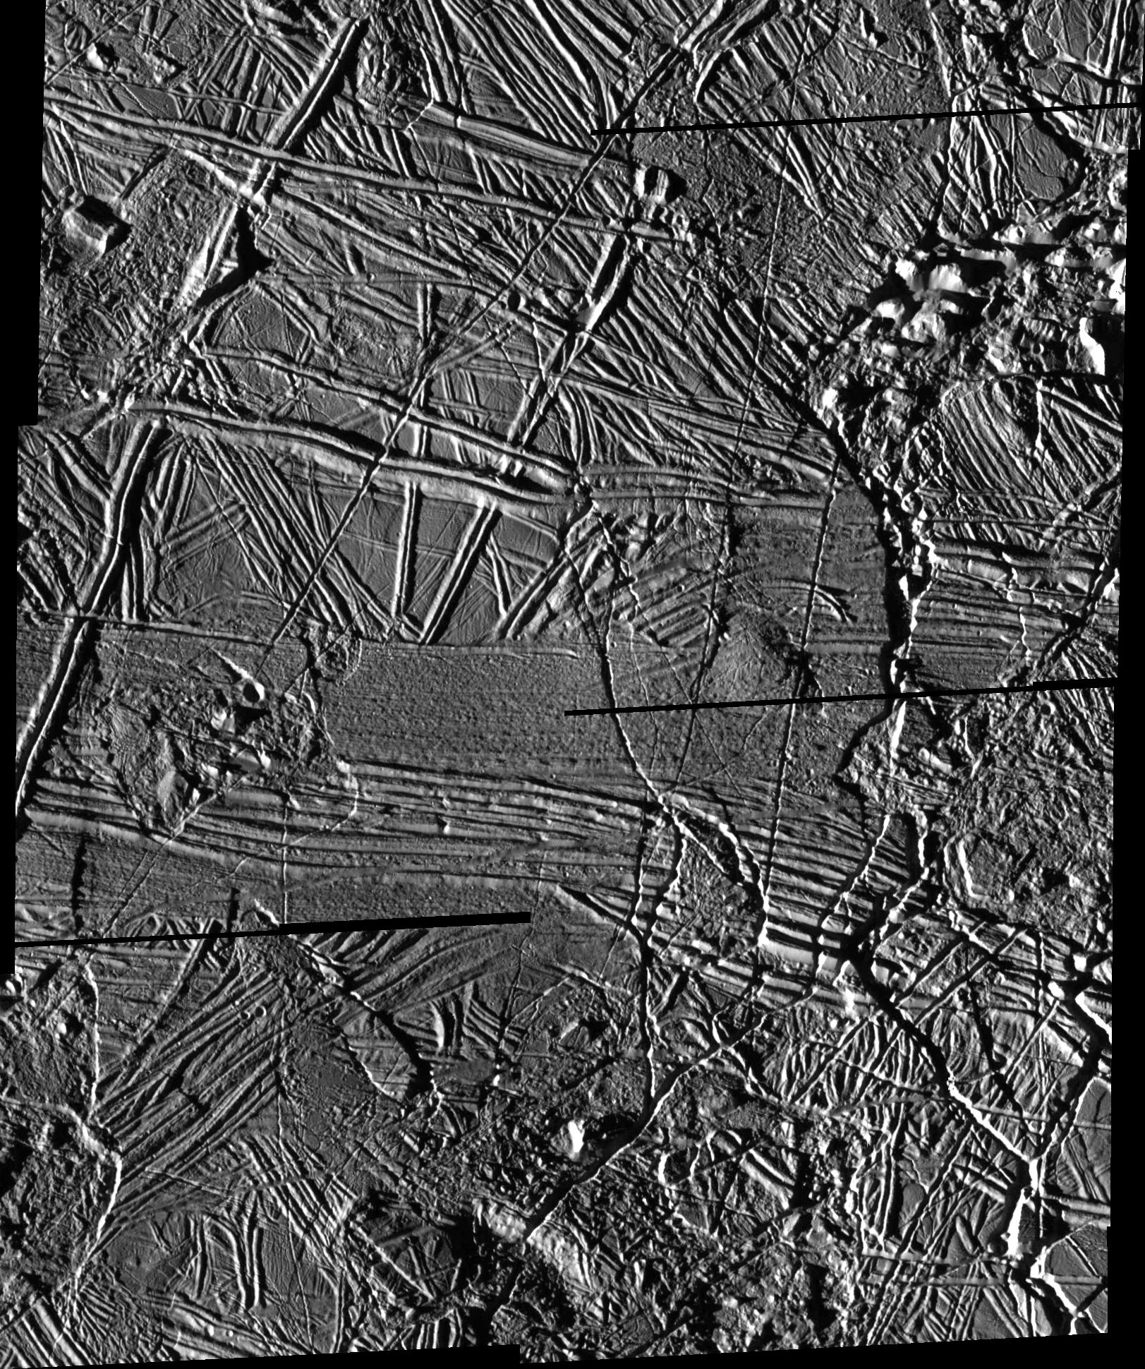
Ridges

Slide 18
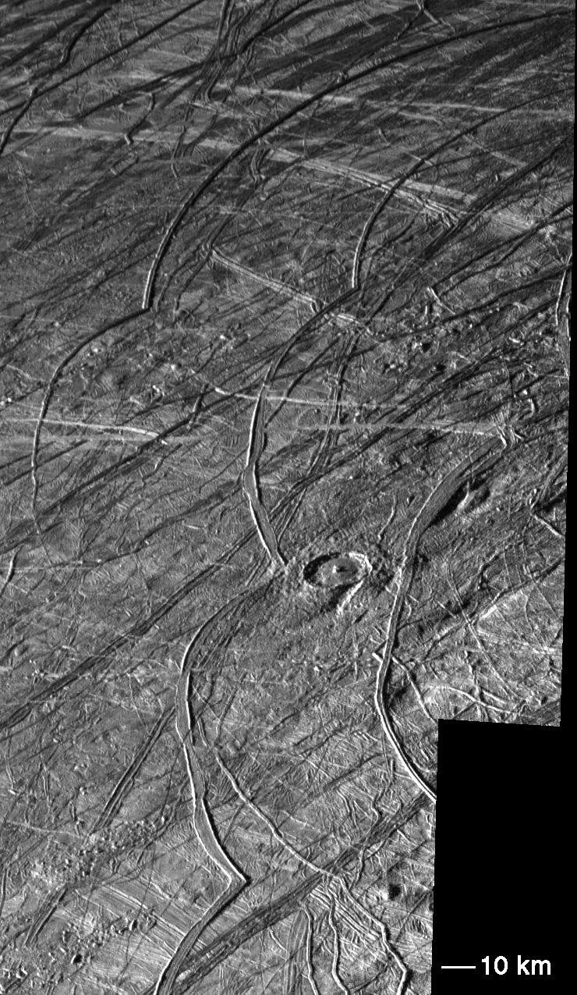
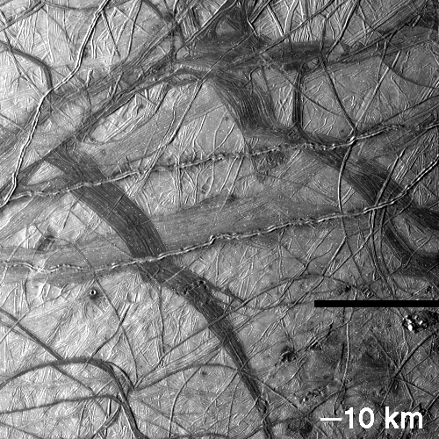
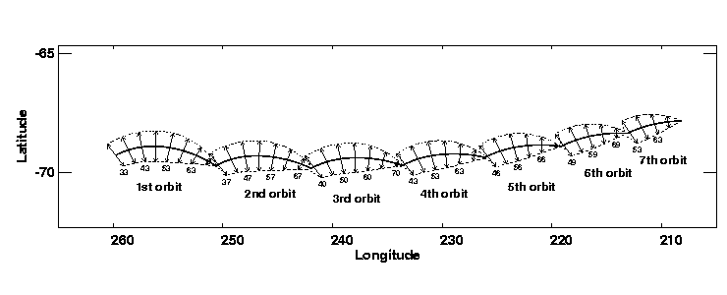
Cycloids

Slide 19
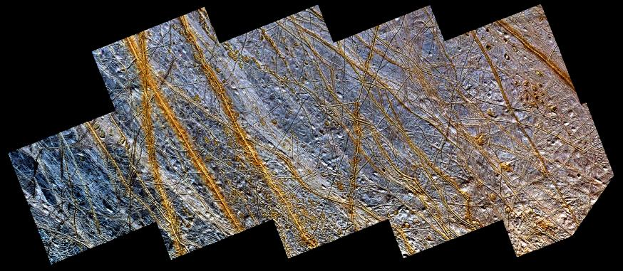
Plains

Slide 20
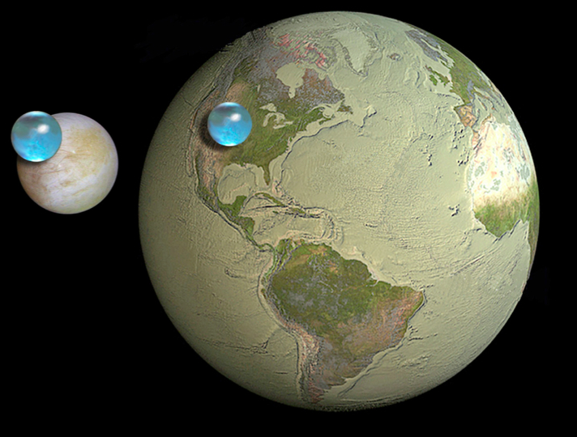
Oceans

Slide 21
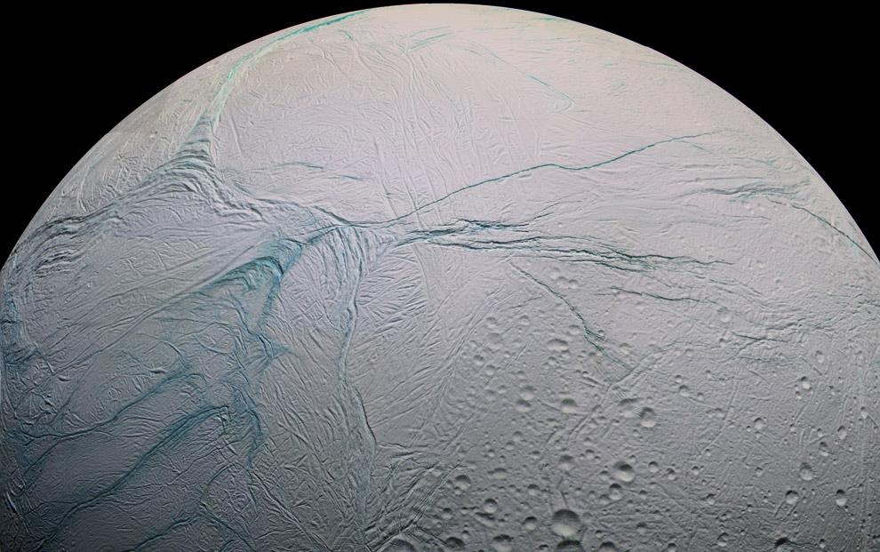
Enceladus:

Slide 22
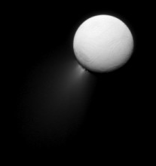
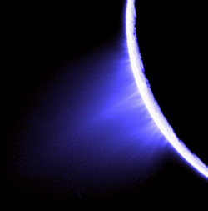
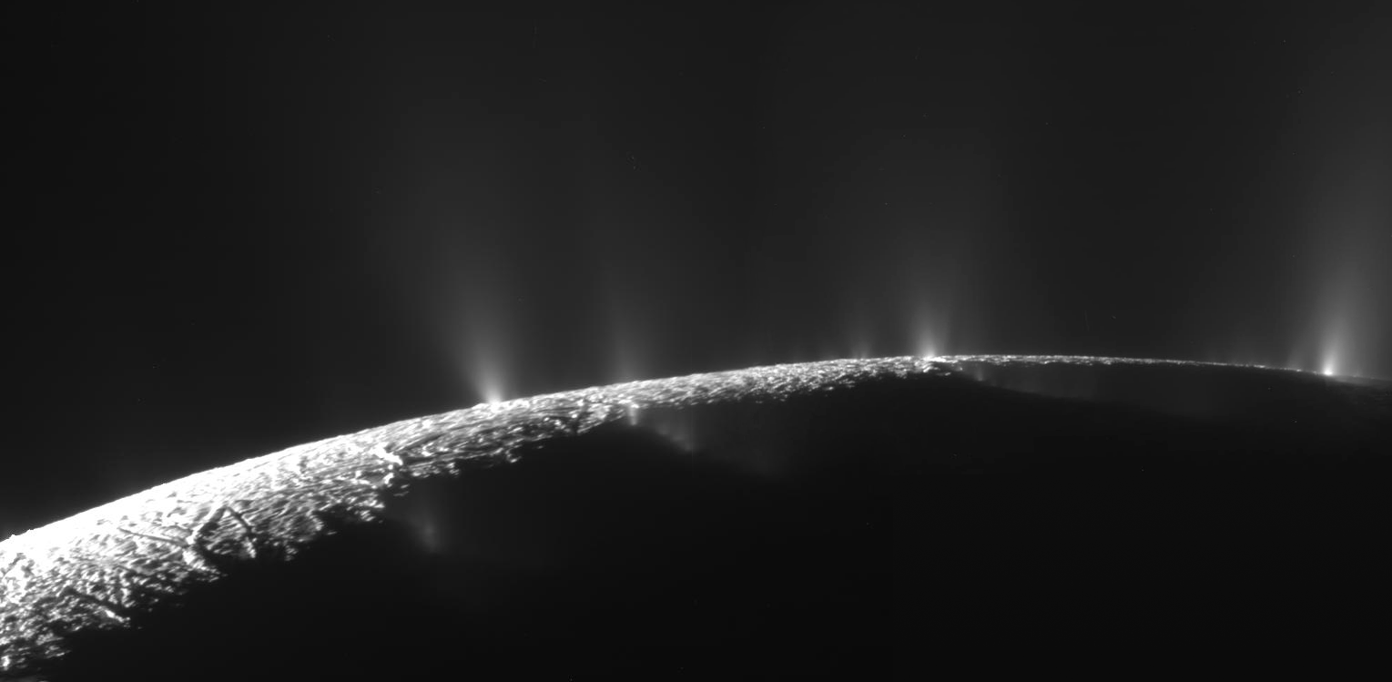
Plumes

Slide 23
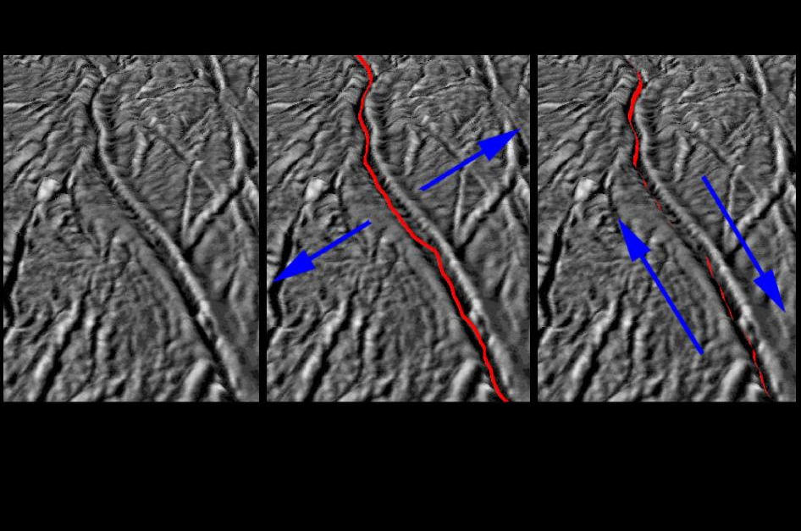
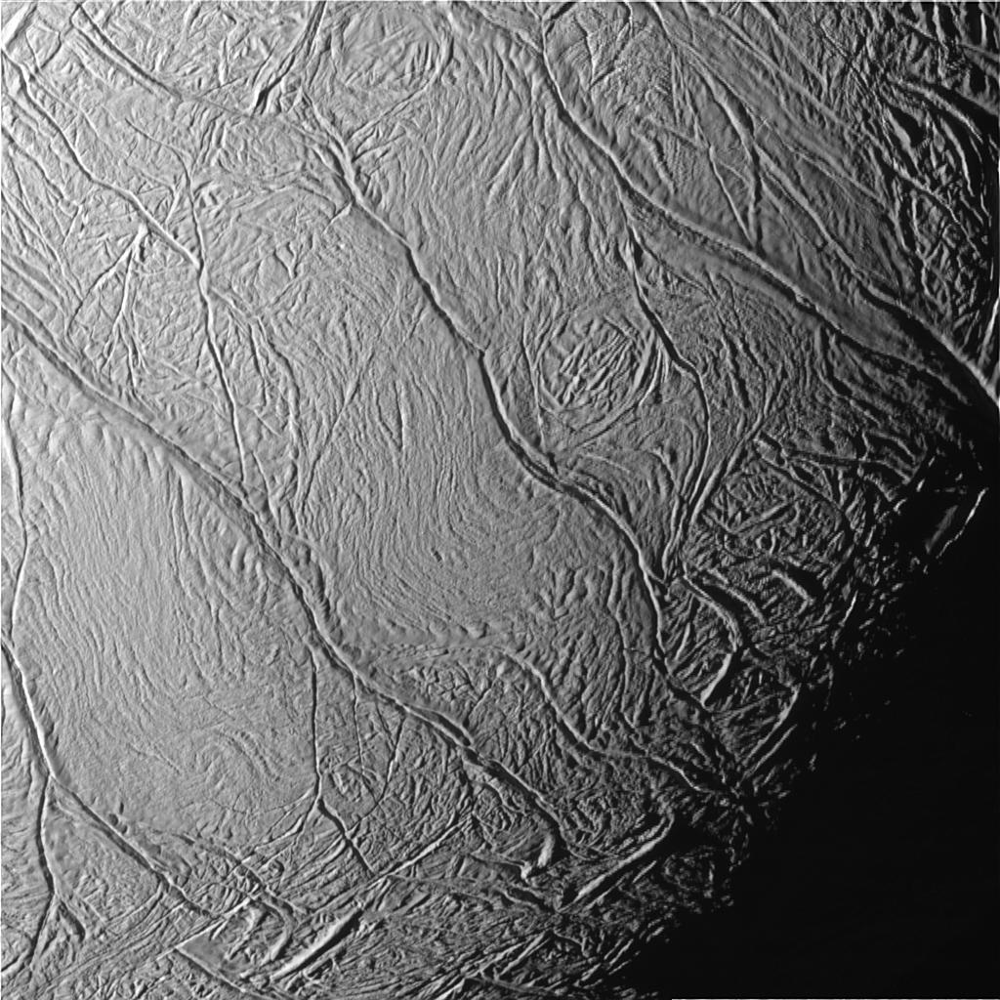
Tiger Stripes

Slide 24
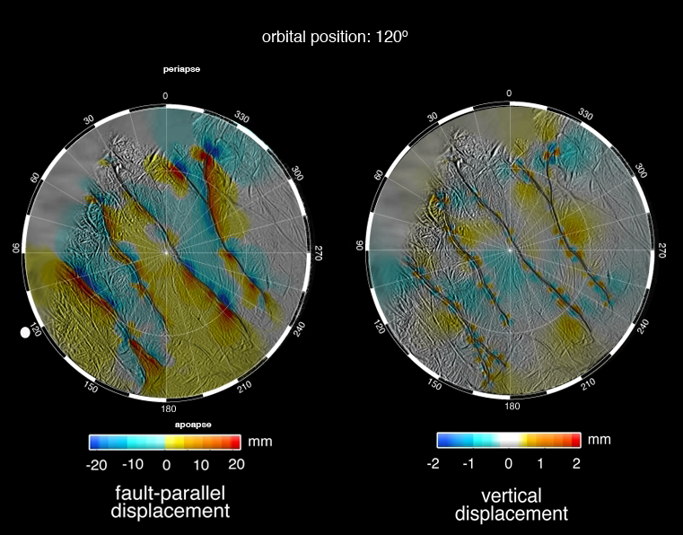

Slide 25
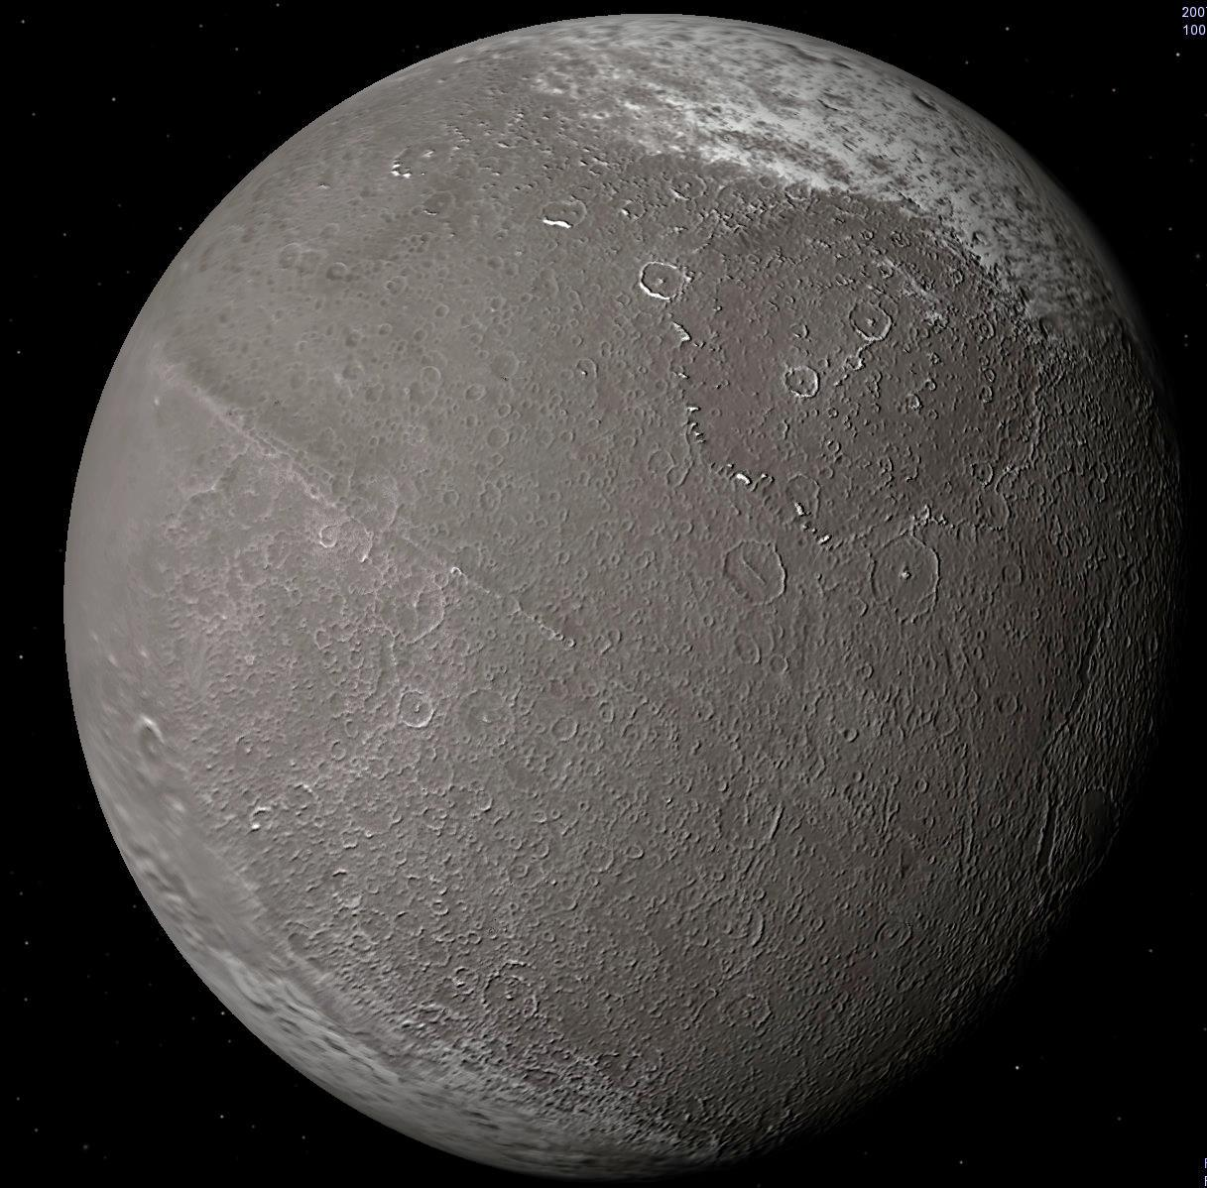
Iapetus

Slide 26
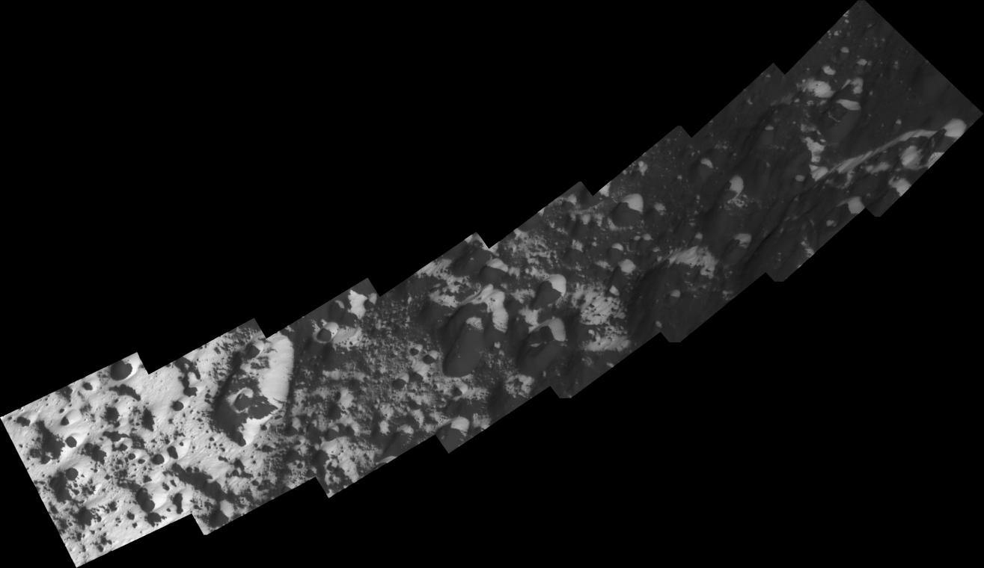
Transition Zone

Slide 27
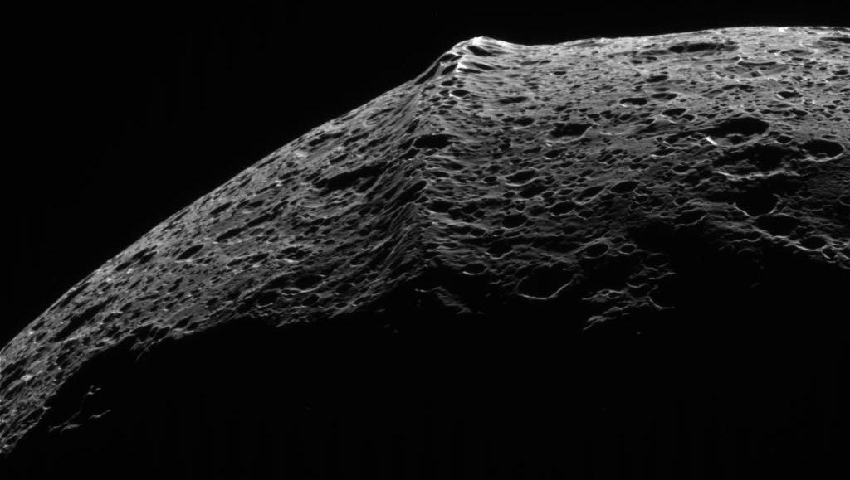
The Wall

Slide 28
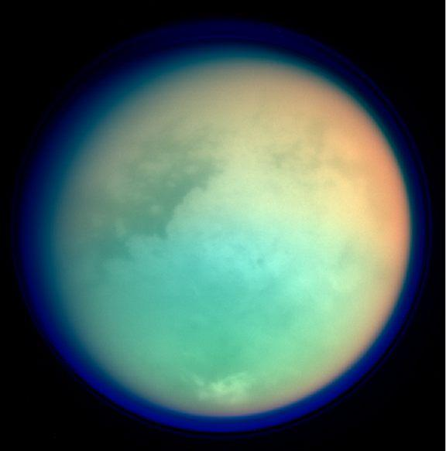
Titan

Slide 29
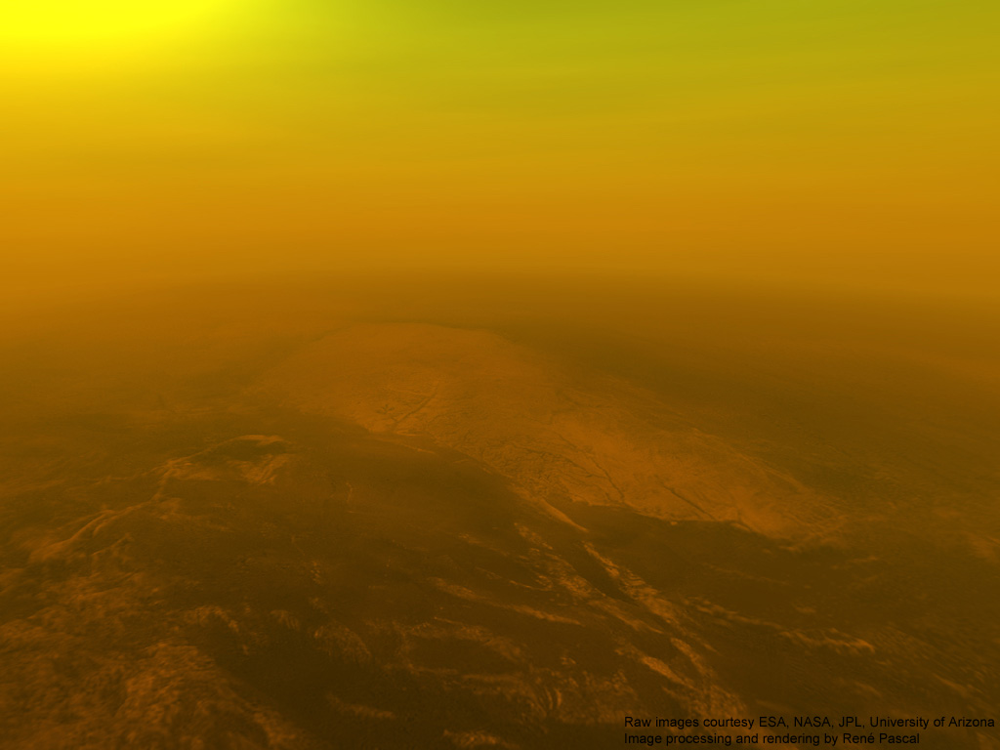
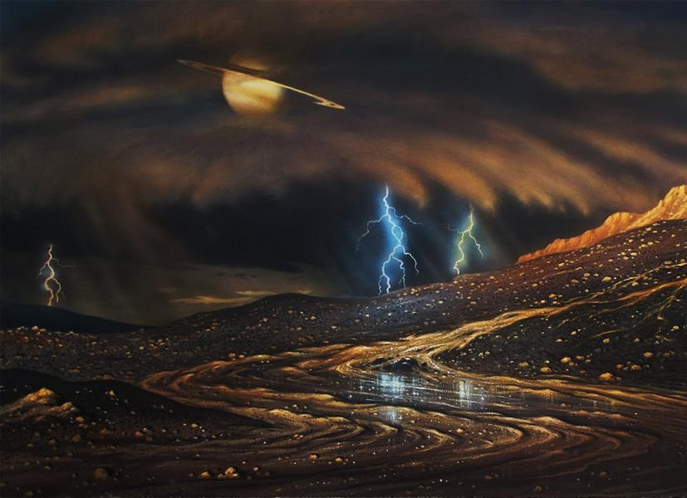
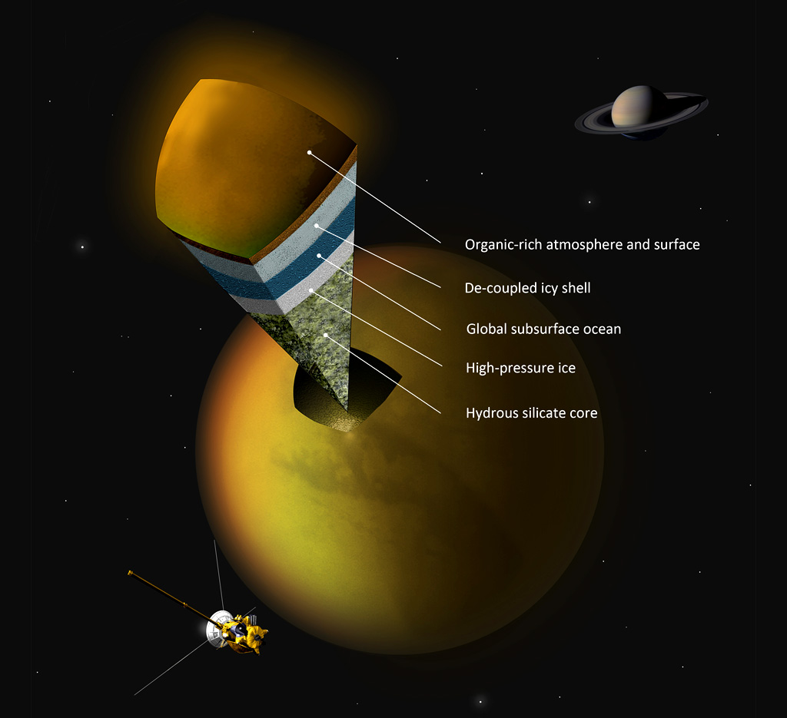

Slide 30
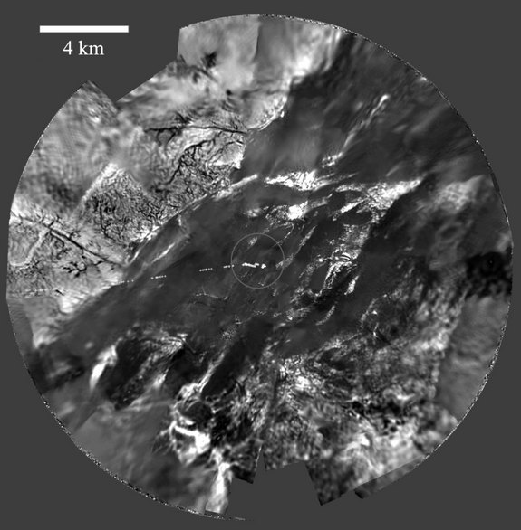
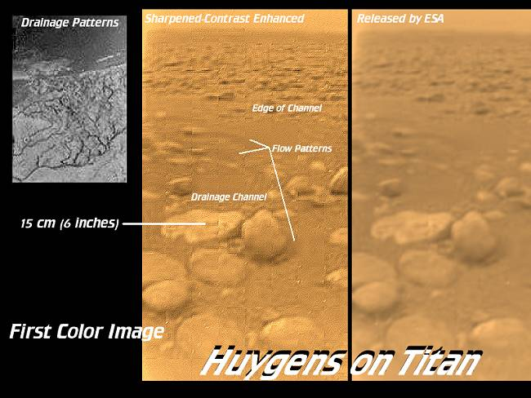

Slide 31
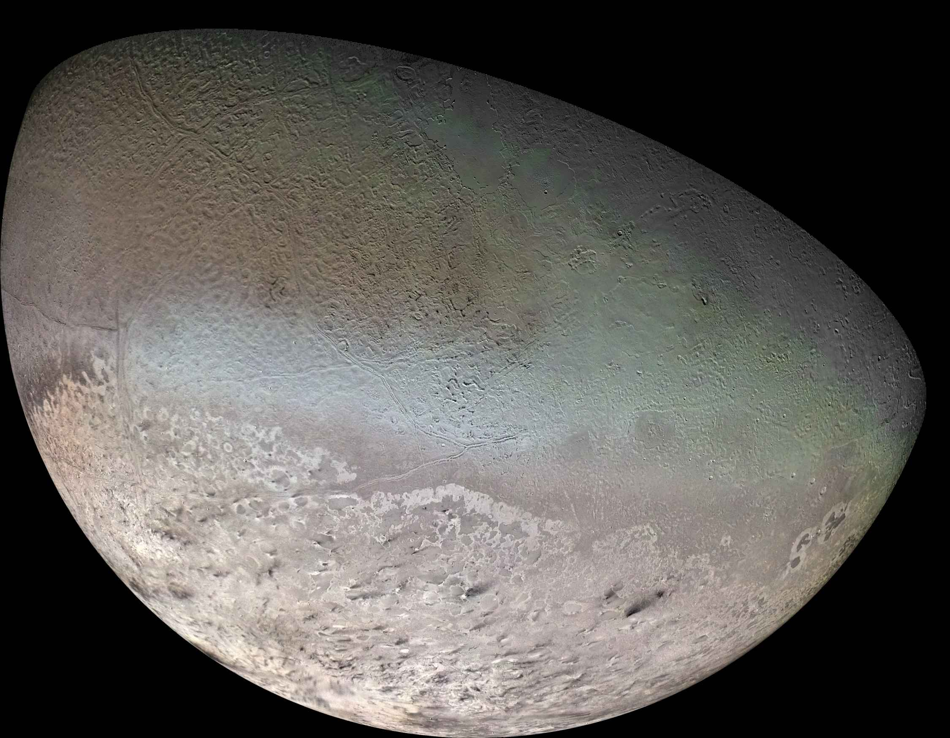
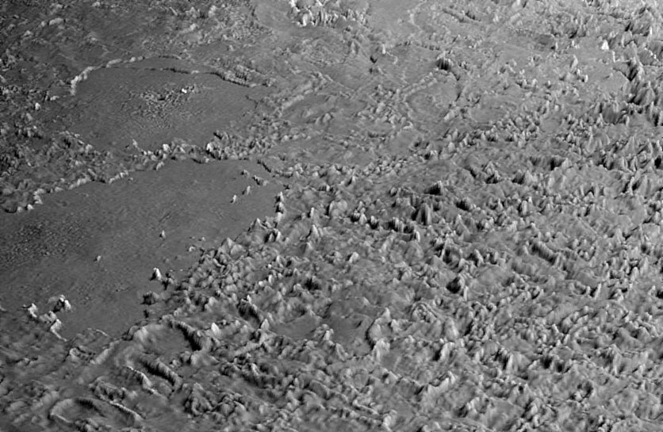
Triton

Slide 32
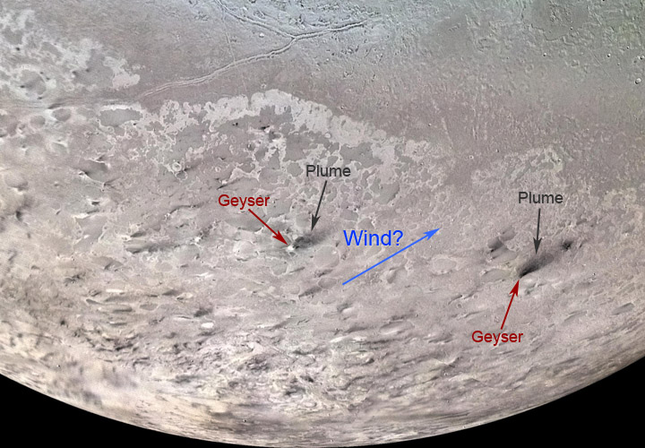
Ice Volcanoes

Slide 33

Ceres

Slide 34


Slide 35

Comets

Slide 36



Slide 37



Slide 38

The Oort Cloud

Slide 39

The Kuiper Belt

Slide 40

Part II: Interpretation
History and Process of Formation for Specific Features

Slide 41


Mars

Slide 42


Titan
Europa

Slide 43

Remote Sensing, Imagery, Satellite Measurements of
Objects & Features

Slide 44







Slide 45

Physical, Thermal, and Chemical Properties of
Potential Habitats for Life

Slide 46

EXTREMOPHILES
Psychrophiles, Thermophiles, Radioresistant, Alkaliphiles,
Acidophiles, Halophiles, Xerophiles, Barophiles, Endoliths
AND gravity!

Slide 47

Missions
http://www.nasa.gov/missions/index.html

Slide 48

Missions to Mars

Slide 49





Slide 50




Slide 51


Slide 52


Slide 53

Future Missions?

Slide 54

Future Missions – JUICE

Slide 55

Future Missions – JUICE

Slide 56





chandra.harvard.edu – Webinars
http://www.jpl.nasa.gov/ – Everything Solar System
apod.nasa.gov – Images, Content
aavso.org – 2014 Events, Flash Cards, PPTs
http://soinc.org

Slide 57



Slide 58



Slide 59



Slide 60


Slide 61


Slide 62



Slide 63
National Astronomy Event Supervisor – Dusty Schroeder
dschroed@gmail.com
Rules clarifications:
available at www.soinc.org under event information
Event Preparation:
Read the Event Description for content and allowable resources.
Use the Webinar and PowerPoint for an overview of the content
topics, landforms, features, planets and moons.
3. Use the JPL website for images and content.
4. Download the 2014 event and flash card set from the AAVSO
website, and watch the webinar on the Chandra website.

