Slide 1
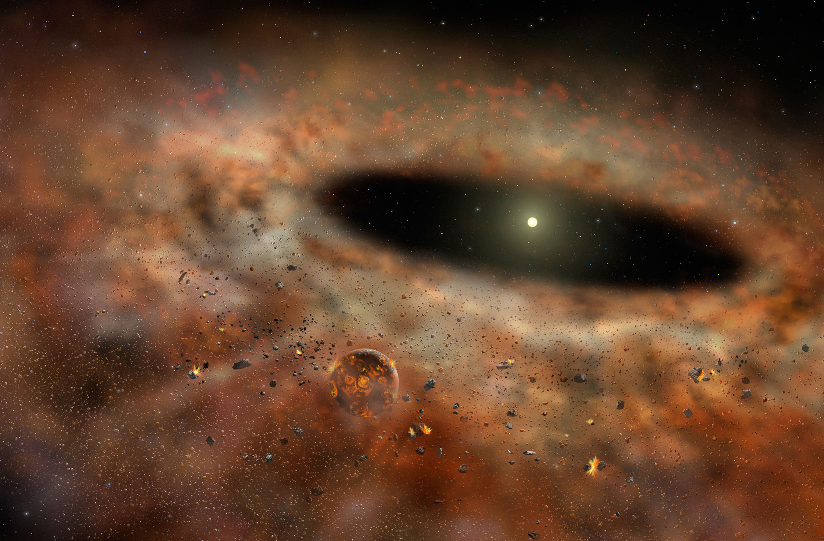
National Science Olympiad
Astronomy C Event 2015
Stellar Evolution – Star & Planet Formation

Slide 2
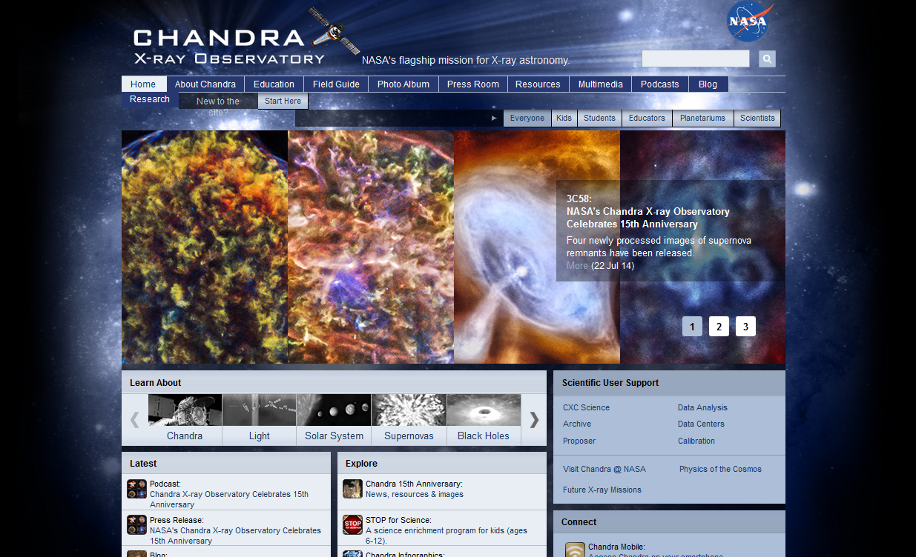
Chandra X-Ray E/PO Office
Donna L Young, NSO Astronomy Event Co-Supervisor – donna@aavso.org
Tad Komacek, NSO Astronomy Event Co- Supervisor – tkomacek@gmail.com

Slide 3
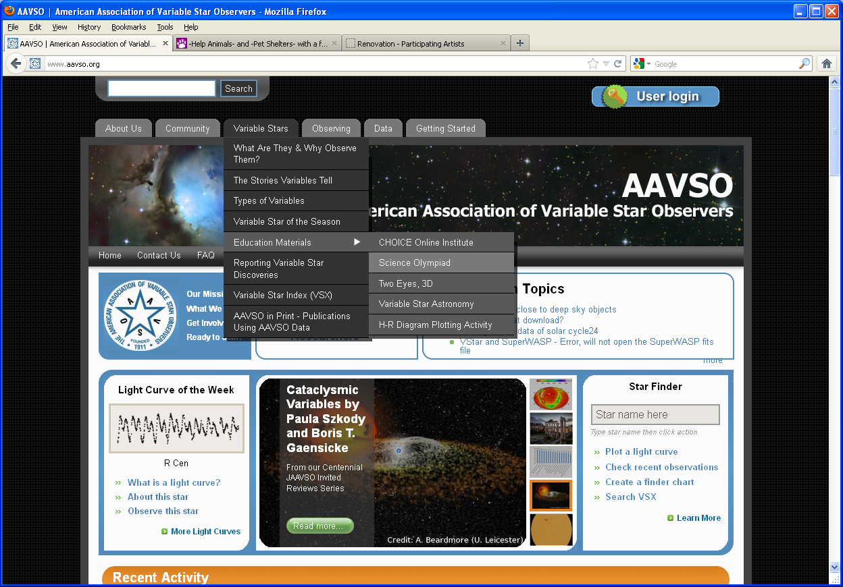
The American Association of Variable Star Observers
aavso.org

Slide 4
ASTRONOMY, Division C
DESCRIPTION: Teams will demonstrate an understanding of the basic concepts of mathematics and physics relating to stellar evolution and
star & planet formation.
A TEAM OF UP TO: 2 APPROXIMATE
TIME: 50 minutes
THE COMPETITION: Each team is permitted to bring two laptops, or two 3-ring binders (any size) containing information in any form from any source, or one laptop computer and one 3-ring binder. The materials must be inserted into the rings (notebook sleeves are permitted). Each team member is permitted to bring a programmable calculator. No Internet access is allowed.

Slide 5
Using information which may include Hertzsprung-Russell diagrams, spectra, light curves, motions, distance equations and relationships, stellar magnitudes and classification, multi-wavelength images (X-ray, UV, optical, IR, sub-mm, radio), charts, graphs, animations and DS9 imaging analysis software, teams will be asked to answer questions relating to:
a. The processes and stages of stellar evolution, including spectral features and chemical composition, luminosity, blackbody radiation, color index, and the H-R diagram with an emphasis on the following: protostars, planet formation, T Tauri variables, FU Orionis variables, Herbig Ae/Be stars, brown dwarfs, protoplanetary disks, debris disks, H I/II regions, molecular clouds, exoplanets including but not limited to: gas giants, terrestrial planets, super-Earths, mini-Neptunes, and hot Jupiters.
b. Use Kepler’s laws, rotation and circular motion to determine answers relating to the orbital motions of planets & planetary systems; use parallax, spectroscopic parallax, and the distance modulus to calculate distances to planetary systems; use radial velocity and transit timing methods to determine properties of exoplanets; calculate surface temperature of an exoplanet to determine habitability
c. Students will be asked to identify, know the location, be knowledgeable about, and/or
answer questions relating to the three content areas outlined above for the following
Objects: FU Orionis, TW Hya, 2M1207, CoRoT-2, HD 209458b, HD 189733b, Kepler-7b,
GJ 1214b, Beta Pictoris, Formalhaut, HR 8799, WISE 1049-5319, Gliese 229B,
LP 944-20, N159, M20

Slide 6
Deep Sky Objects
A. Star Formation Regions
1) N159 (Papillon Nebula)
2) M20 (Trifid Nebula)
B. Pre-Main Sequence Stars
1) TW Hydrae (TW Hya) – T Tauri
2) FU Orionis (Fuors) – FU Orionis
C. Brown Dwarfs
1) 2M1207
2) WISE 1049-5319 – Binary System
3) LP-944-20
4) Gliese 229B
D. Transiting Planets
1) HD 209458b – Hot Jupiter
2) HD 189733b – Hot Jupiter
3) Kepler-7b – Hot Jupiter
4) GJ 1214b – Super-Earth
5) CoRoT-2 & 2b – Main Sequence Star with Hot Jupiter
E. Directly Imaged Stars with Planet(s) & Debris Disks
1) Beta Pictoris – Main Sequence Star
2) Formalhaut (α Piscis Austrini) – Main Sequence Star
3) HR 8799 – Main Sequence Star

Slide 7
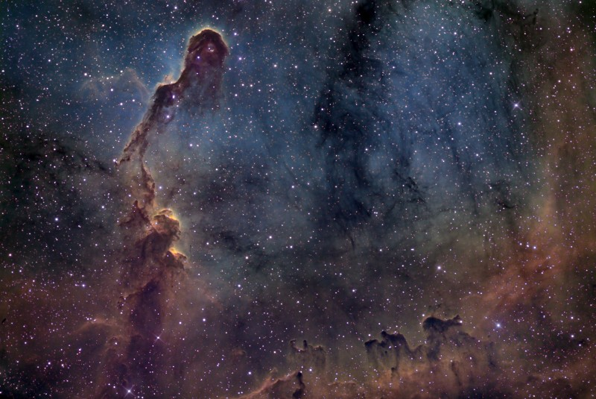
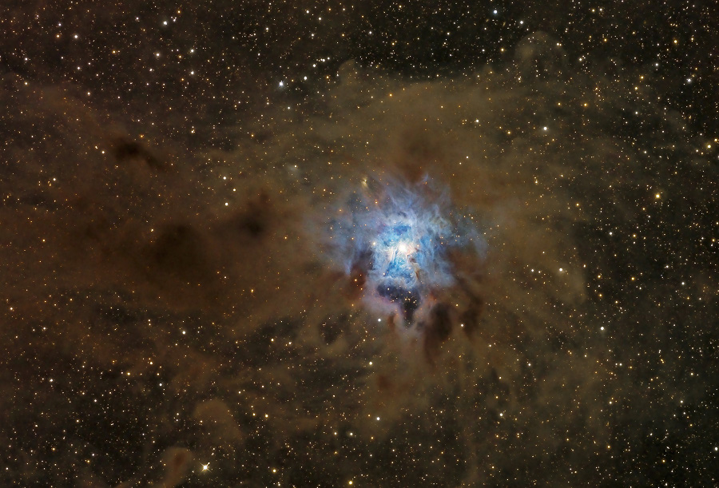
Interstellar Medium (ISM), Molecular Clouds, & HI/HII Regions

Slide 8
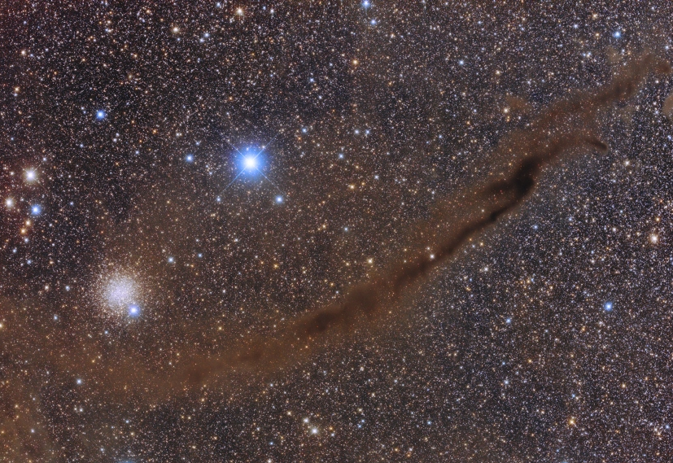
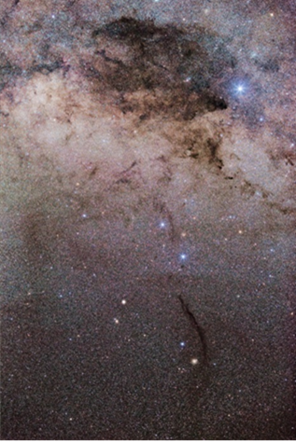
Molecular Clouds & HI Regions

Slide 9
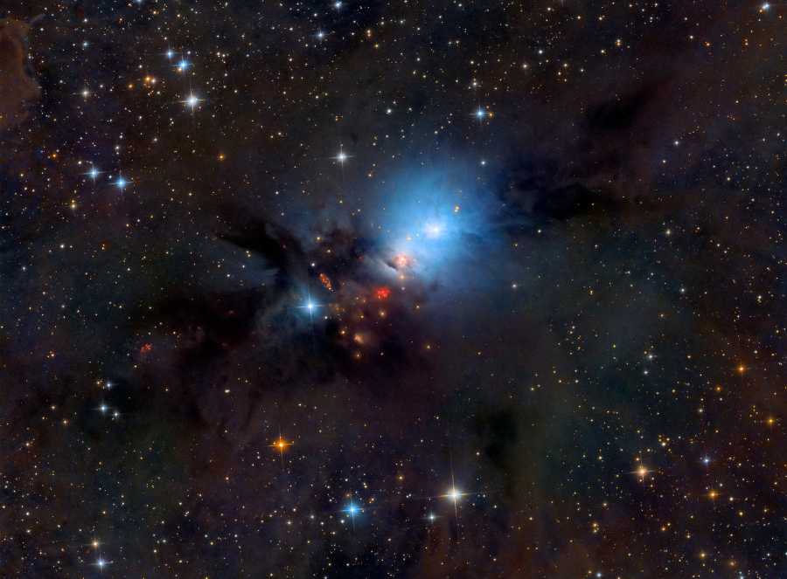
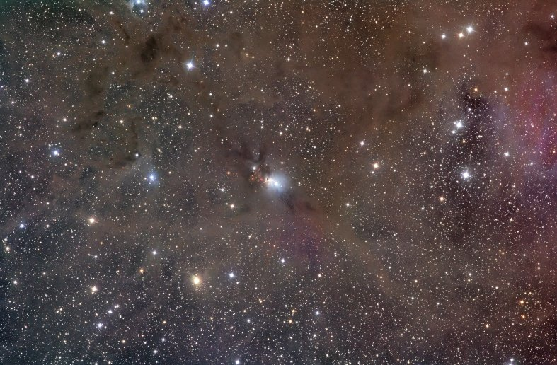
Molecular Clouds & HII Regions

Slide 10
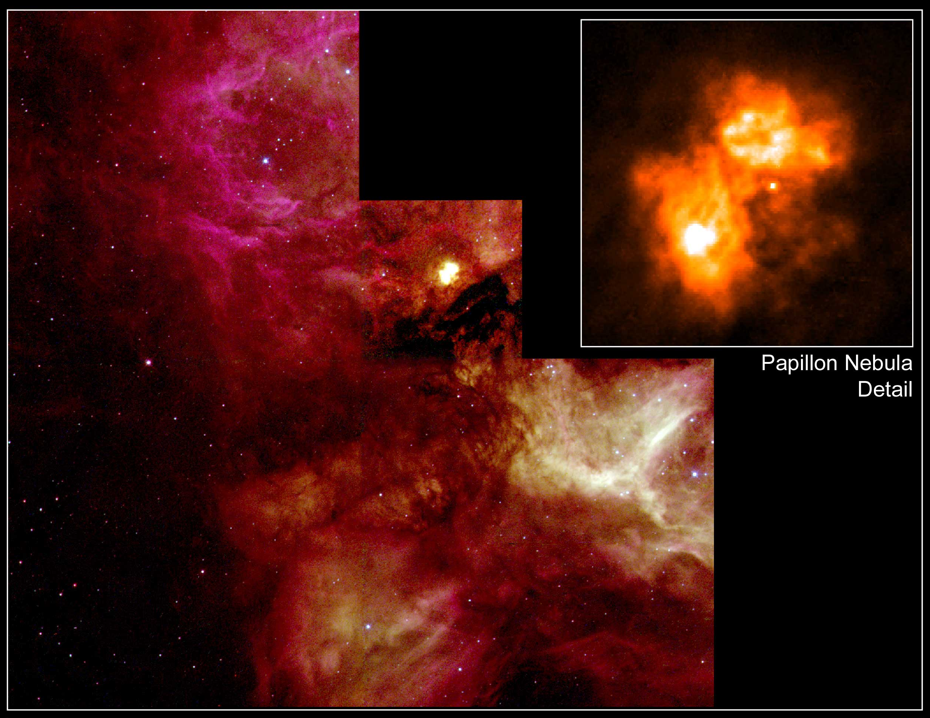
Star Formation Region – N159 (Papillon Nebula)

Slide 11
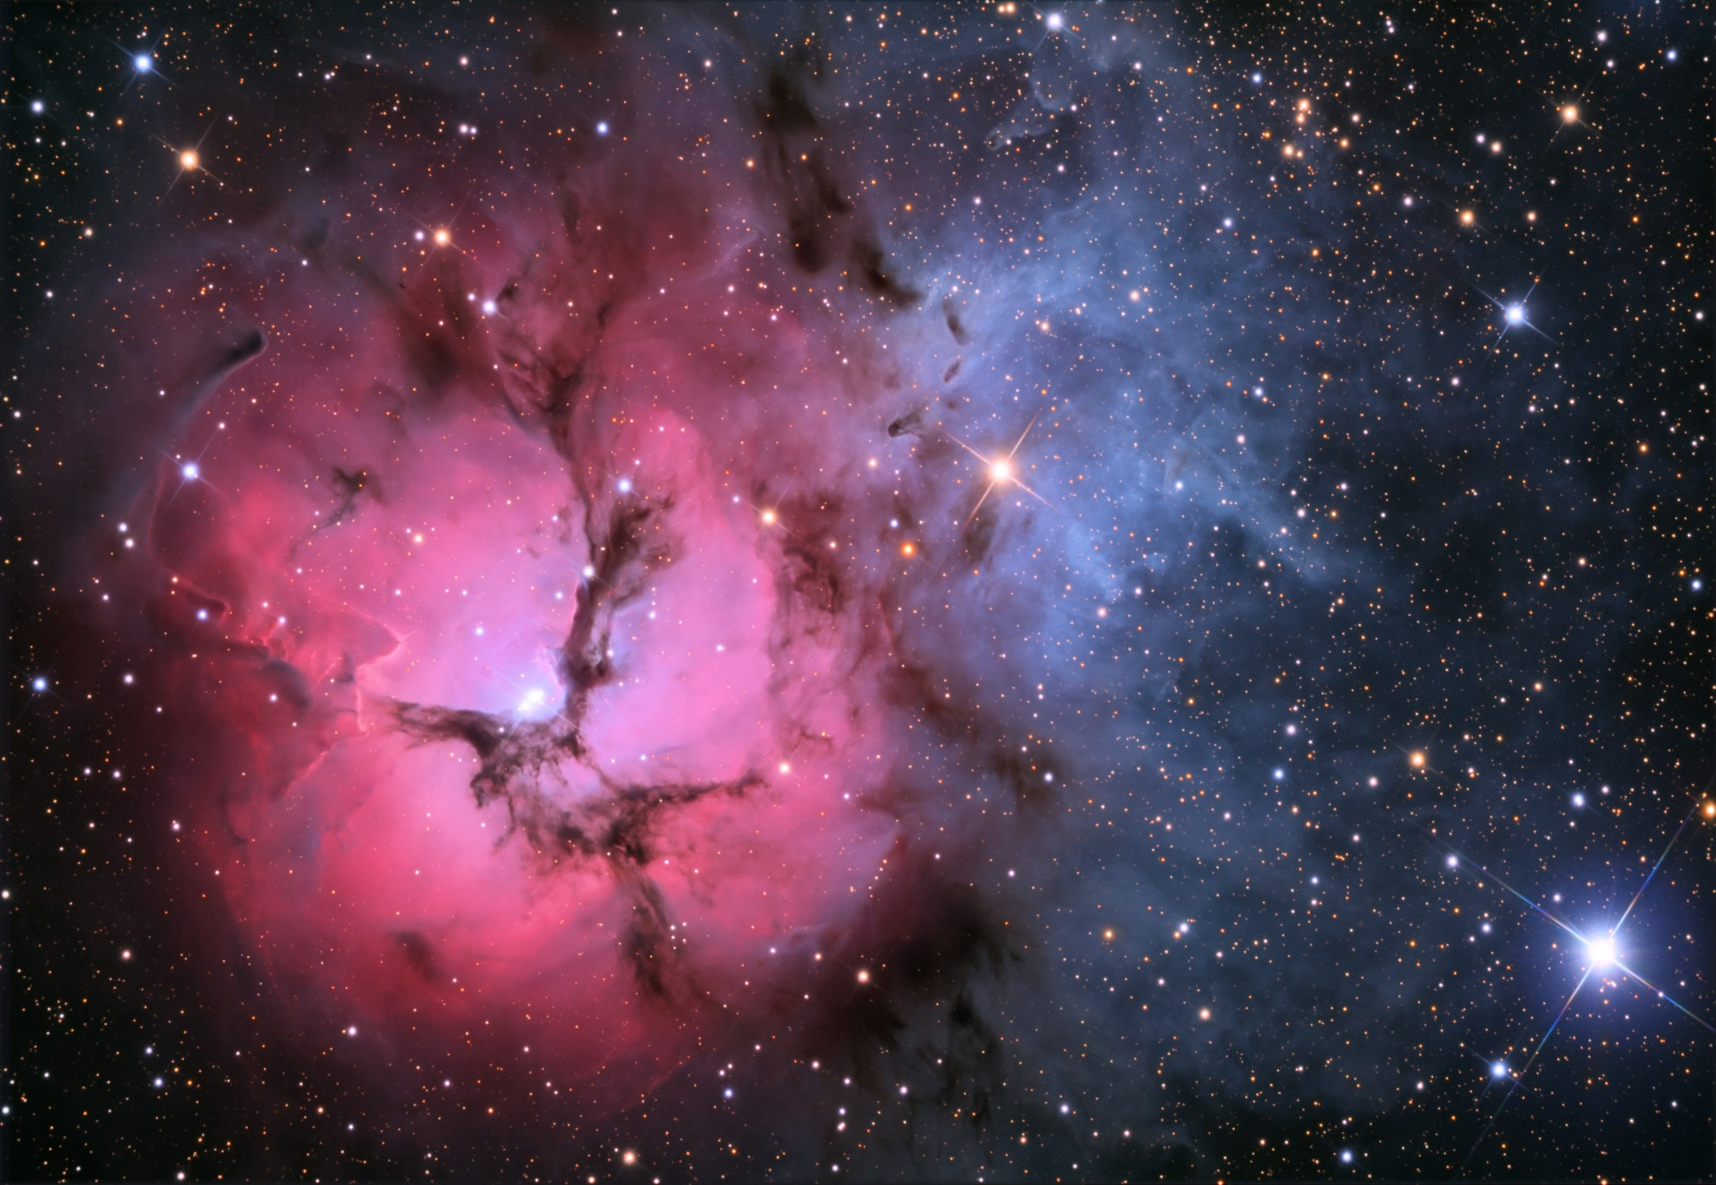
Star Formation Region – M20 (Trifid Nebula)

Slide 12
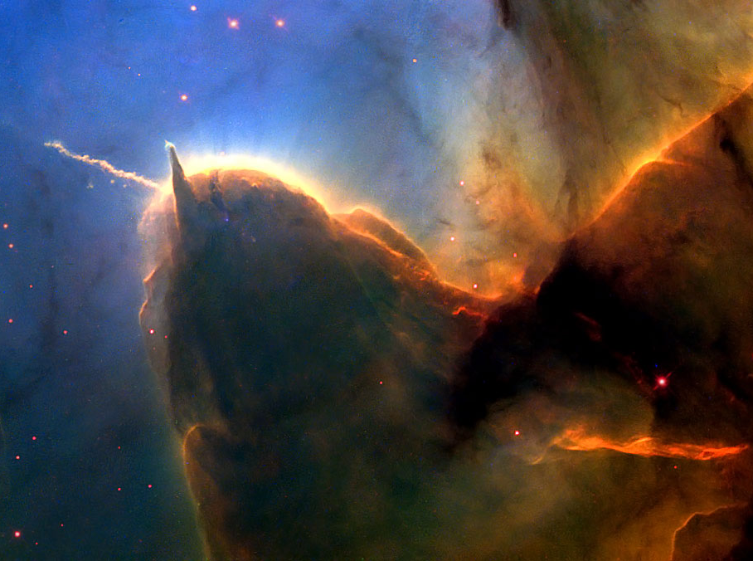
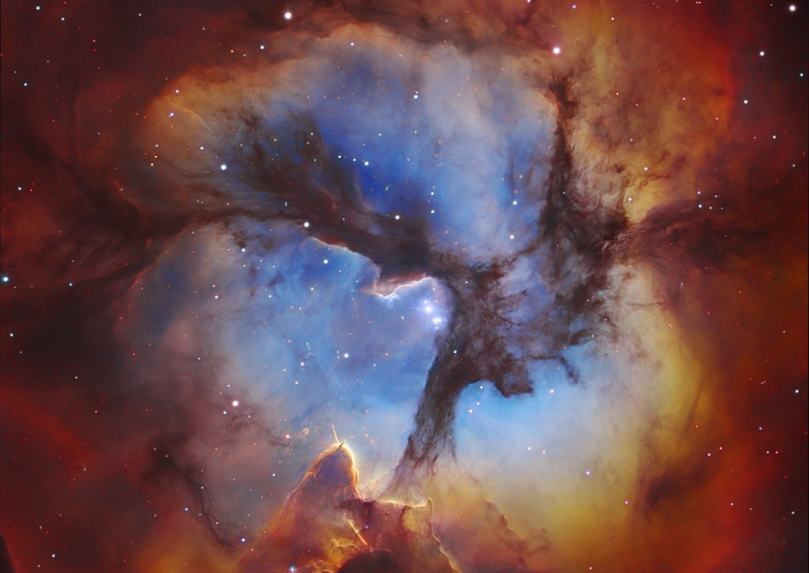
Star Formation Region – M20 (Trifid Nebula)
Star Formation Region – M20 (Trifid Nebula)

Slide 13
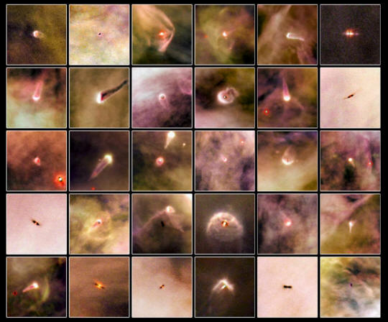
YSOs: Protostars, Pre-Main Sequence Stars
(MYSO, IMYSO, Brown Dwarf)

Slide 14
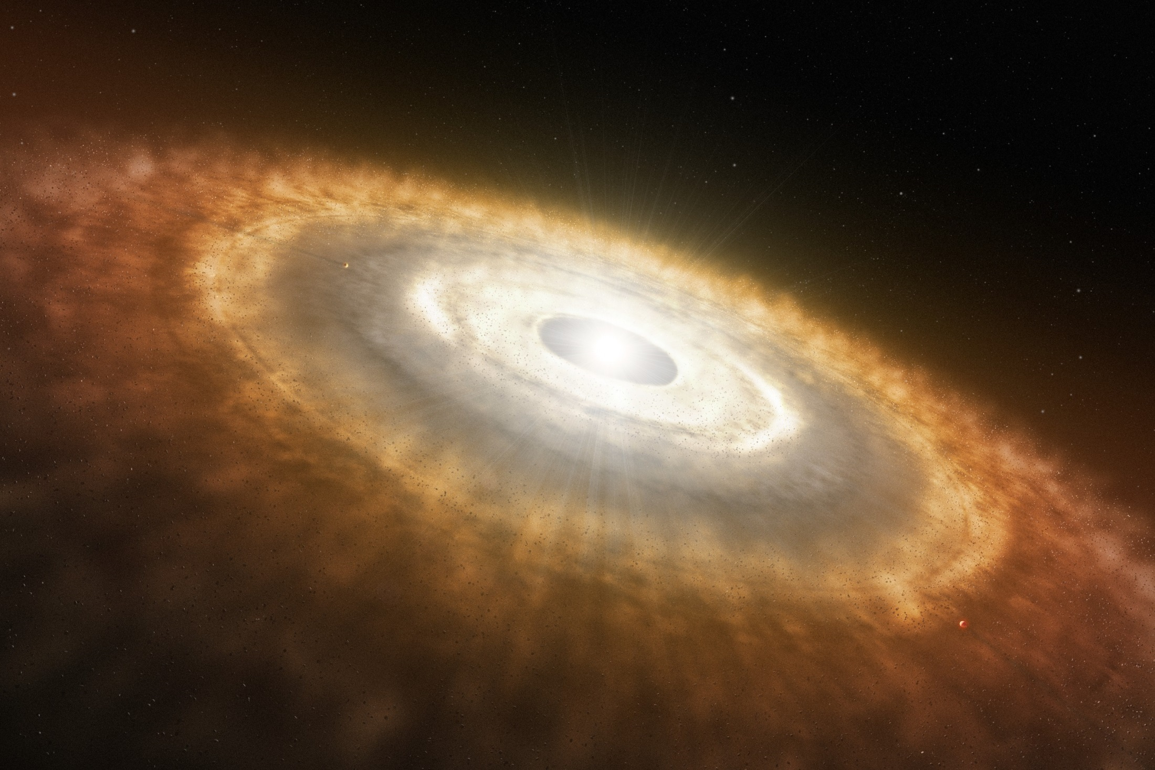
Circumstellar Disks – Protoplanetary Disks

Slide 15
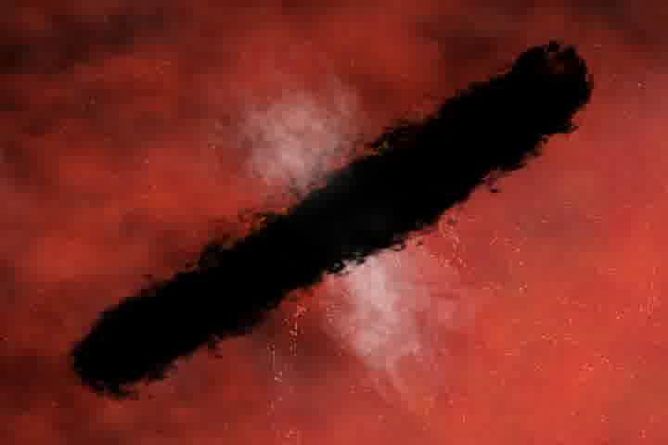

Slide 16
Circumstellar Disks – Debris Disks

Slide 17
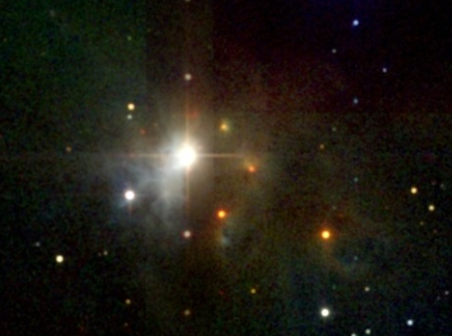
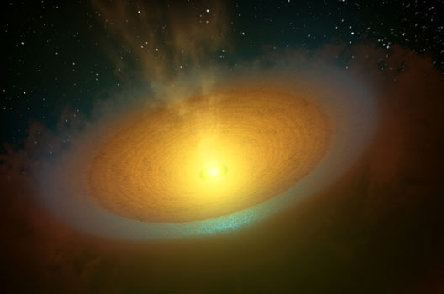
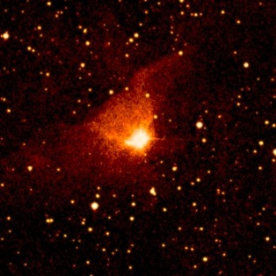
Pre-Main Sequence Stars – T Tauri, FUors, Herbig Ae/Be
Herbig Ae/Be – B & A stars (2-8/10 solar masses)
T Tauri – F,G,K & M stars (less than 2 solar masses)
FU Ori (Fuors) – special case of T Tauri with mass transfer from a disk onto the T Tauri star (~2 solar masses)

Slide 18
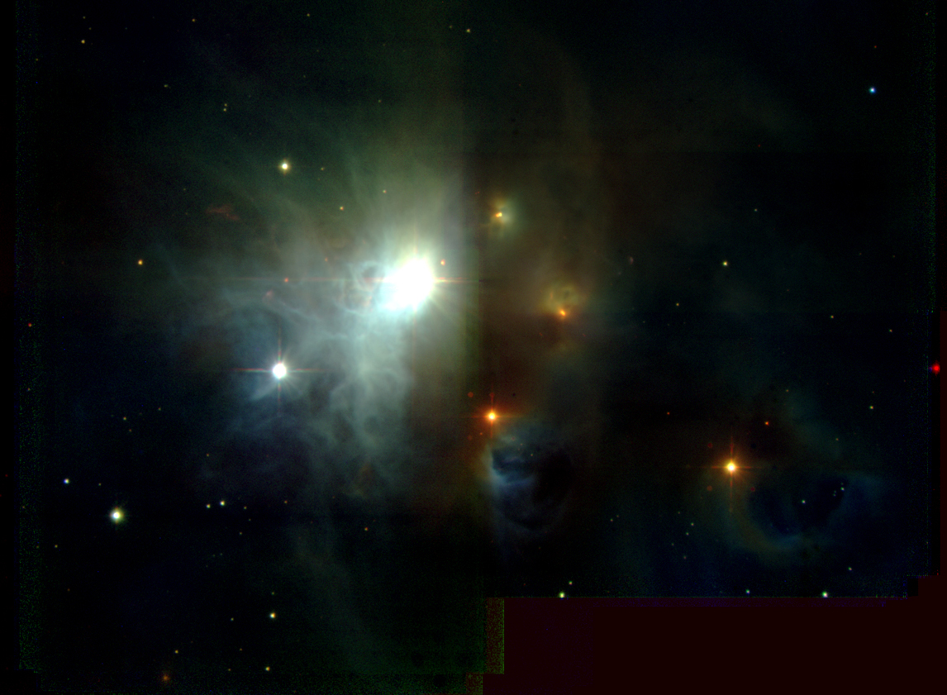
Pre-Main Sequence Stars – Herbig Ae/Be stars

Slide 19
Pre-Main Sequence Stars – TW Hya (T Tauri)

Slide 20
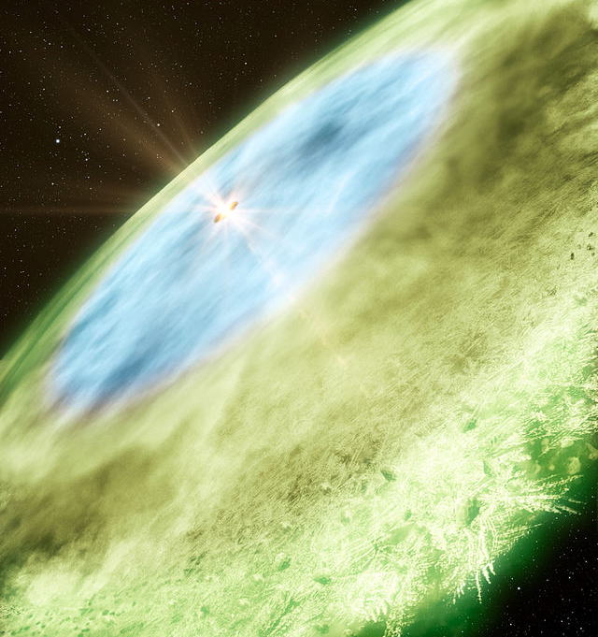
Planet Forming Ring with Frozen Water Vapor

Slide 21
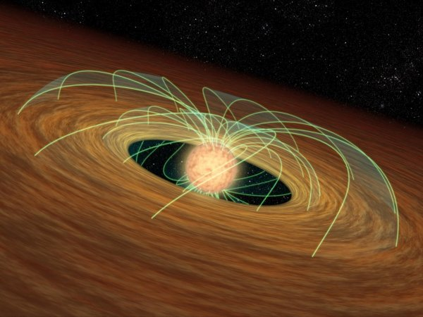
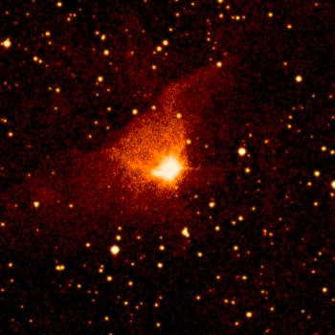
Pre-Main Sequence Stars – FU Orionis (Fuors)

Slide 22
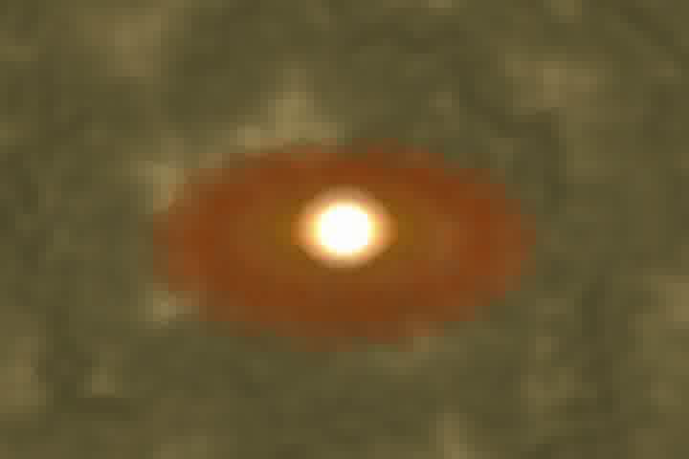

Slide 23
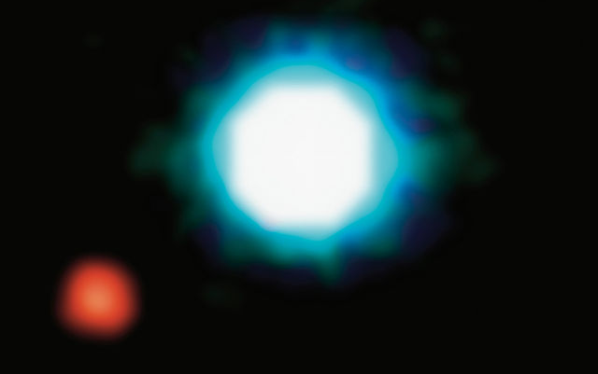
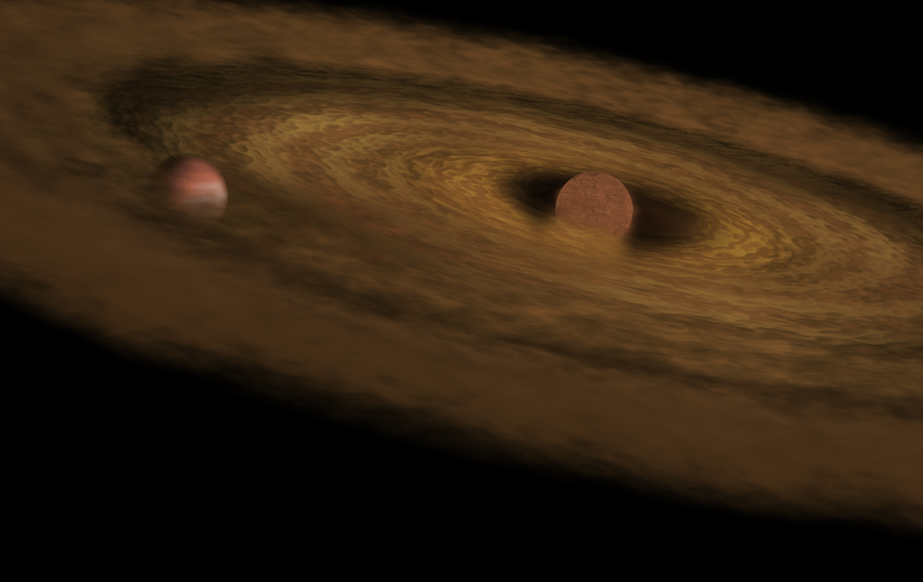
Brown Dwarf – 2M1207

Slide 24
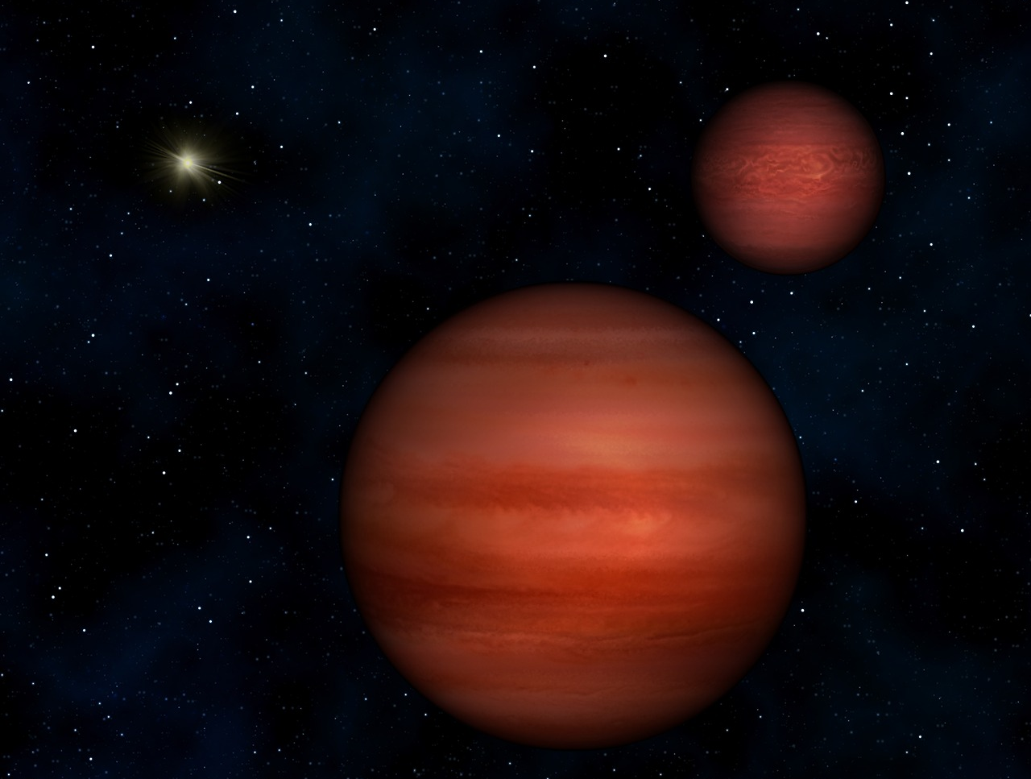
Brown Dwarf – WISE 1049-5319 (binary system)

Slide 25
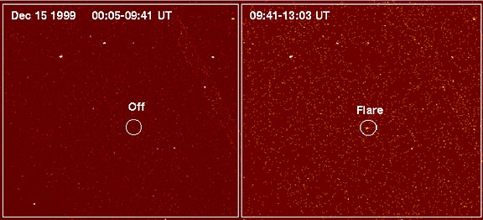
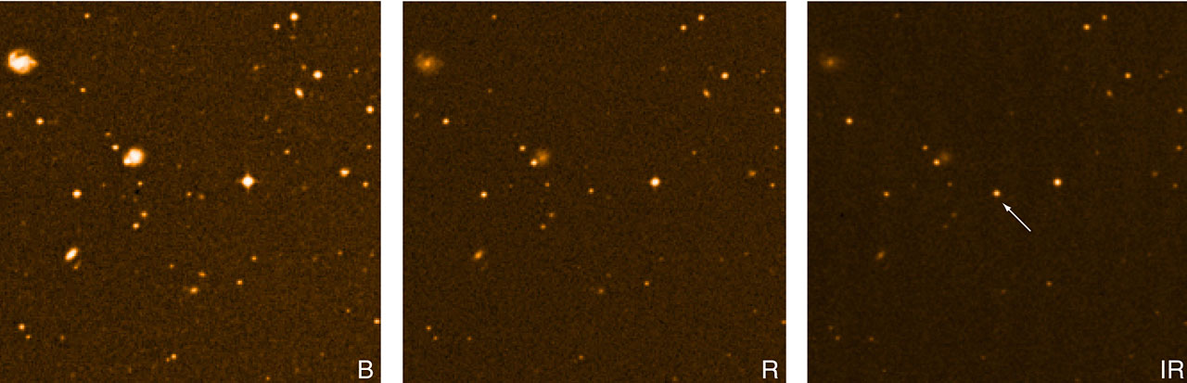
Brown Dwarf – LP-944-20

Slide 26
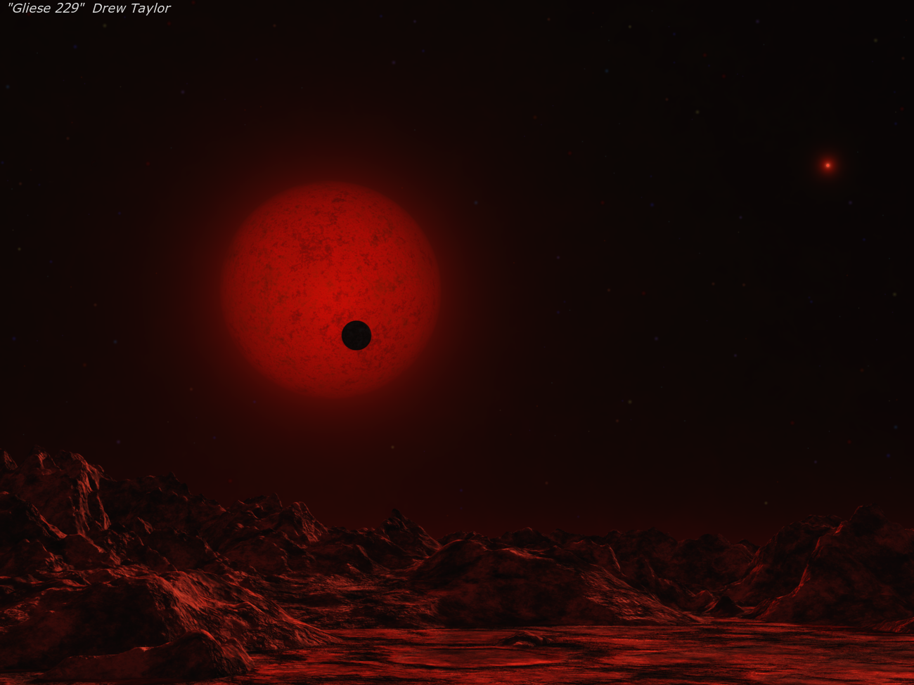
Brown Dwarf – Gliese 229B

Slide 27
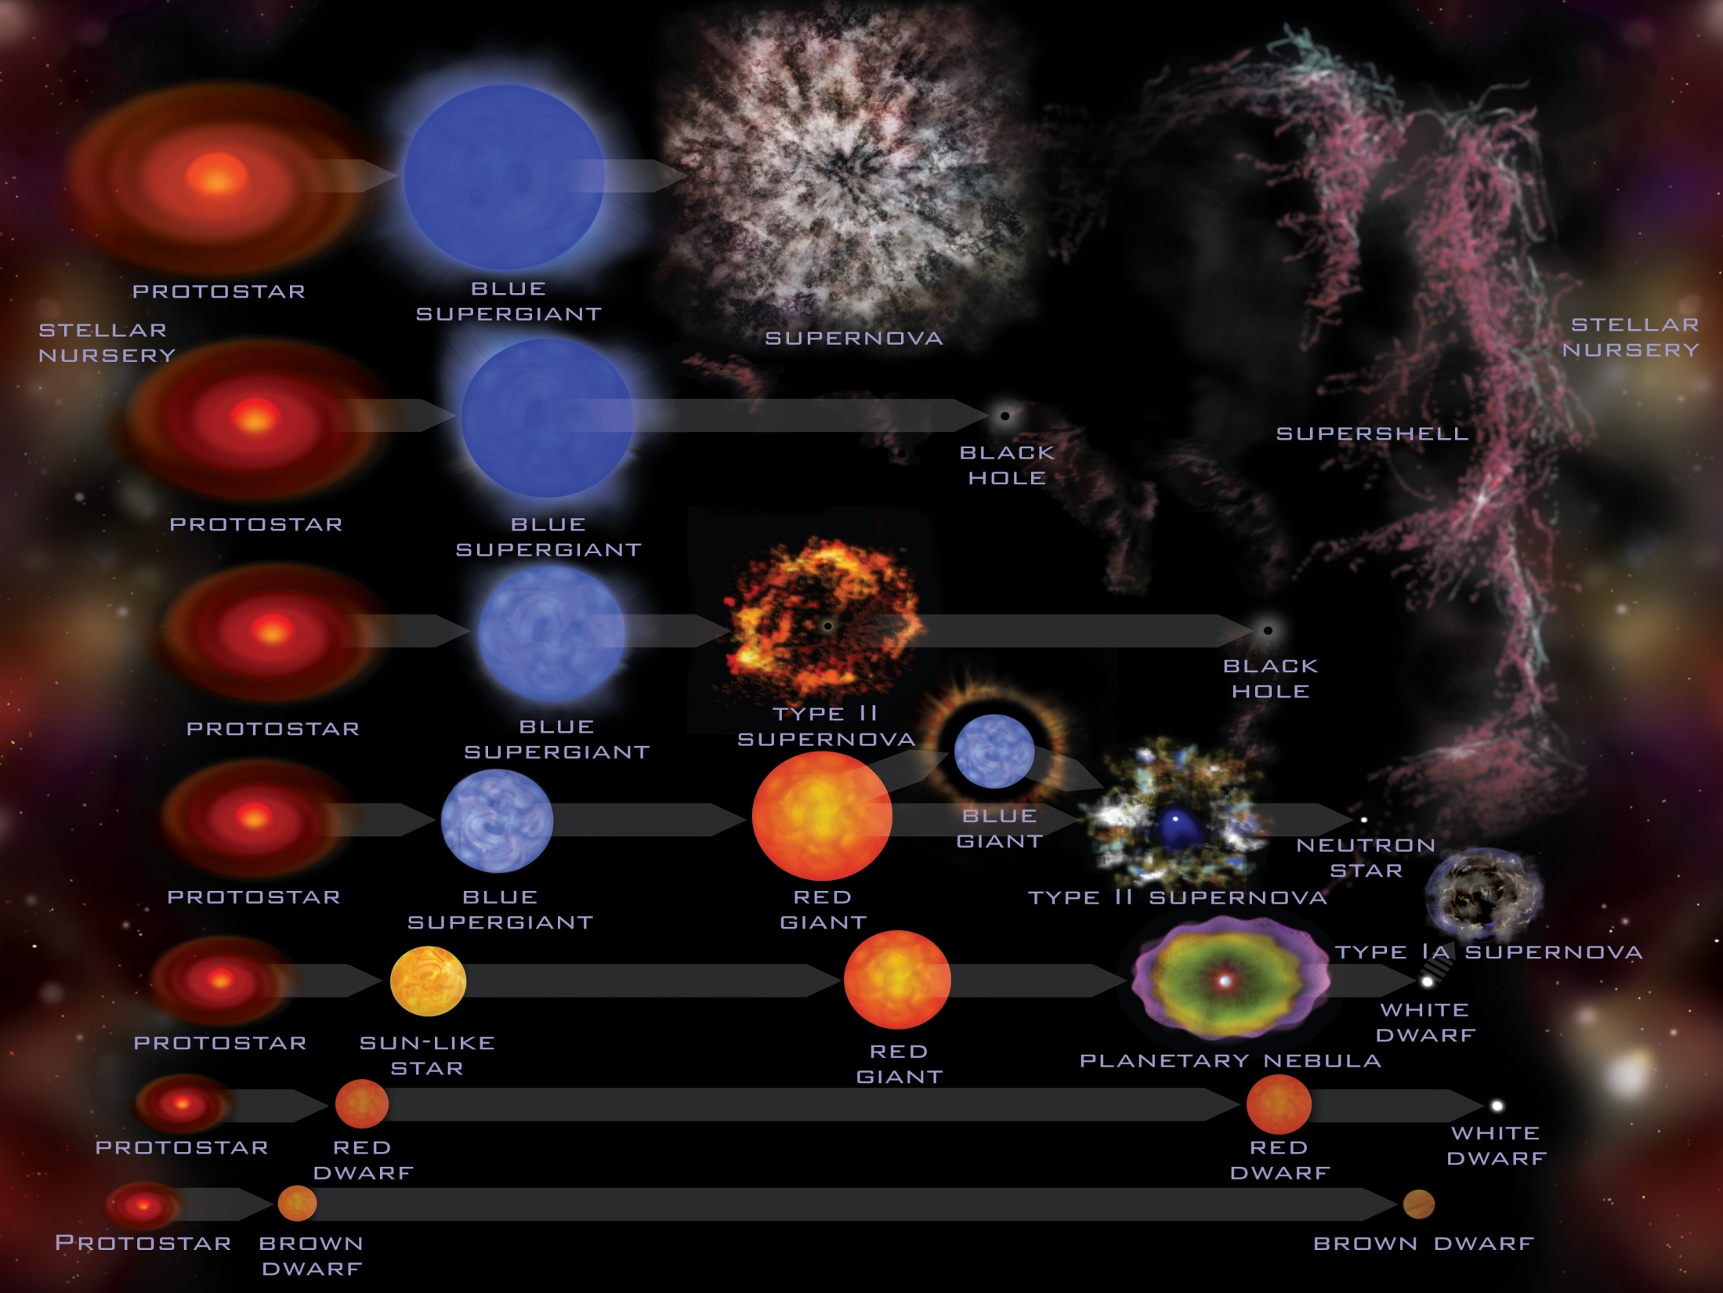

Slide 28
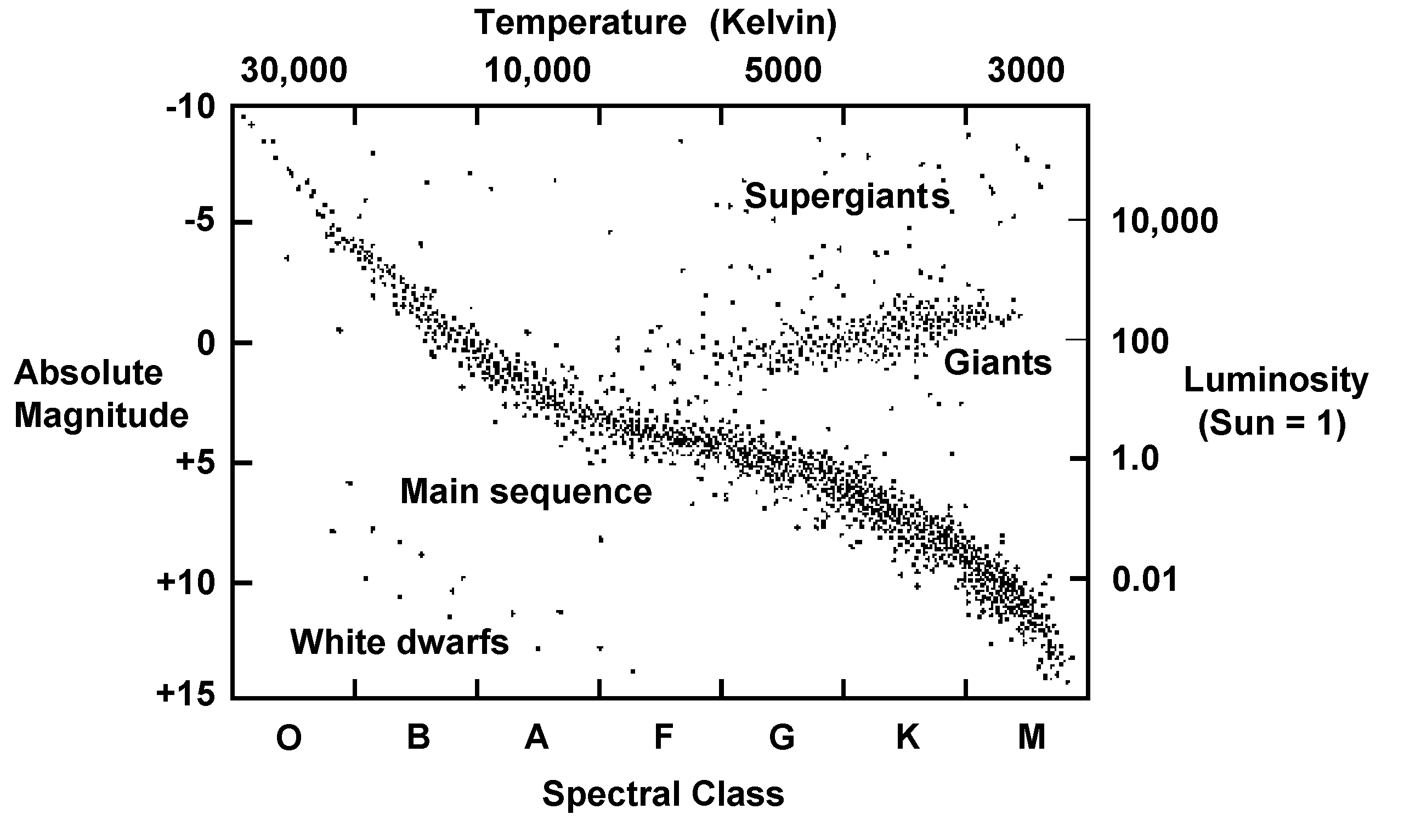
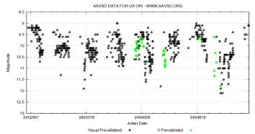
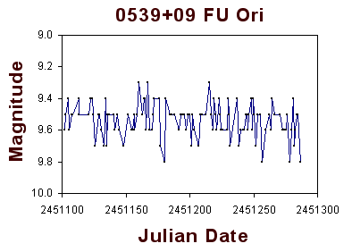
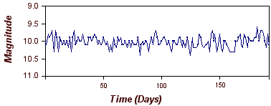
Herbig Ae/Be
FU Orionis
T-Tauri

Slide 29
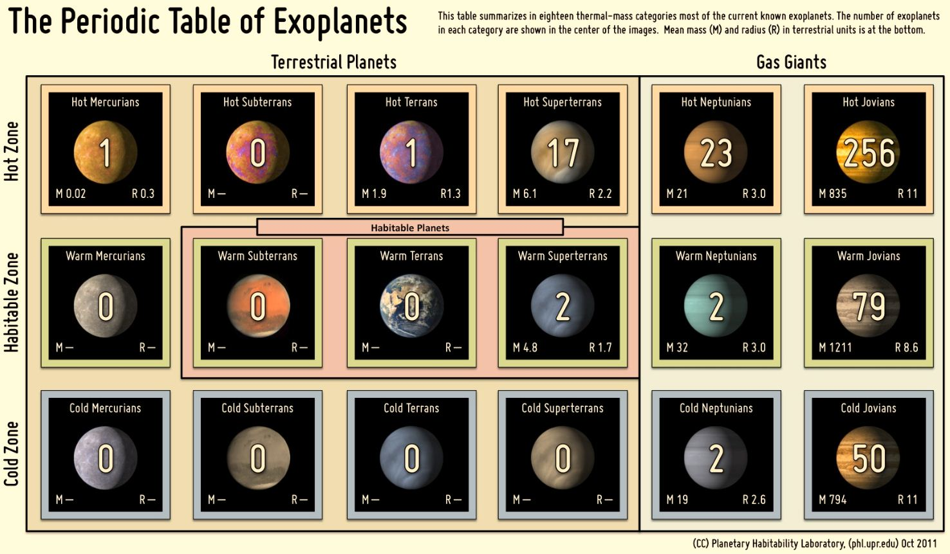
Exoplanets

Slide 30
Exoplanets

Slide 31
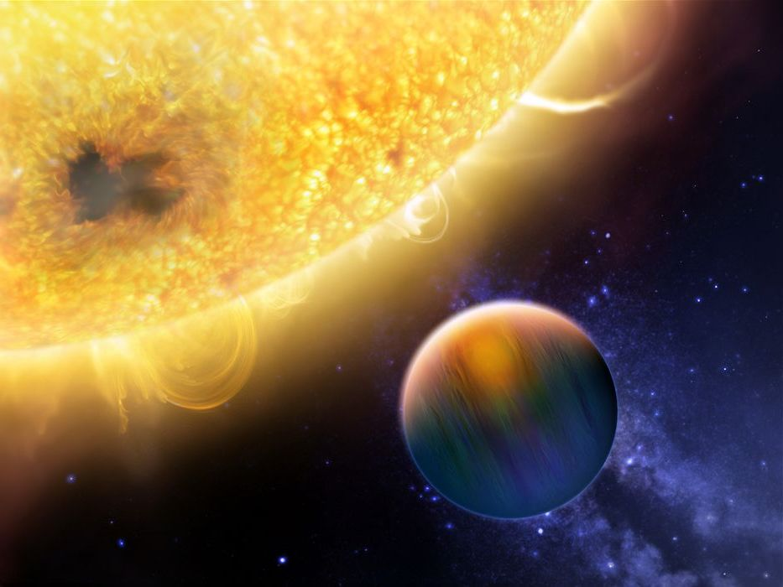
Hot Jupiters

Slide 32
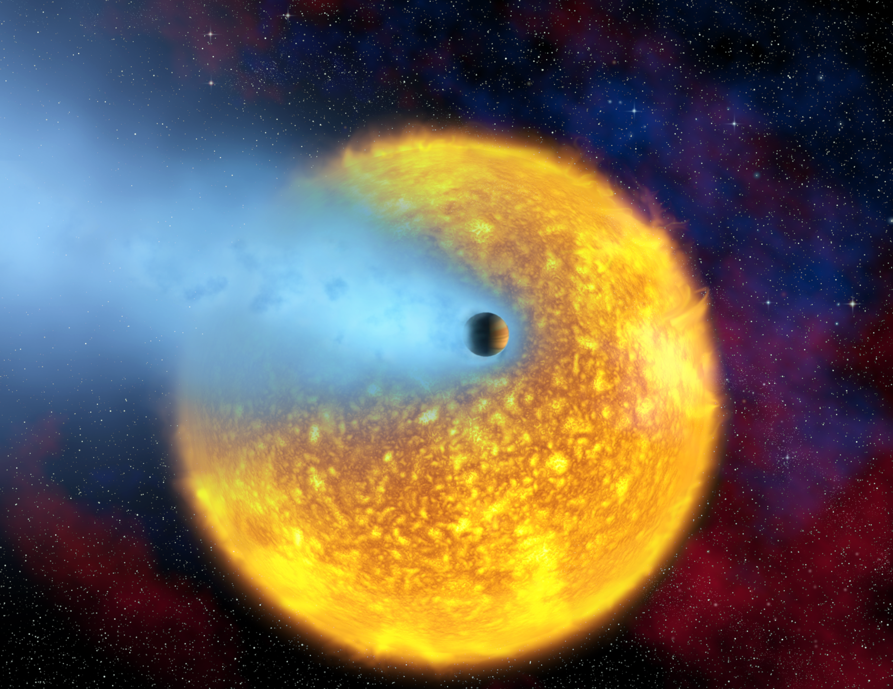
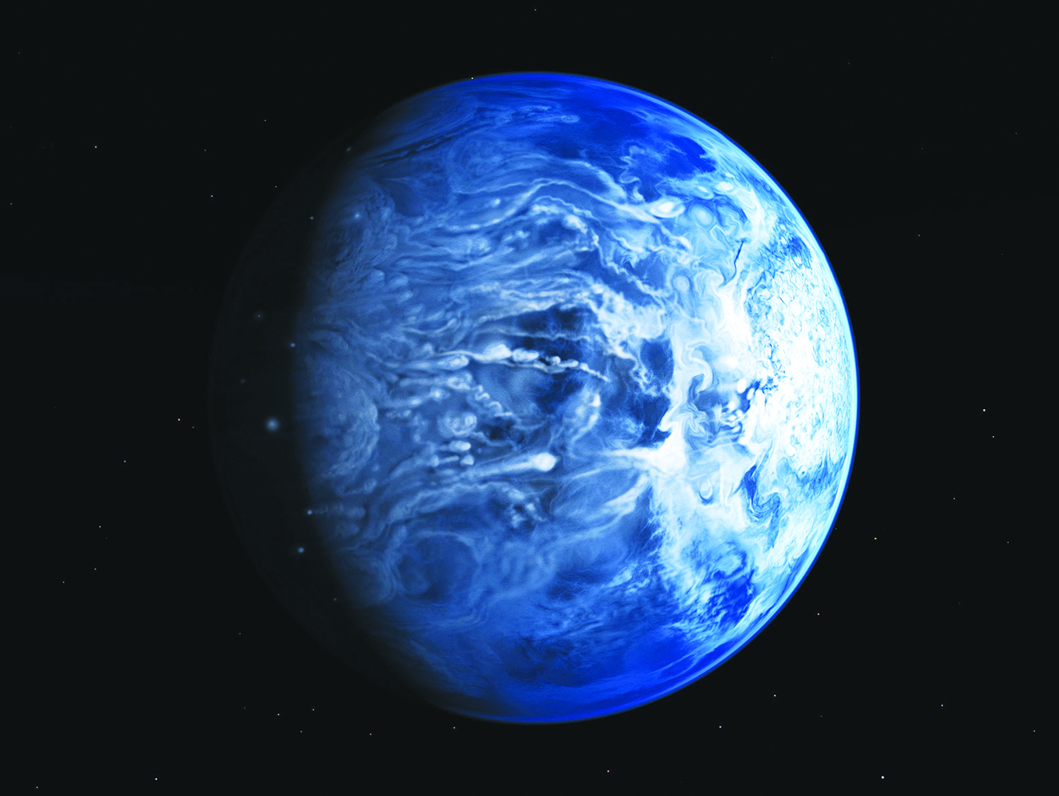
Transiting Planet – HD 209458b (Hot Jupiter)

Slide 33
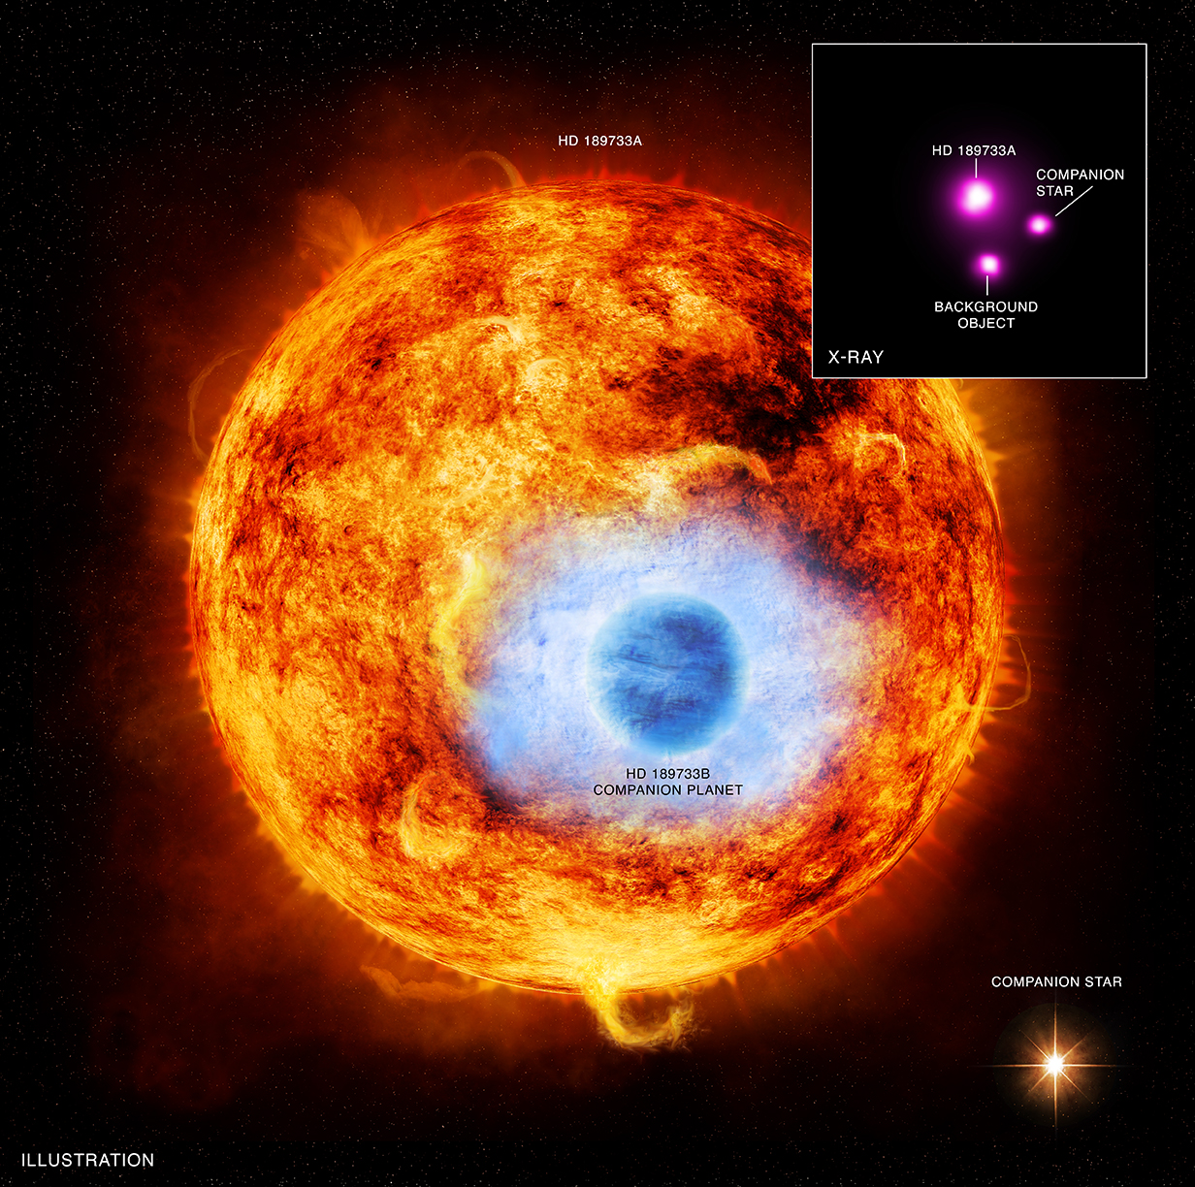
Transiting Planet – HD 189733b (Hot Jupiter)

Slide 34
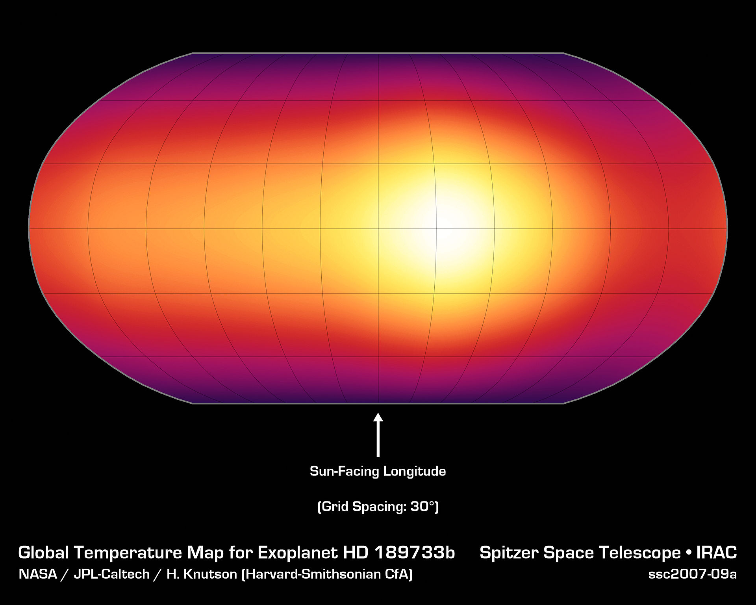
Transiting Planet – HD 189733b (Hot Jupiter)

Slide 35
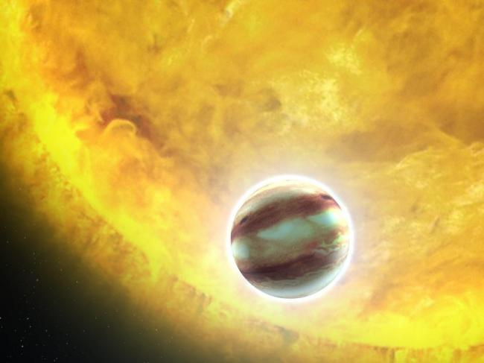
Transiting Planet – Kepler-7b (Hot Jupiter)

Slide 36
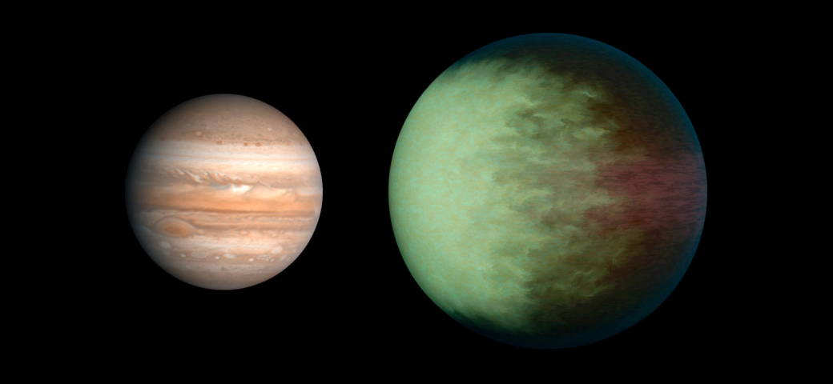
Transiting Planet – Kepler-7b (Hot Jupiter)

Slide 37
Transiting Planet – Kepler-7b (Hot Jupiter)
Planet has brightest point on opposite side expected
first inference of clouds on exoplanet!

Slide 38
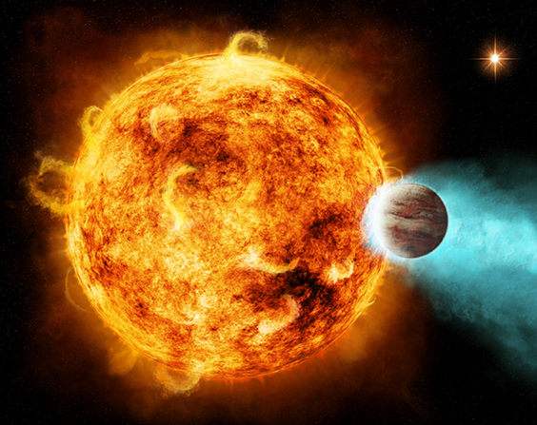
Transiting Planet – CoRoT-2a & CoRoT-2b (Hot Jupiter)

Slide 39
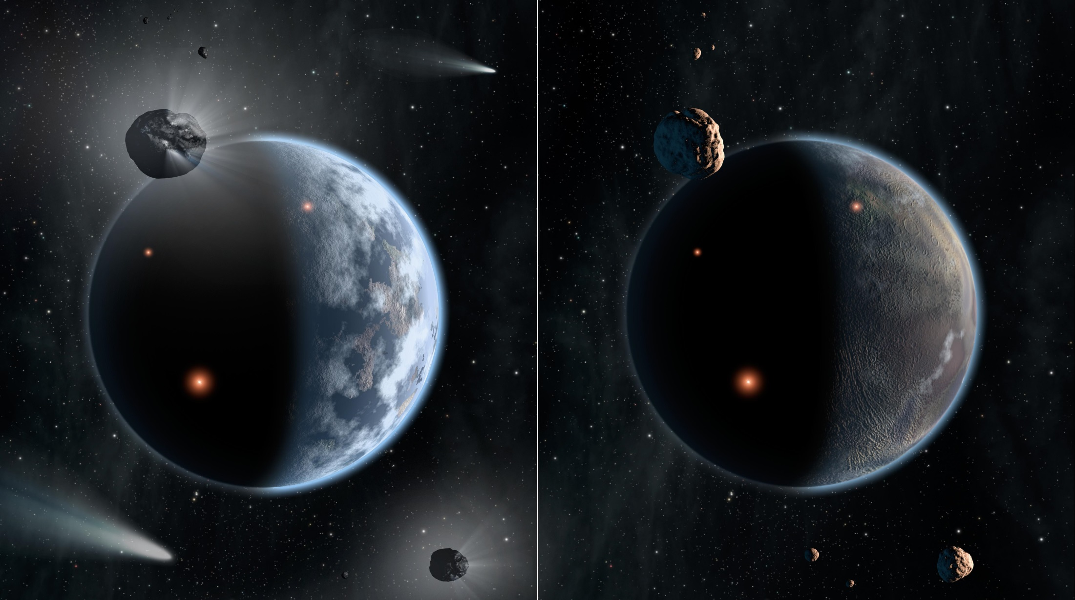
Super Earths

Slide 40
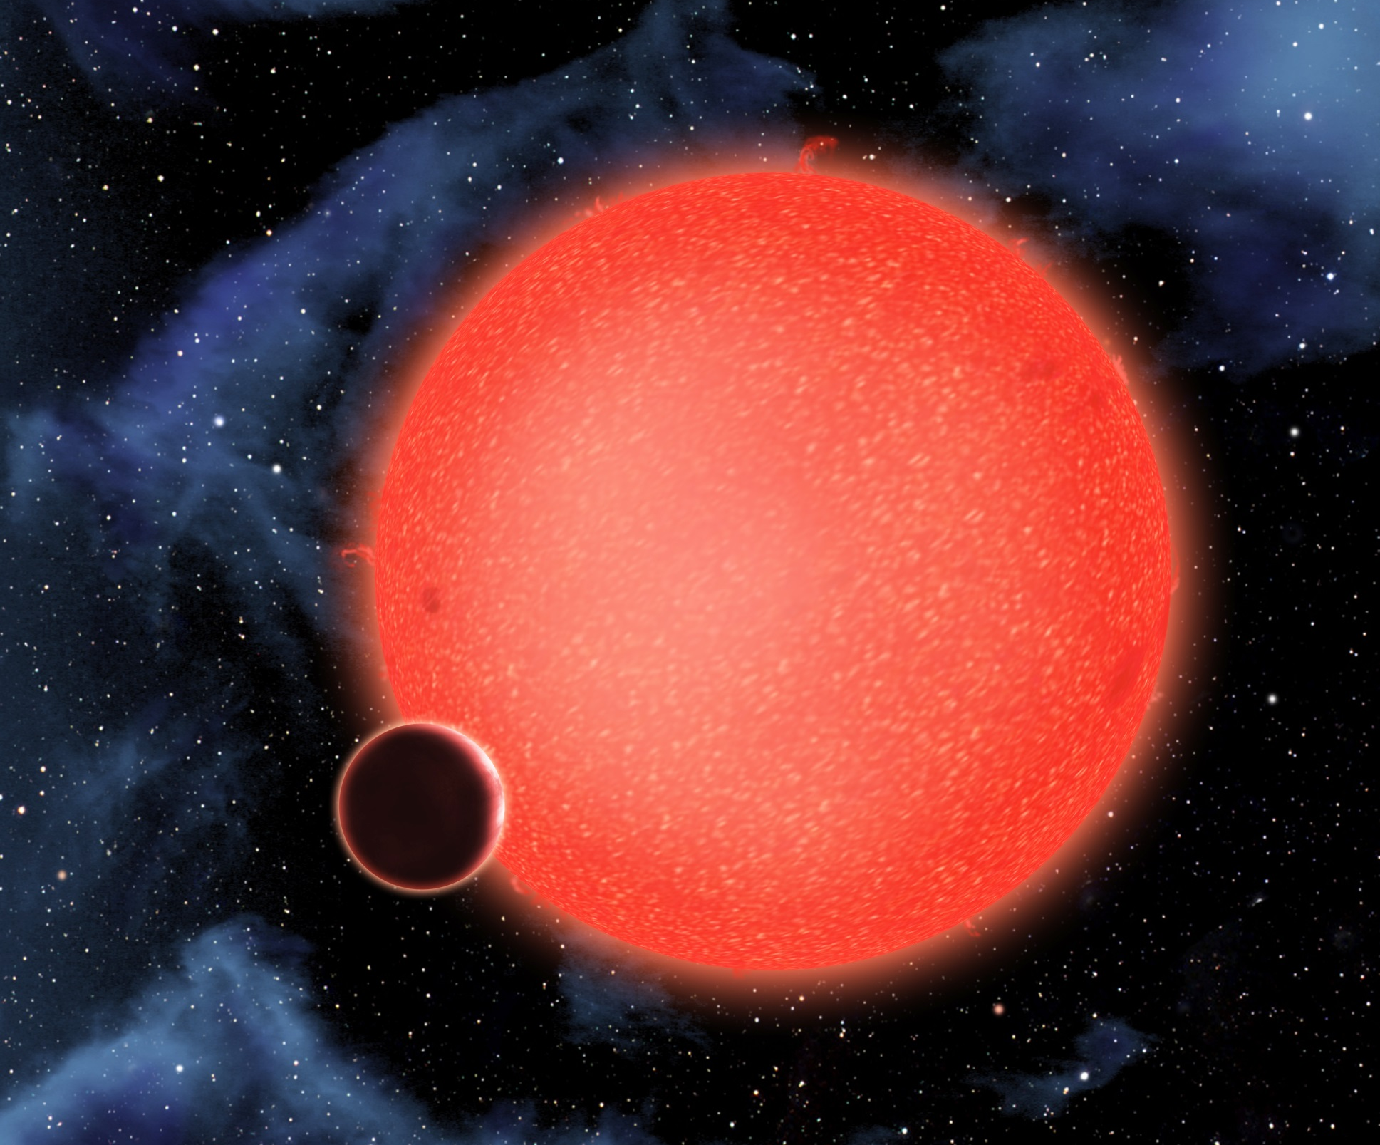
Transiting Planet – GJ 1214b (Super-Earth)

Slide 41
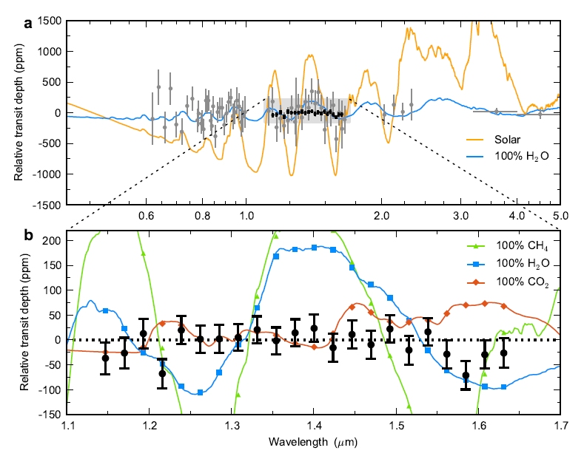
Transiting Planet – GJ 1214b (Super-Earth)

Slide 42
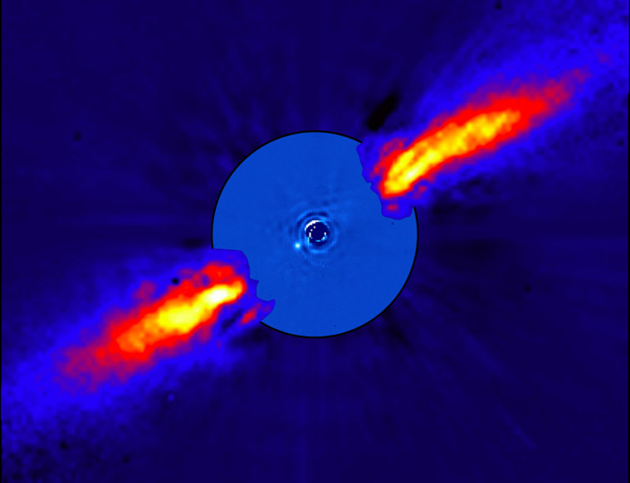
Directly Imaged Planetary Systems
Beta Pictoris (Main Sequence Star – Disk & Planet)

Slide 43
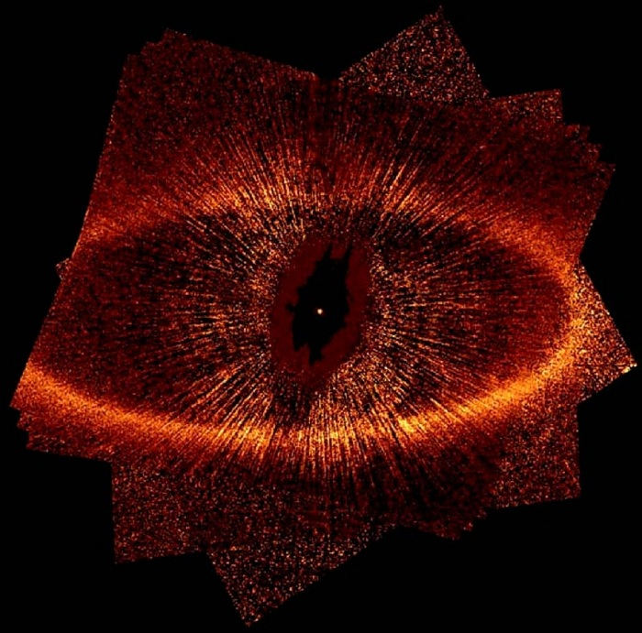
Directly Imaged Planetary Systems:
Formalhaut (Main Sequence Star – Disk & Planet)

Slide 44
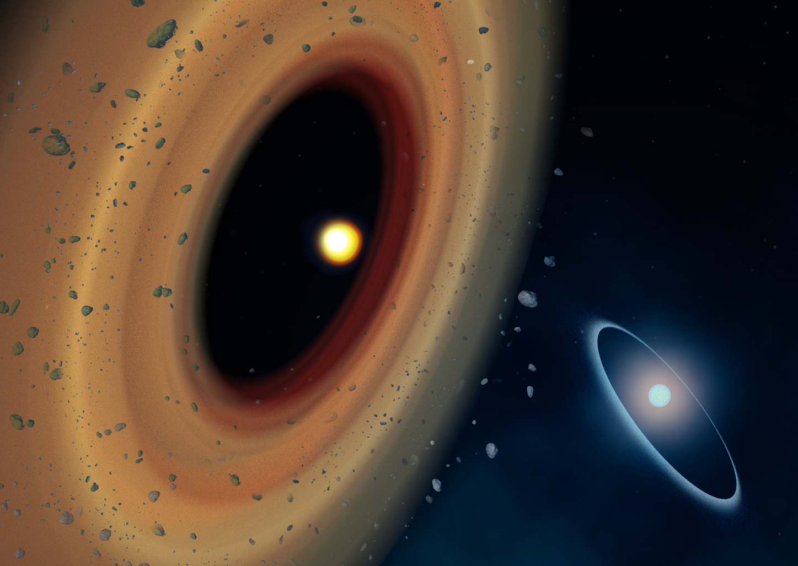
Directly Imaged Planetary Systems
Formalhaut (Main Sequence Star – Disk & Planet)

Slide 45


Directly Imaged Planetary Systems
HR 8799 (Main Sequence Star & Planetary System)

Slide 46

Methods of Detecting Exoplanets
Radial Velocity (Doppler Spectroscopy)
Transit Photometry
Transit Timing
Transmission/Emission Spectrum
3) Direct Imaging
Circumstellar Disks

Slide 47

Radial Velocity (Doppler Spectroscopy)

Slide 48


Transit Photometry – Transit Timing

Slide 49
Hands-on Radial Velocity and Transit Timing Applets
From the University of Nebraska - Lincoln
Radial Velocity:
http://astro.unl.edu/classaction/animations/extrasolarplanets/radialvelocitysimulator.html
Transit Timing:
http://astro.unl.edu/naap/esp/animations/transitSimulator.html

Slide 50

Transit Photometry – Transmission Spectrum

Slide 51

Transit Photometry – Transmission Spectrum
http://www.exoclimes.com/topics/transmission-spectroscopy/

Slide 52

Direct Imaging – Circumstellar Disks

Slide 53





Spitzer

Slide 54

Spitzer

Slide 55

Kepler

Slide 56


Ground Based Sub-mm observatories

Slide 57


Slide 58


Slide 59




Spectra

Slide 60



Stellar Radiation Laws:
Planck’s Law
Wien’s Law
Stefan-Boltzmann’s Law
(λ_{max} = 2.9 x 10⁷ /T)
L = 4πR²σT⁴

Slide 61

Basic Equations and Relationships
The Distance Modulus: M = m - 5log₁₀ (r)
10
Kepler’s 3rd Law: (M_{A} + M_{B}) = a³
p²
v = d ; a = v ; 2π a = vP ; F_{c} = ma_{c} ; a_{c} = v² = rω²
t t r
Small Angle Formula: D = αd
206,265
1 pc = 206,265 au = 3.26 ly = 3.08 x 10¹⁶m
1° = 60 arcmin = 60´ ; 1´ = 60 arcsec = 60˝
Equilibrium Temperature
Inverse Square Law: L = 1/r² equilibrium temperature
Circumference, Area, Surface Area, and Volume of a Sphere

Slide 62




chandra.harvard.edu – Webinars, Content, Images
apod.nasa.gov – Images, Content
aavso.org – Images, Content, 2014 Events, PPTs
http://soinc.org

Slide 63




Slide 64
National Astronomy Event Supervisors:
Donna L Young – donna@aavso.org
Tad Komacek – tkomacek@gmail.com
Rules clarifications:
available at www.soinc.org under event information
Event Preparation:
Read the Event Description for content and allowable resources.
Use the Webinar and PowerPoint for an overview of the content
topics and deep sky objects.
3. Use the Astronomy Coaches Manuel as a guide to collect images
and information for the 2015 competition.
4. Use the APOD, Chandra and AAVSO websites for images and
content.
5. Download prior Astronomy Events from the AAVSO website
to use as a guide for types of questions.

