Slide 1
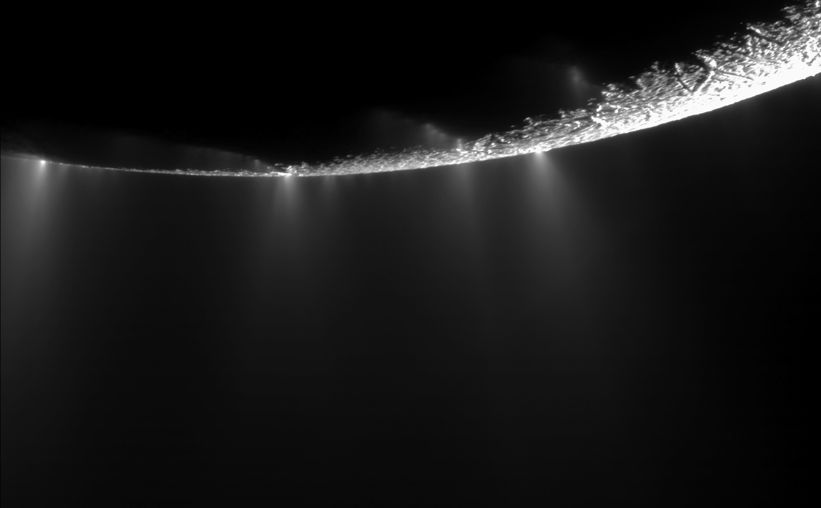
National Science Olympiad
Solar System B Event 2014
Planetary Science

Slide 2
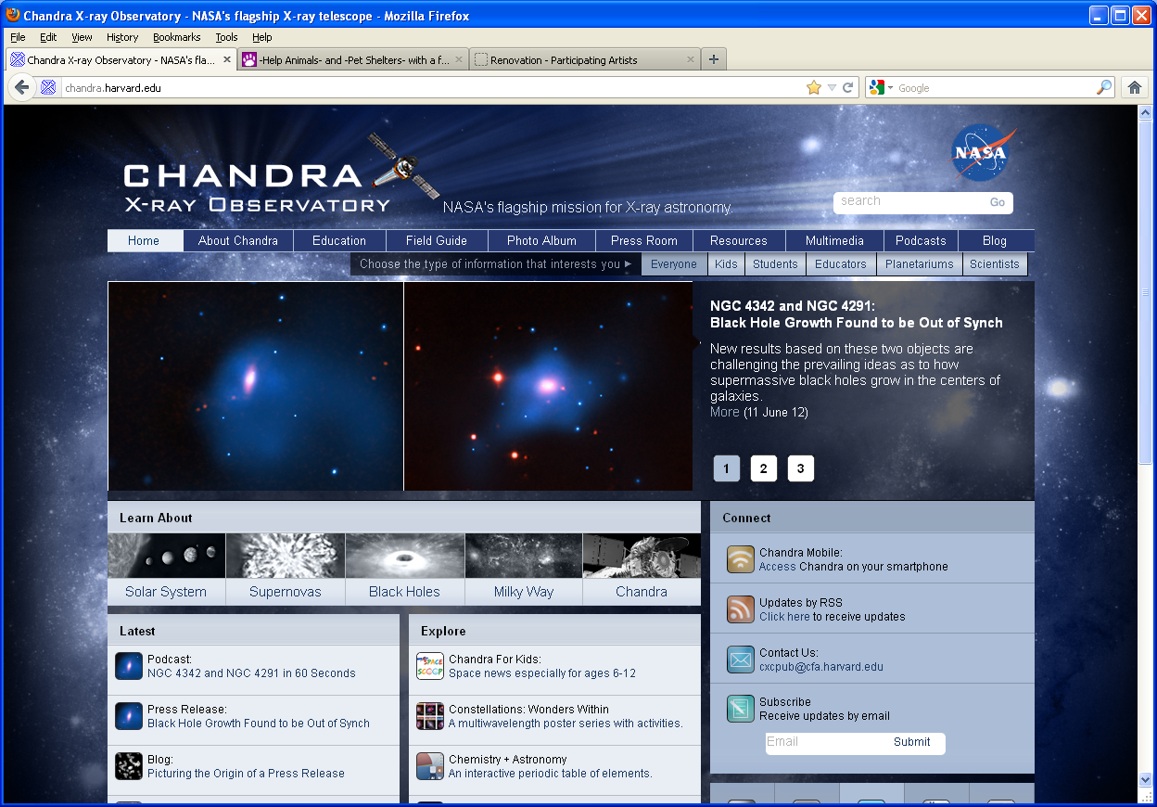
Chandra X-Ray Public Outreach Office
Donna Lee Young, NSO Astronomy Event Supervisor – donna@aavso.org
Dustin Schroeder, NSO Solar System Event Supervisor – dschroed@ gmail.com

Slide 3
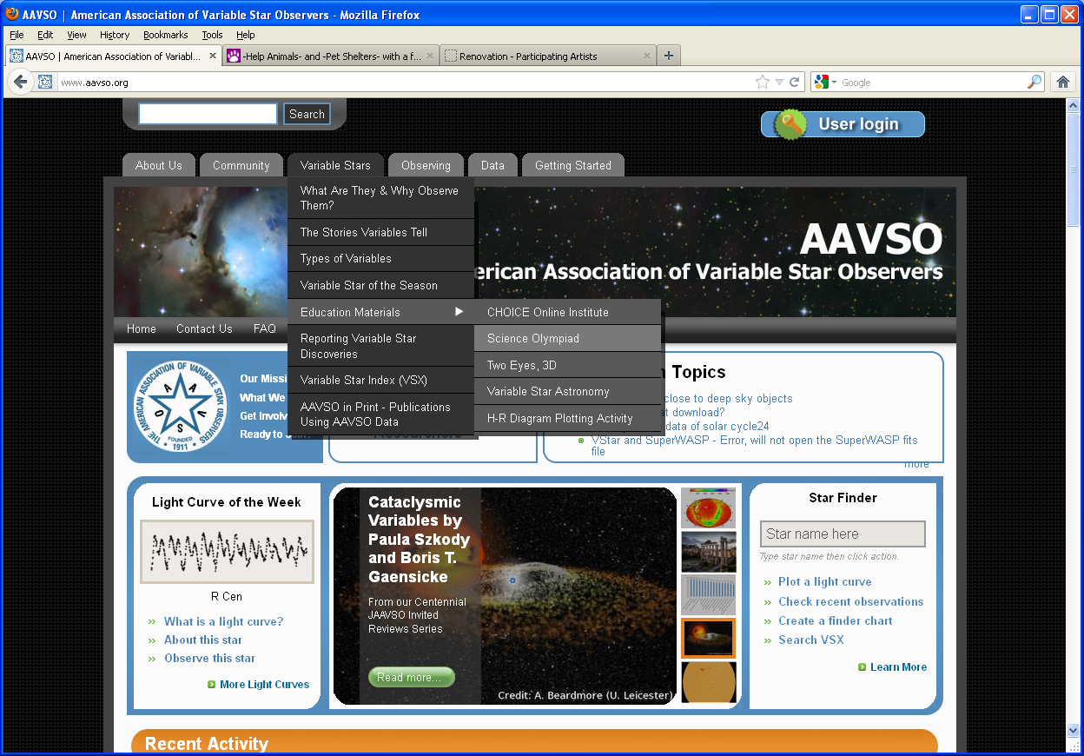
aavso.org

Slide 4
REACH FOR THE STARS, DIVISION B: PLANETARY SCIENCE
DESCRIPTION: Students will demonstrate an understanding and knowledge of the properties and evolution of extraterrestrial ice and water in the solar system.
A TEAM OF UP TO: 2 APPROXIMATE
TIME: 50 minutes
EVENT PARAMETERS: Each team may bring only two 8.5” x 11” two-sided
pages of information in any form from any source.
THE COMPETITION: This event is divided into two parts. Notes may be used during both parts.

Slide 5
Part I: Participants may be asked to identify planets, moons, and features
included in the lists below as they appear on maps or imagery and
must be knowledgeable about the history and processes involving
ice and water for the objects below.
(1) Mars: North & South Polar Ice Caps, Equatorial Glaciers, Permafrost
(2) Europa: Thrace Macula, Thera Macula, Conamara Chaos, Ridges,
Cycloids, Plains, Ocean
(3) Enceladus: Plumes, Jets, Tiger Stripes
(4) Iapetus, Titan, Triton, Ceres,
(5) Comets, The Kuiper Belt, The Oort Cloud
Part II: Participants will be asked to complete one or more hands-on or
interpretive tasks selected from the following topics:
i: The history and process of formation for specific features
ii: The use of remote sensing, imagery, and satellite measurements of objects
and features
iii: The physical, thermal, and chemical properties of potential habitats for life
iv: Past, current, and planned future missions to explore these objects

Slide 6
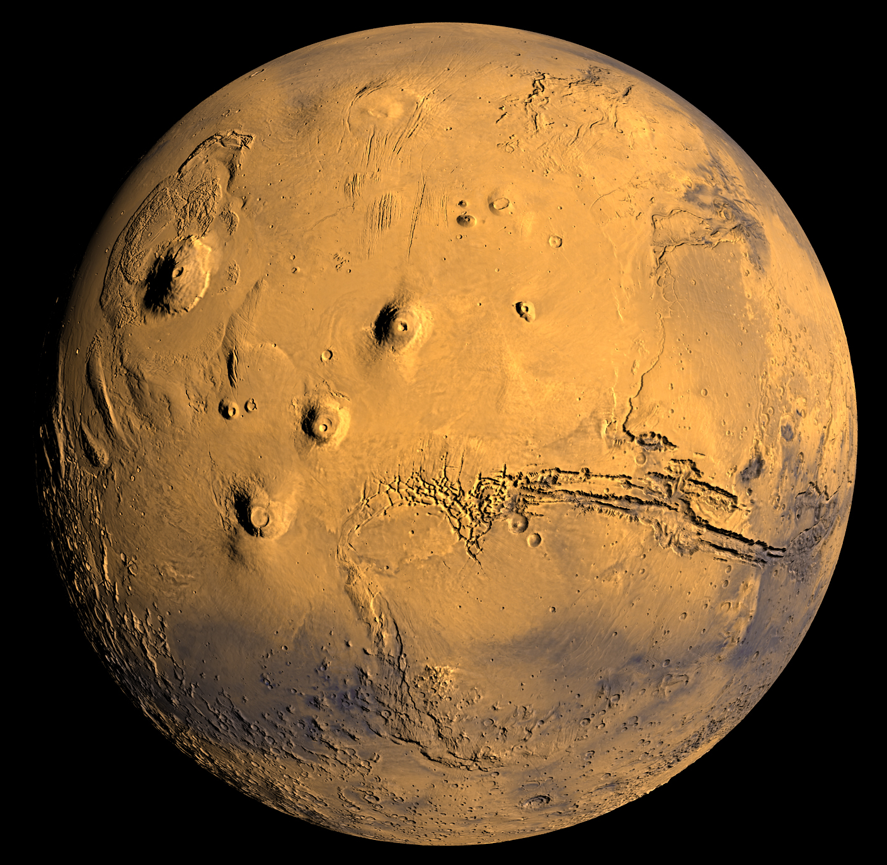
Part I: Mars

Slide 7
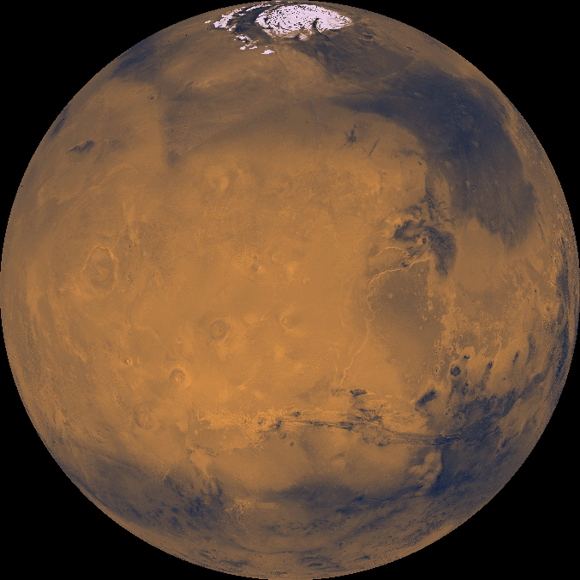
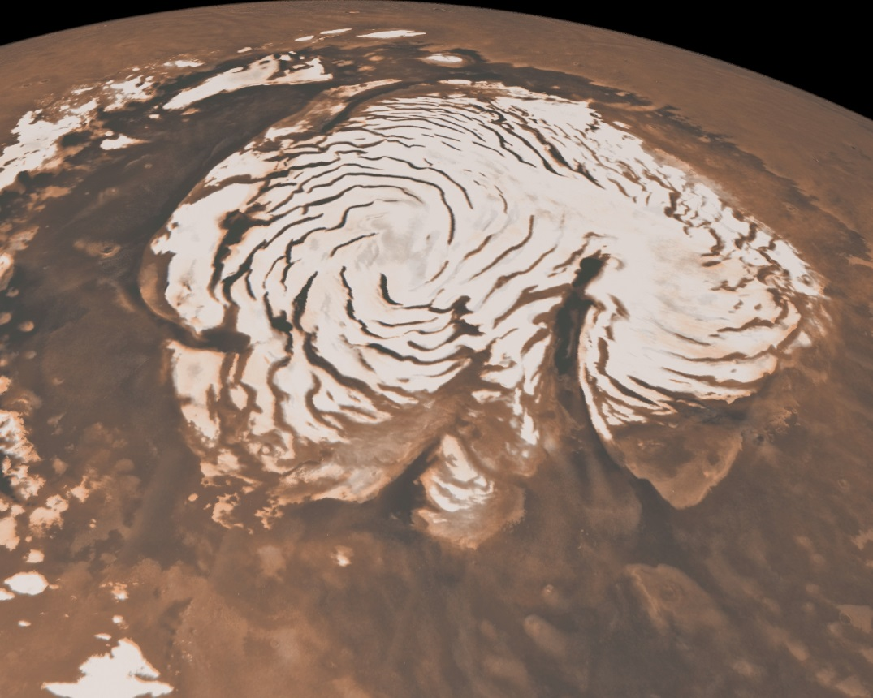
North Polar Ice Cap

Slide 8
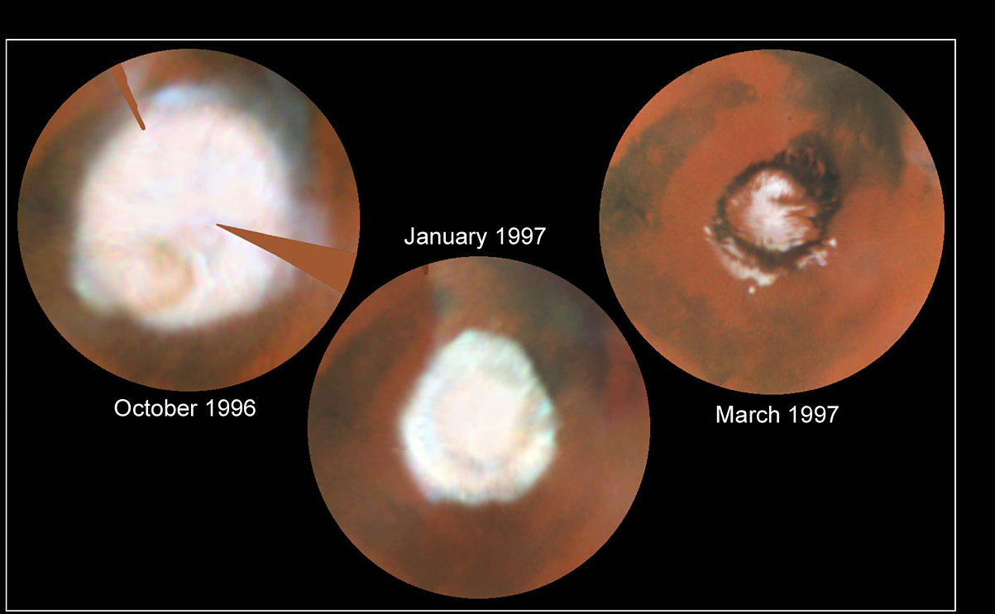
Seasonal Changes

Slide 9
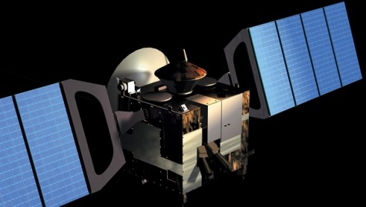
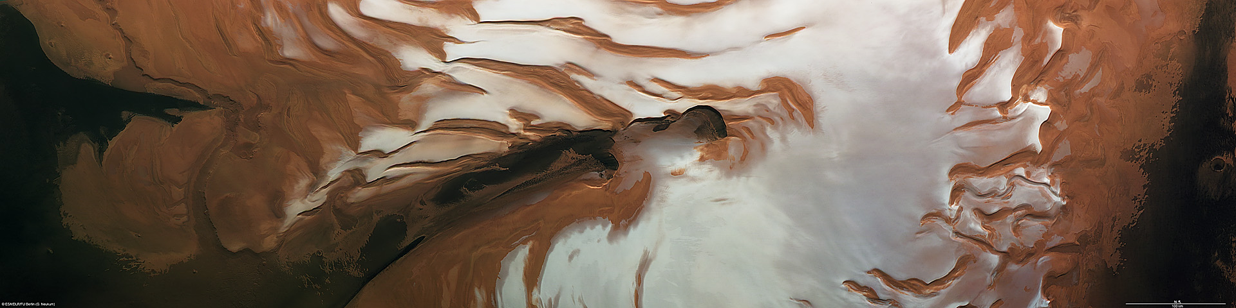
ESA Mars Express - 2003
Summer Solstice Transition
Infrared Mineralogical Mapping Spectrometer (OMEGA) – phyllosilicates
High Resolution Stereo Camera (HRSC) – volcanism
Planetary Fourier Spectrometer (PFS) – Methane

Slide 10
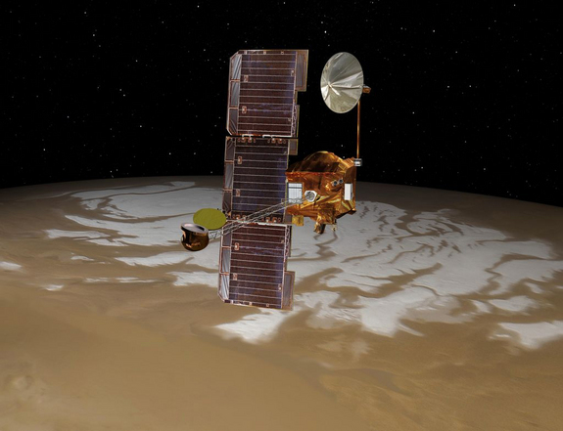
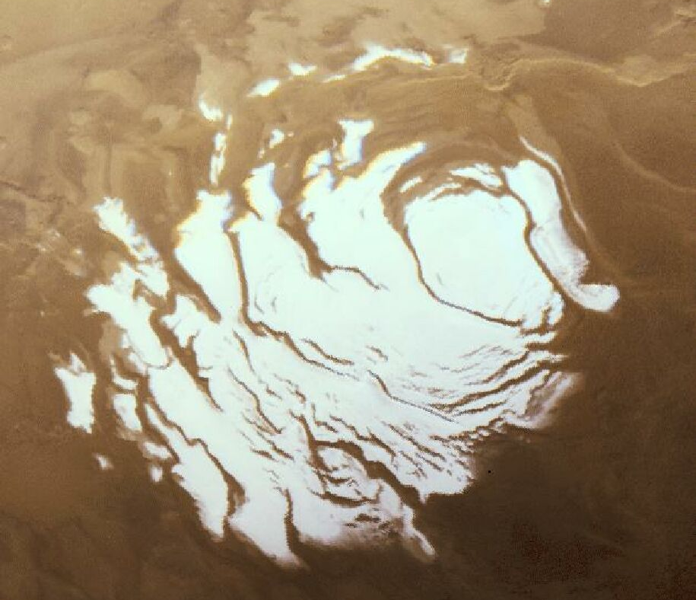
South Polar Ice Cap – Mars Odyssey Mission

Slide 11
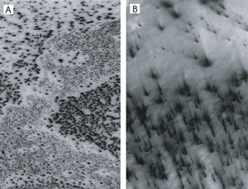
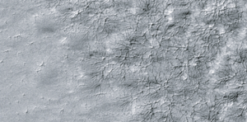
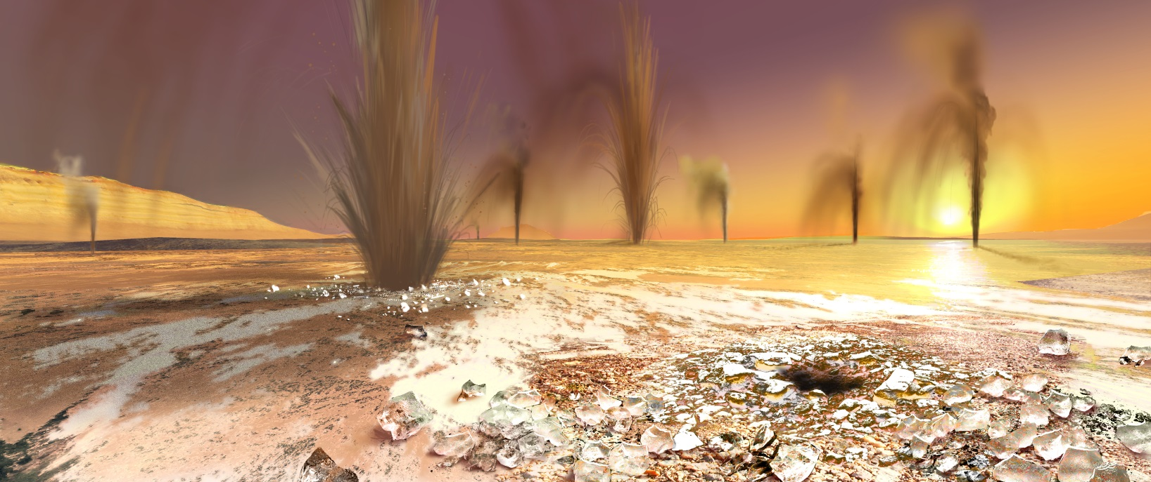
Sand Jets – spring thaw
Thermal Emission Imaging System (THEMIS)

Slide 12
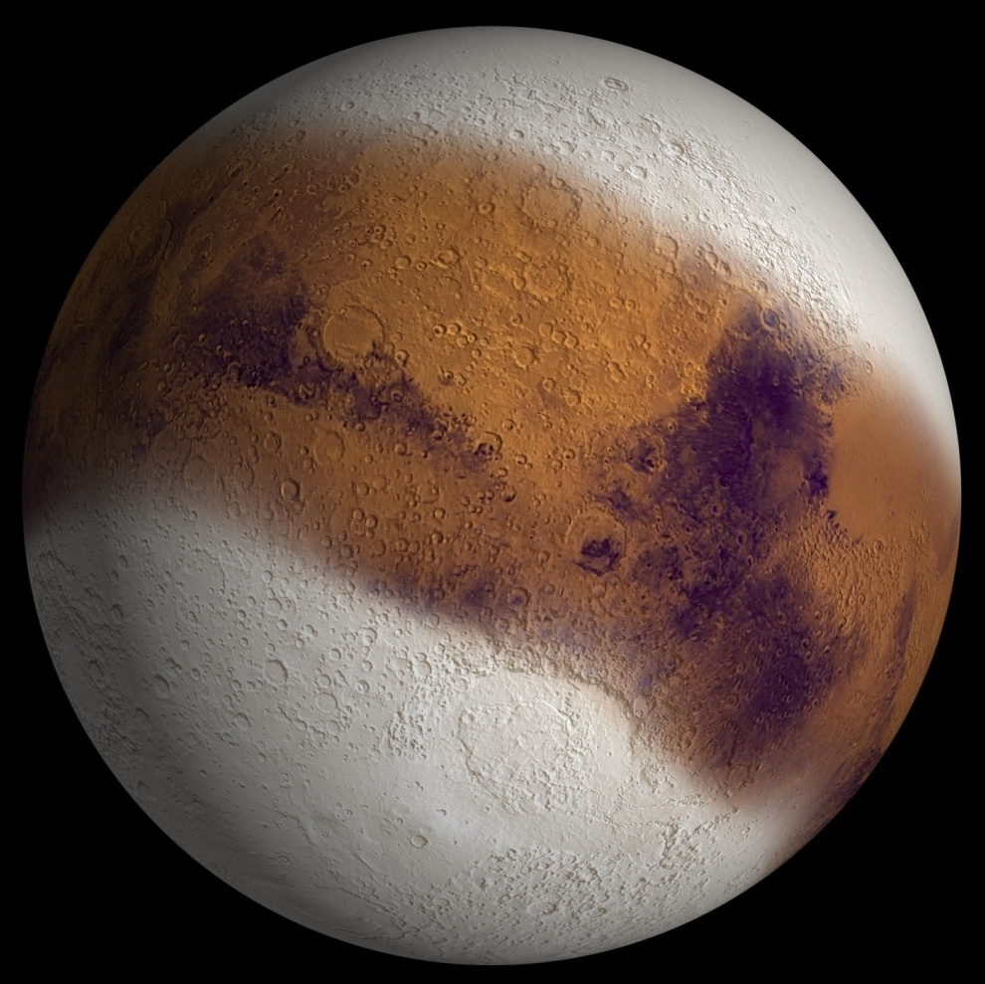
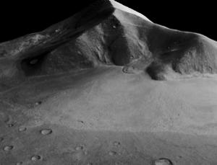
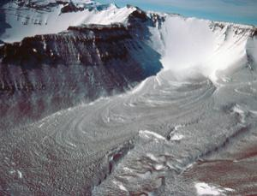
Equatorial Glaciers
Mars Reconnaissance Orbiter

Slide 13
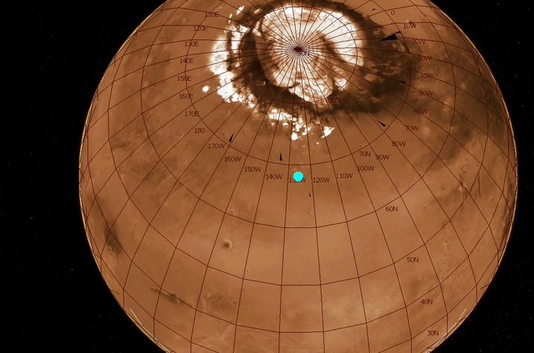
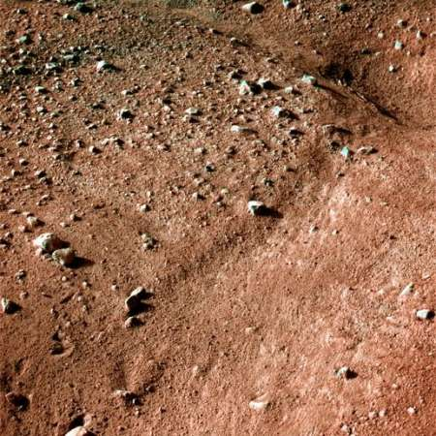
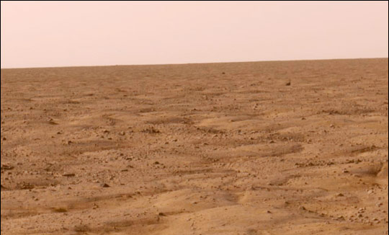

The Phoenix Mission
permafrost – polygons

Slide 14
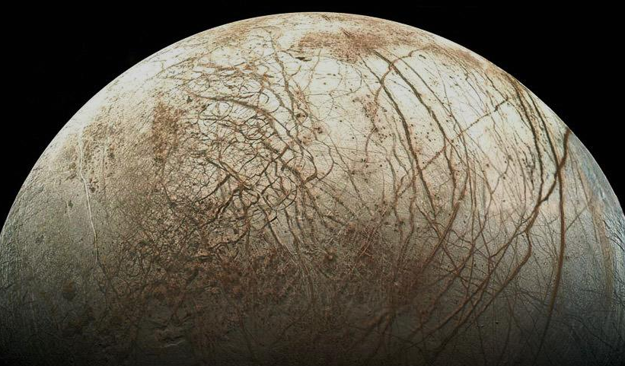
Europa

Slide 15
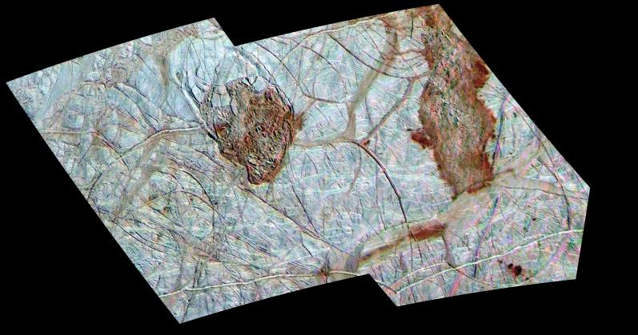
Thera Macula & Thrace Macula

Slide 16
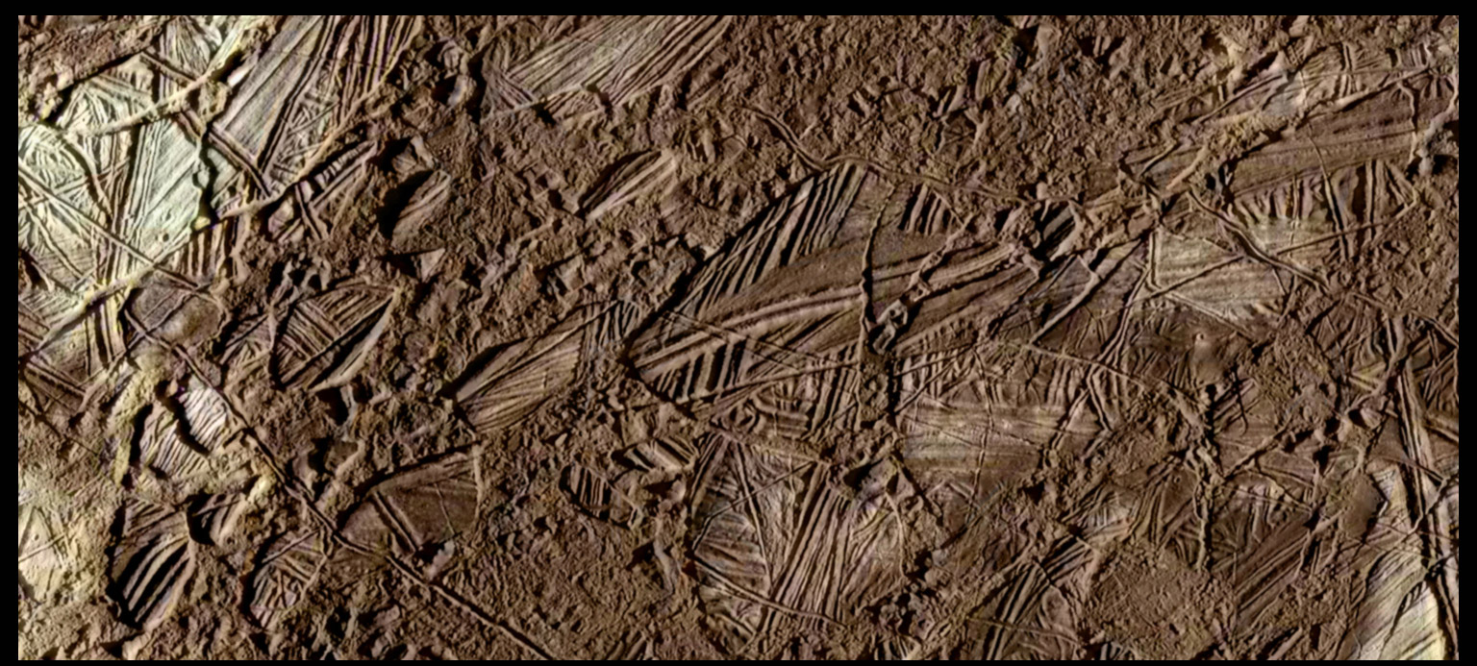
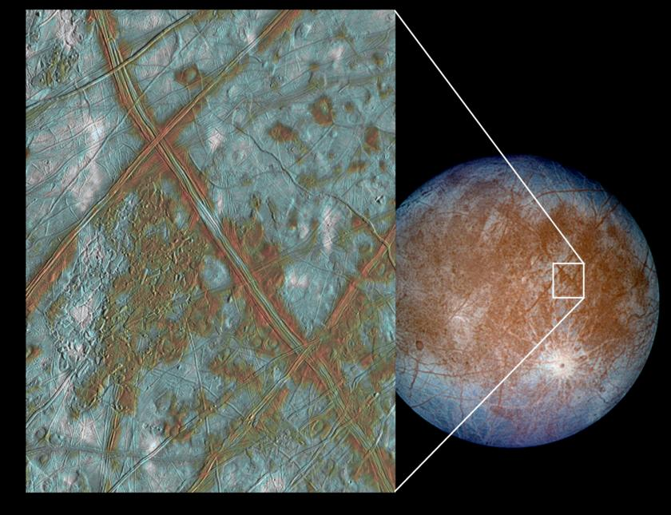
Conamara Chaos

Slide 17
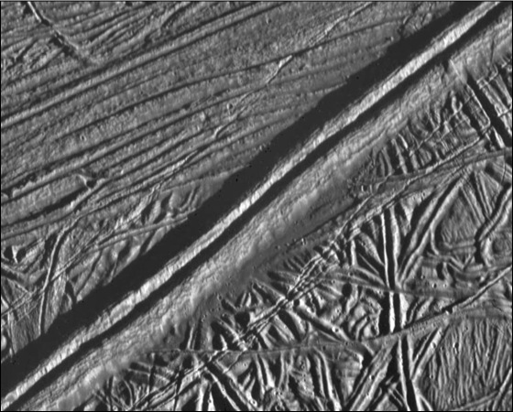
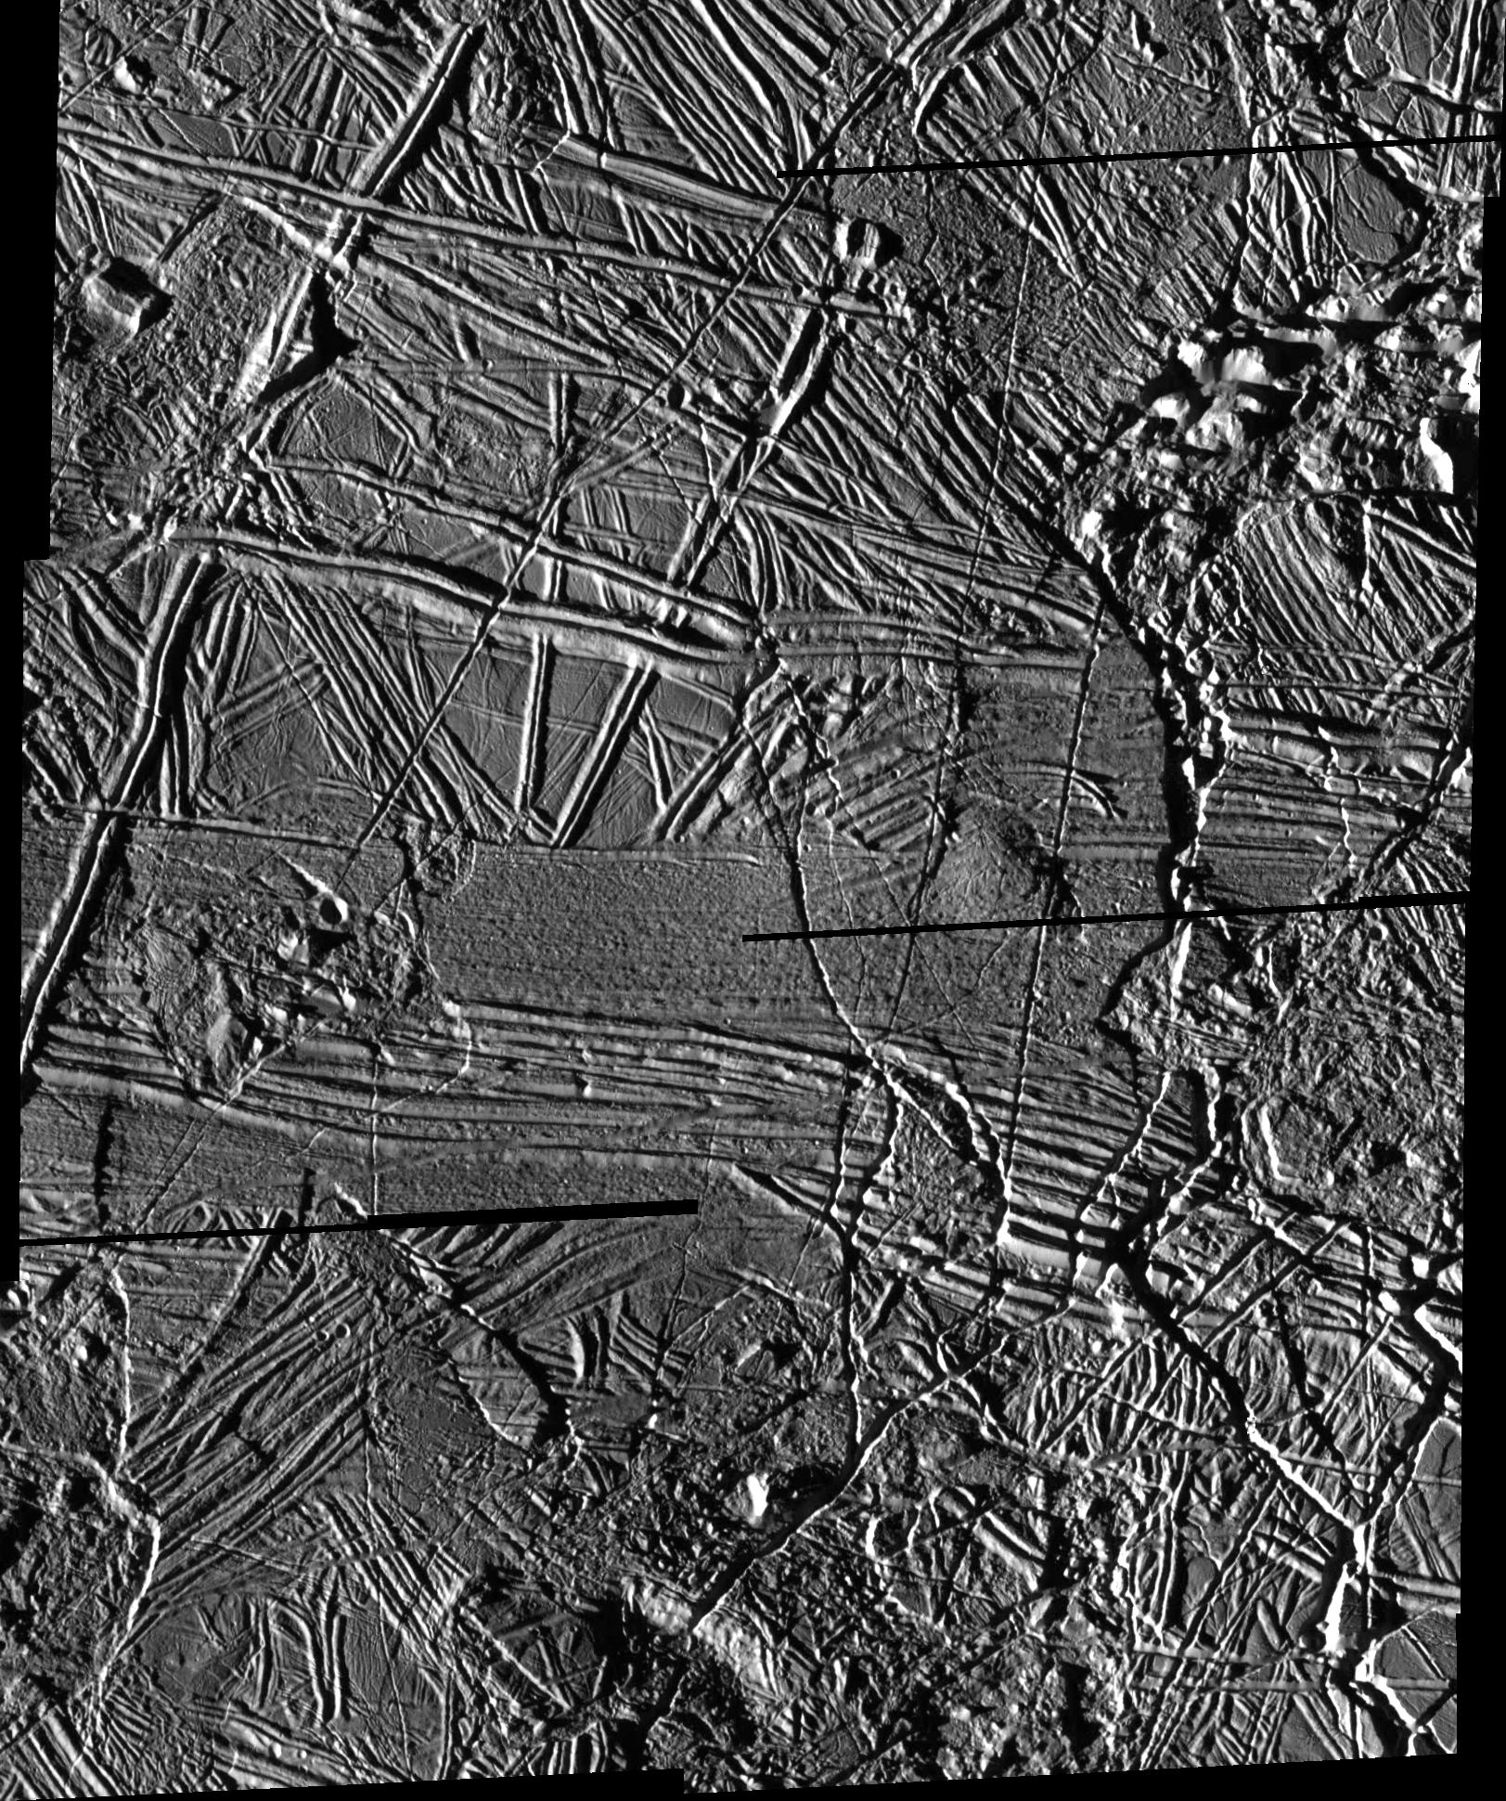
Ridges

Slide 18
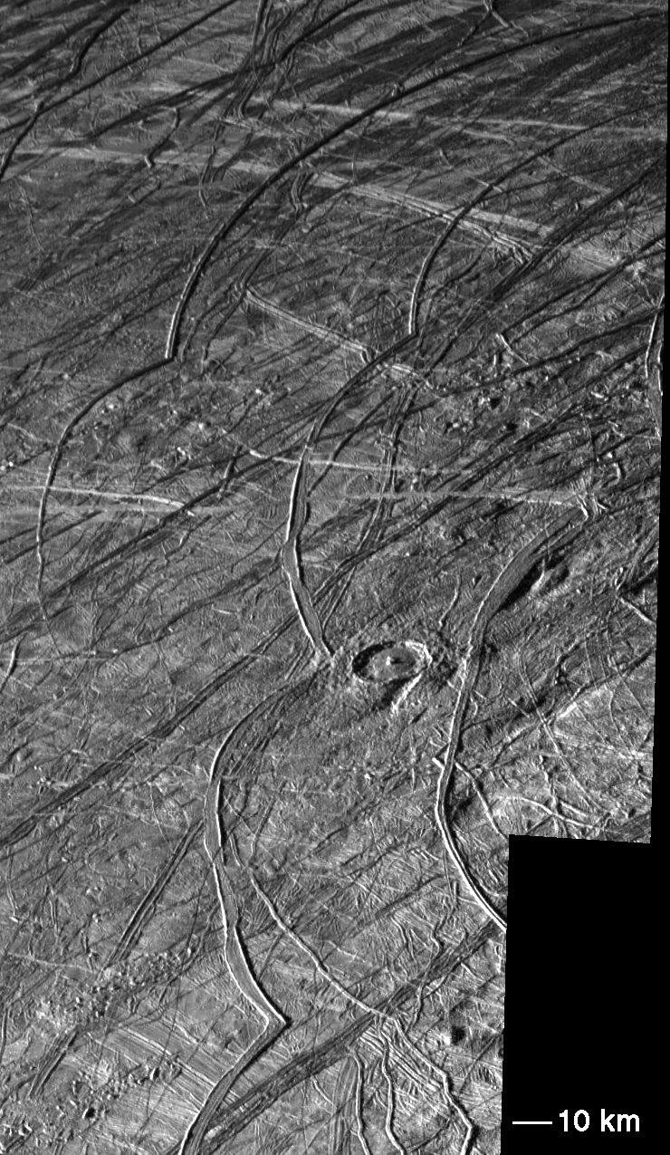
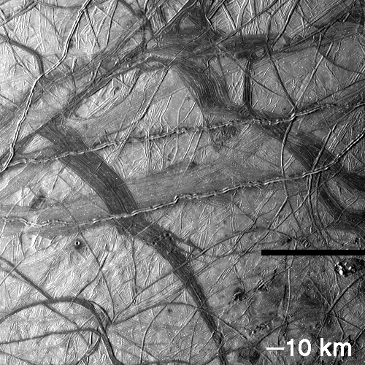
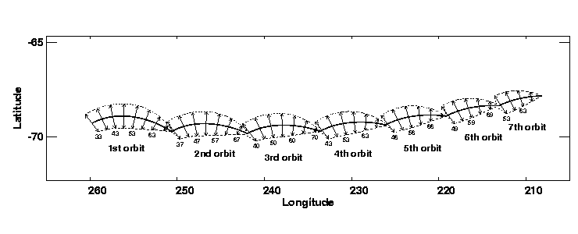
Cycloids

Slide 19
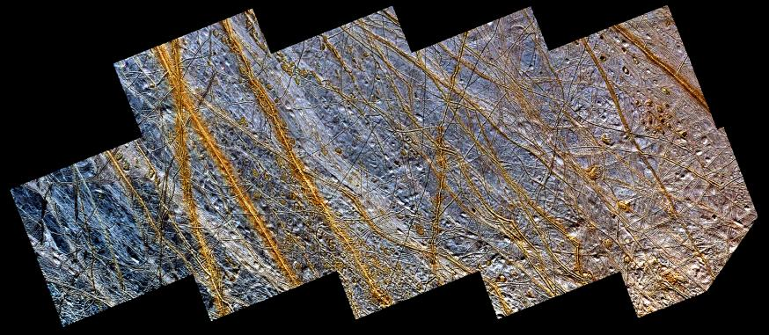
Plains

Slide 20
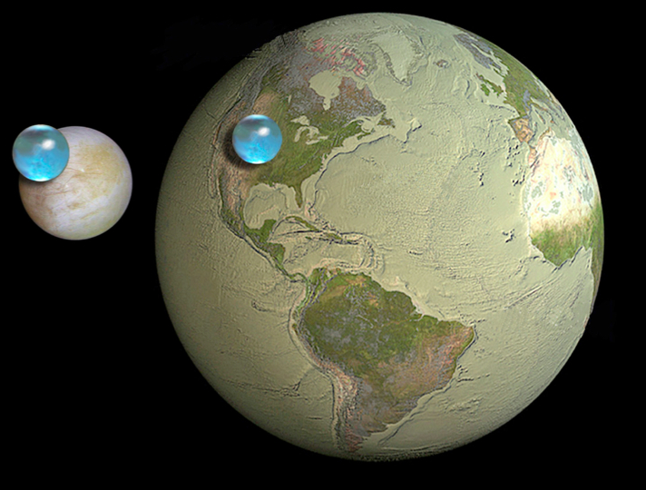
Oceans

Slide 21
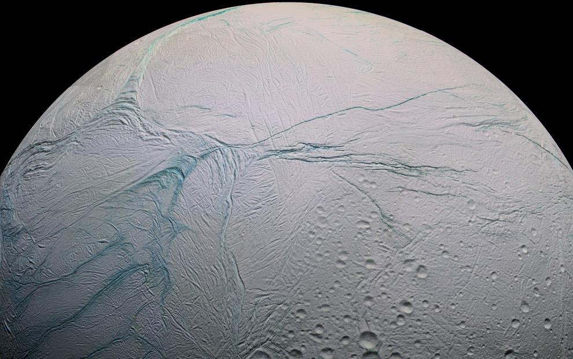
Enceladus:

Slide 22
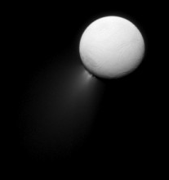
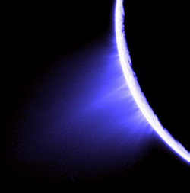
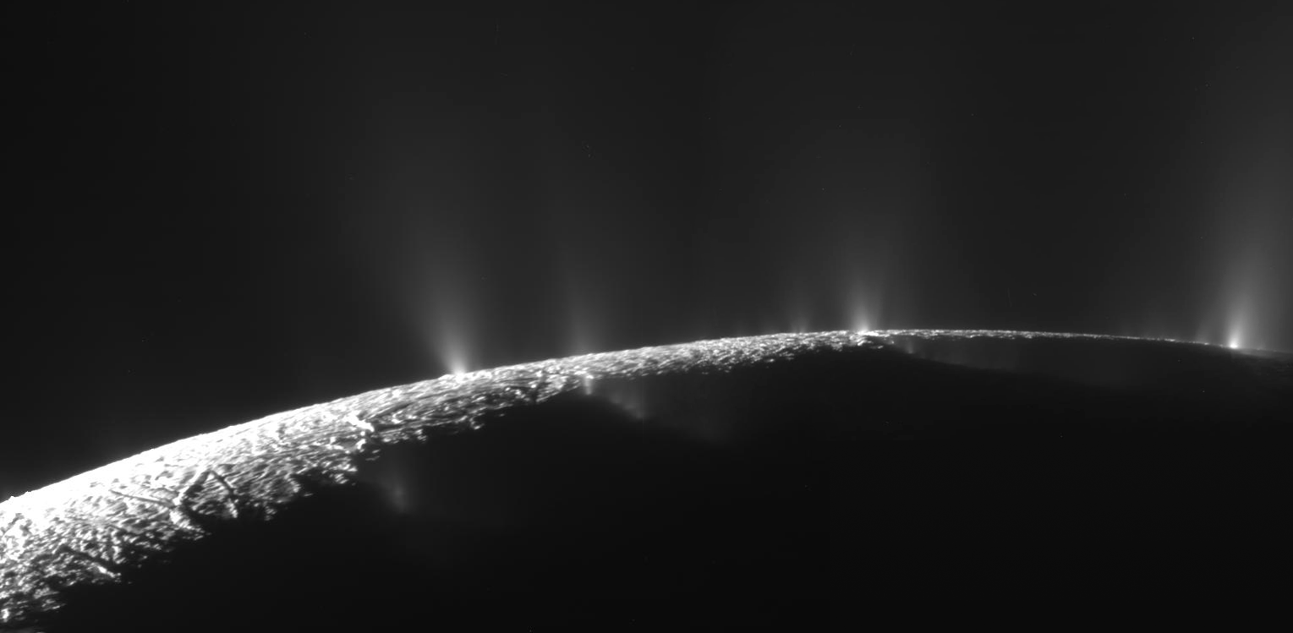
Plumes & Jets

Slide 23
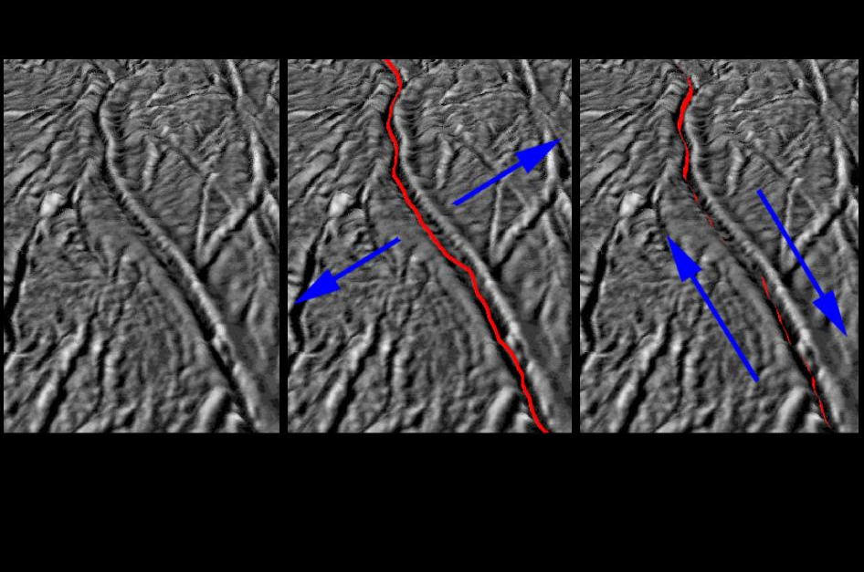
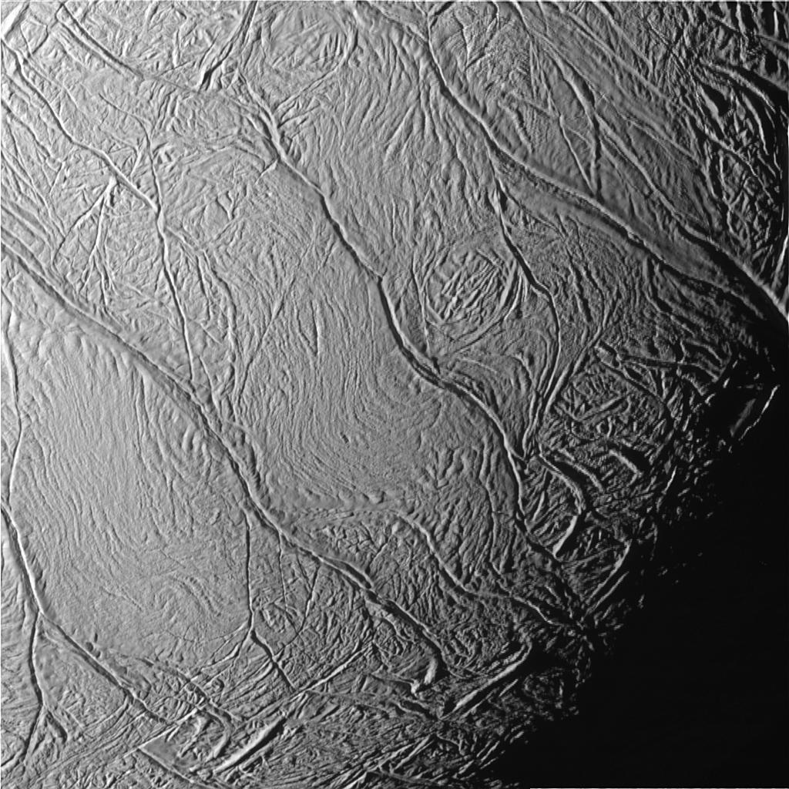
Tiger Stripes

Slide 24
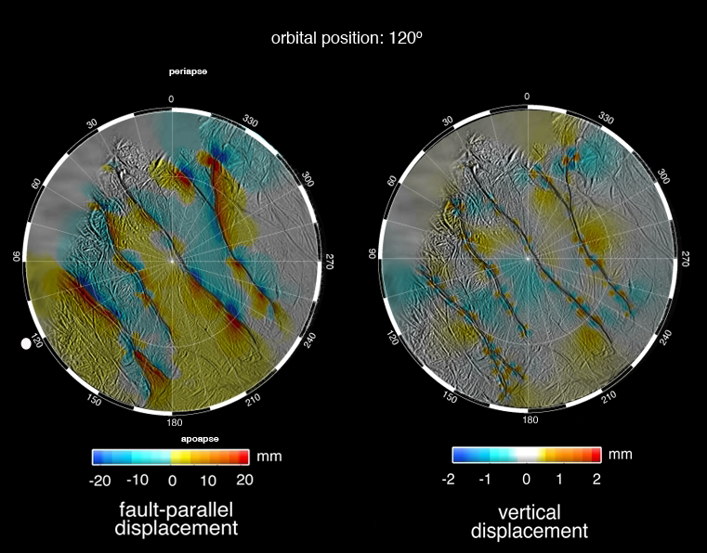

Slide 25
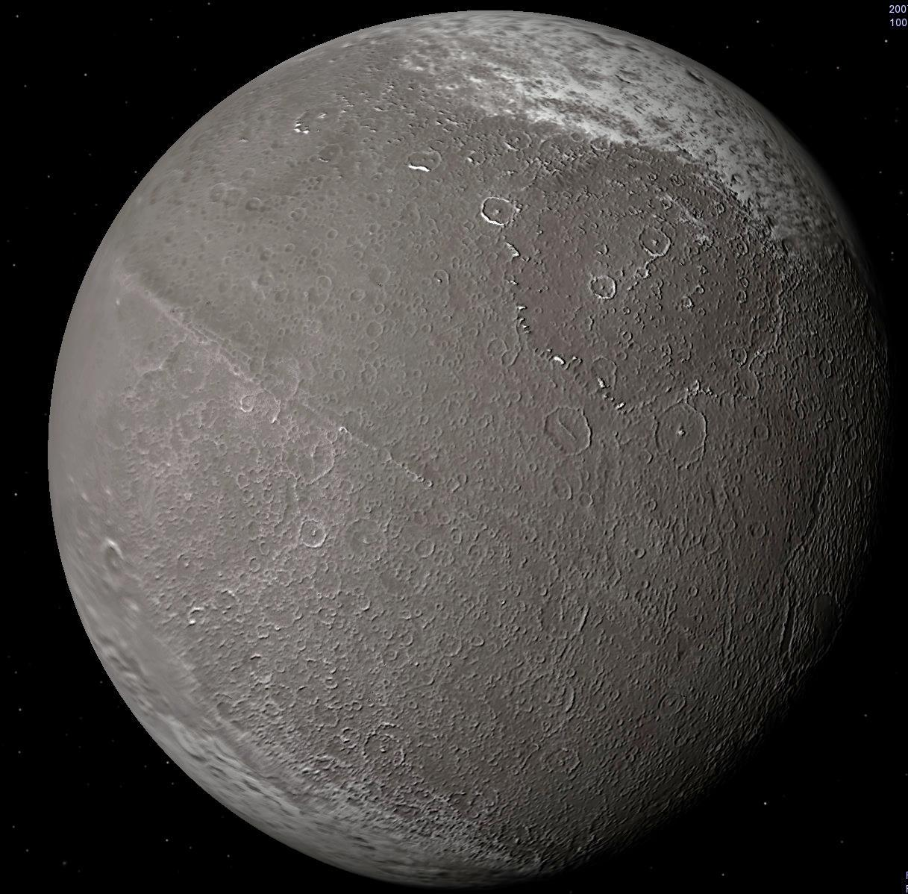
Iapetus

Slide 26
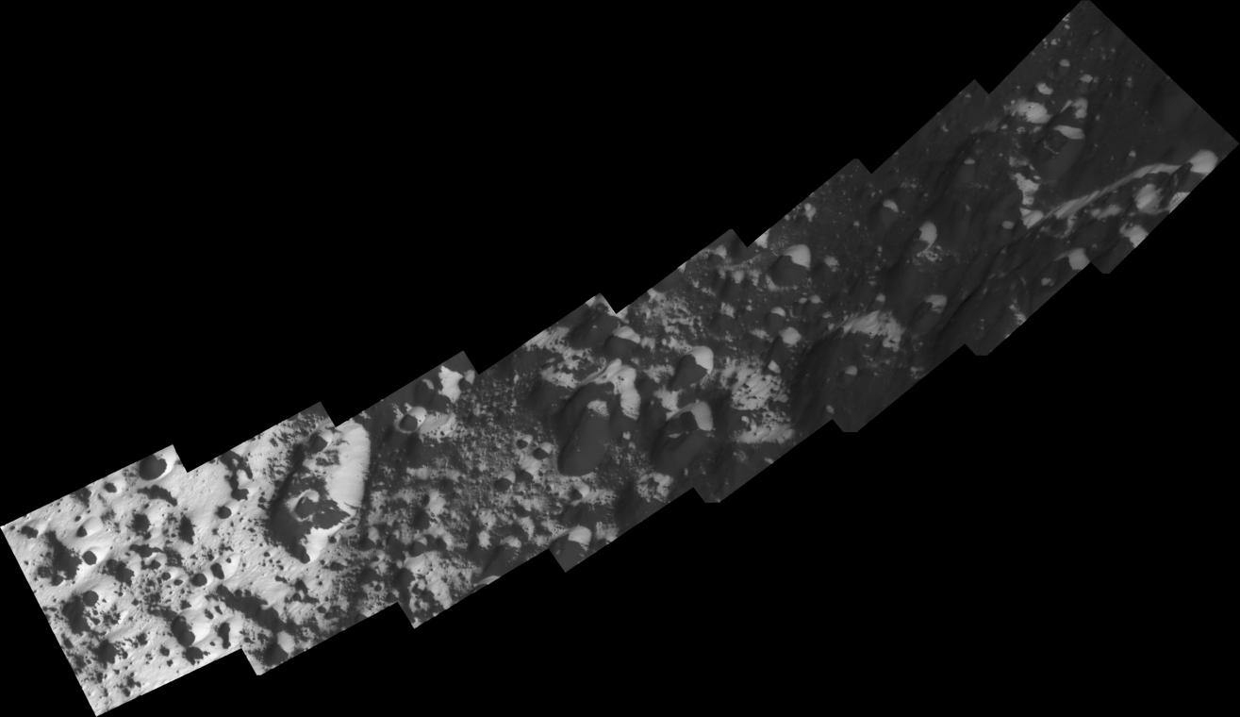
Transition Zone

Slide 27
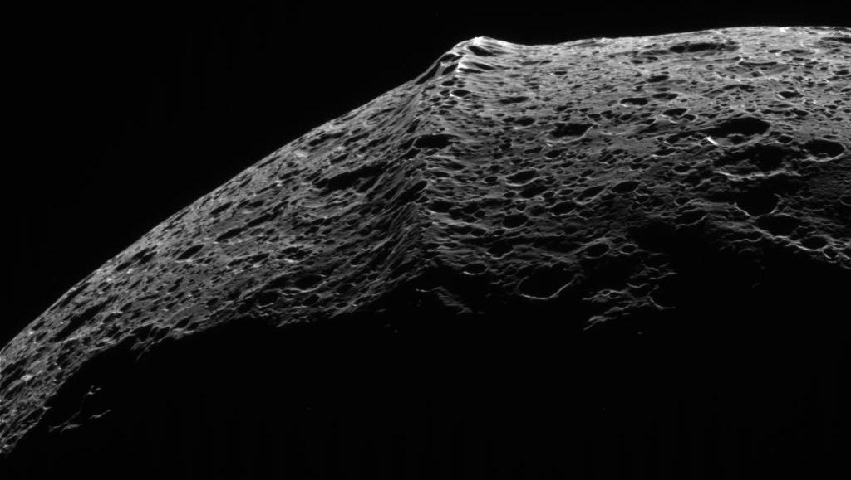
The Wall

Slide 28
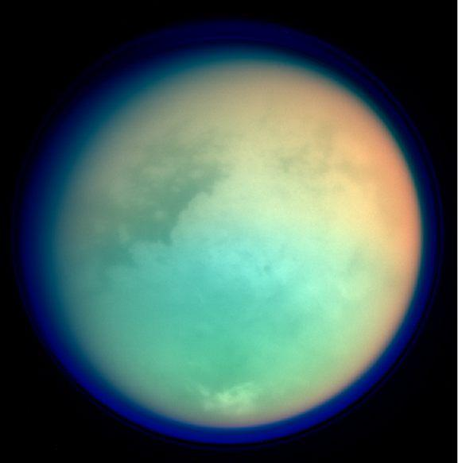
Titan

Slide 29
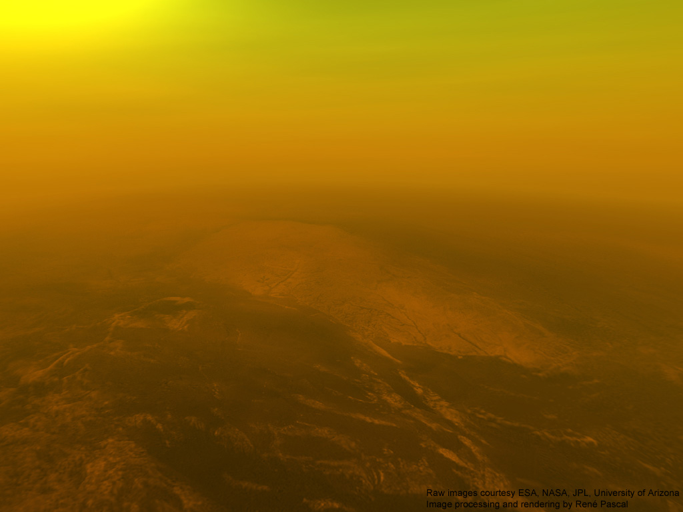
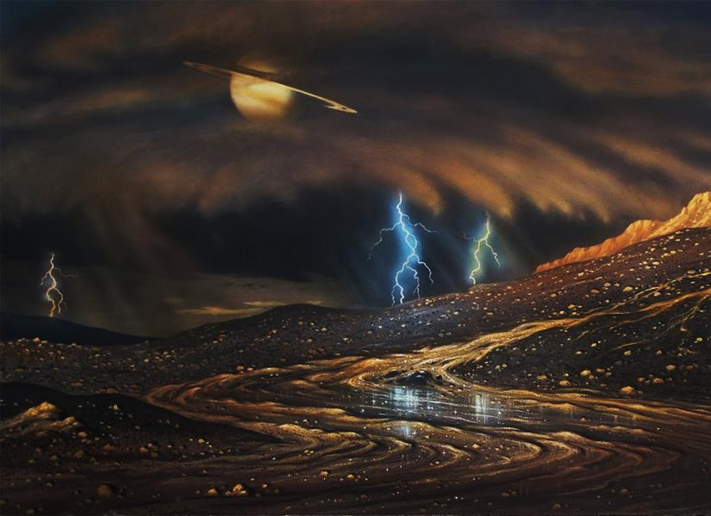
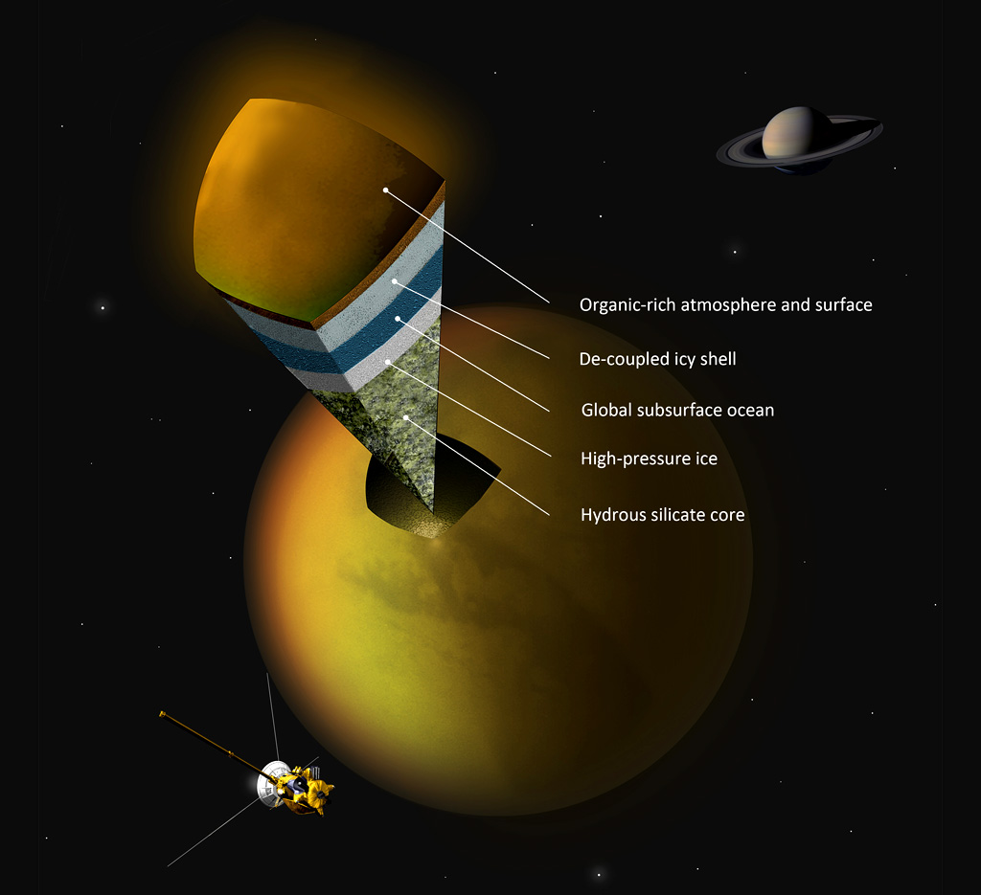

Slide 30
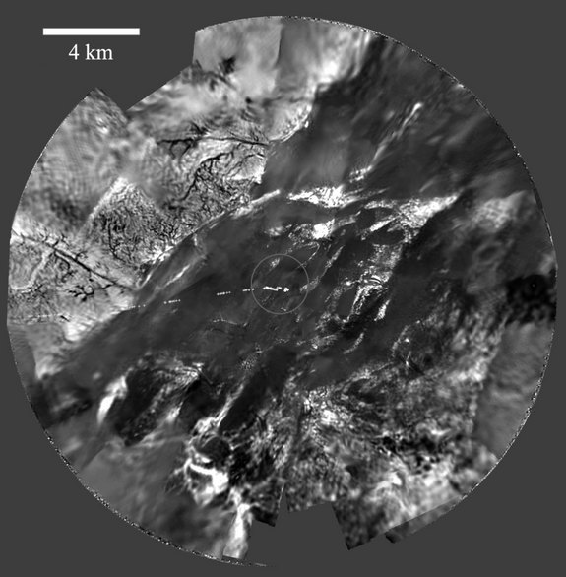
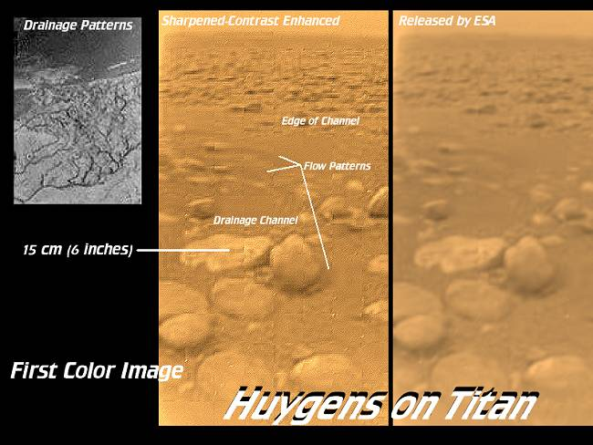

Slide 31
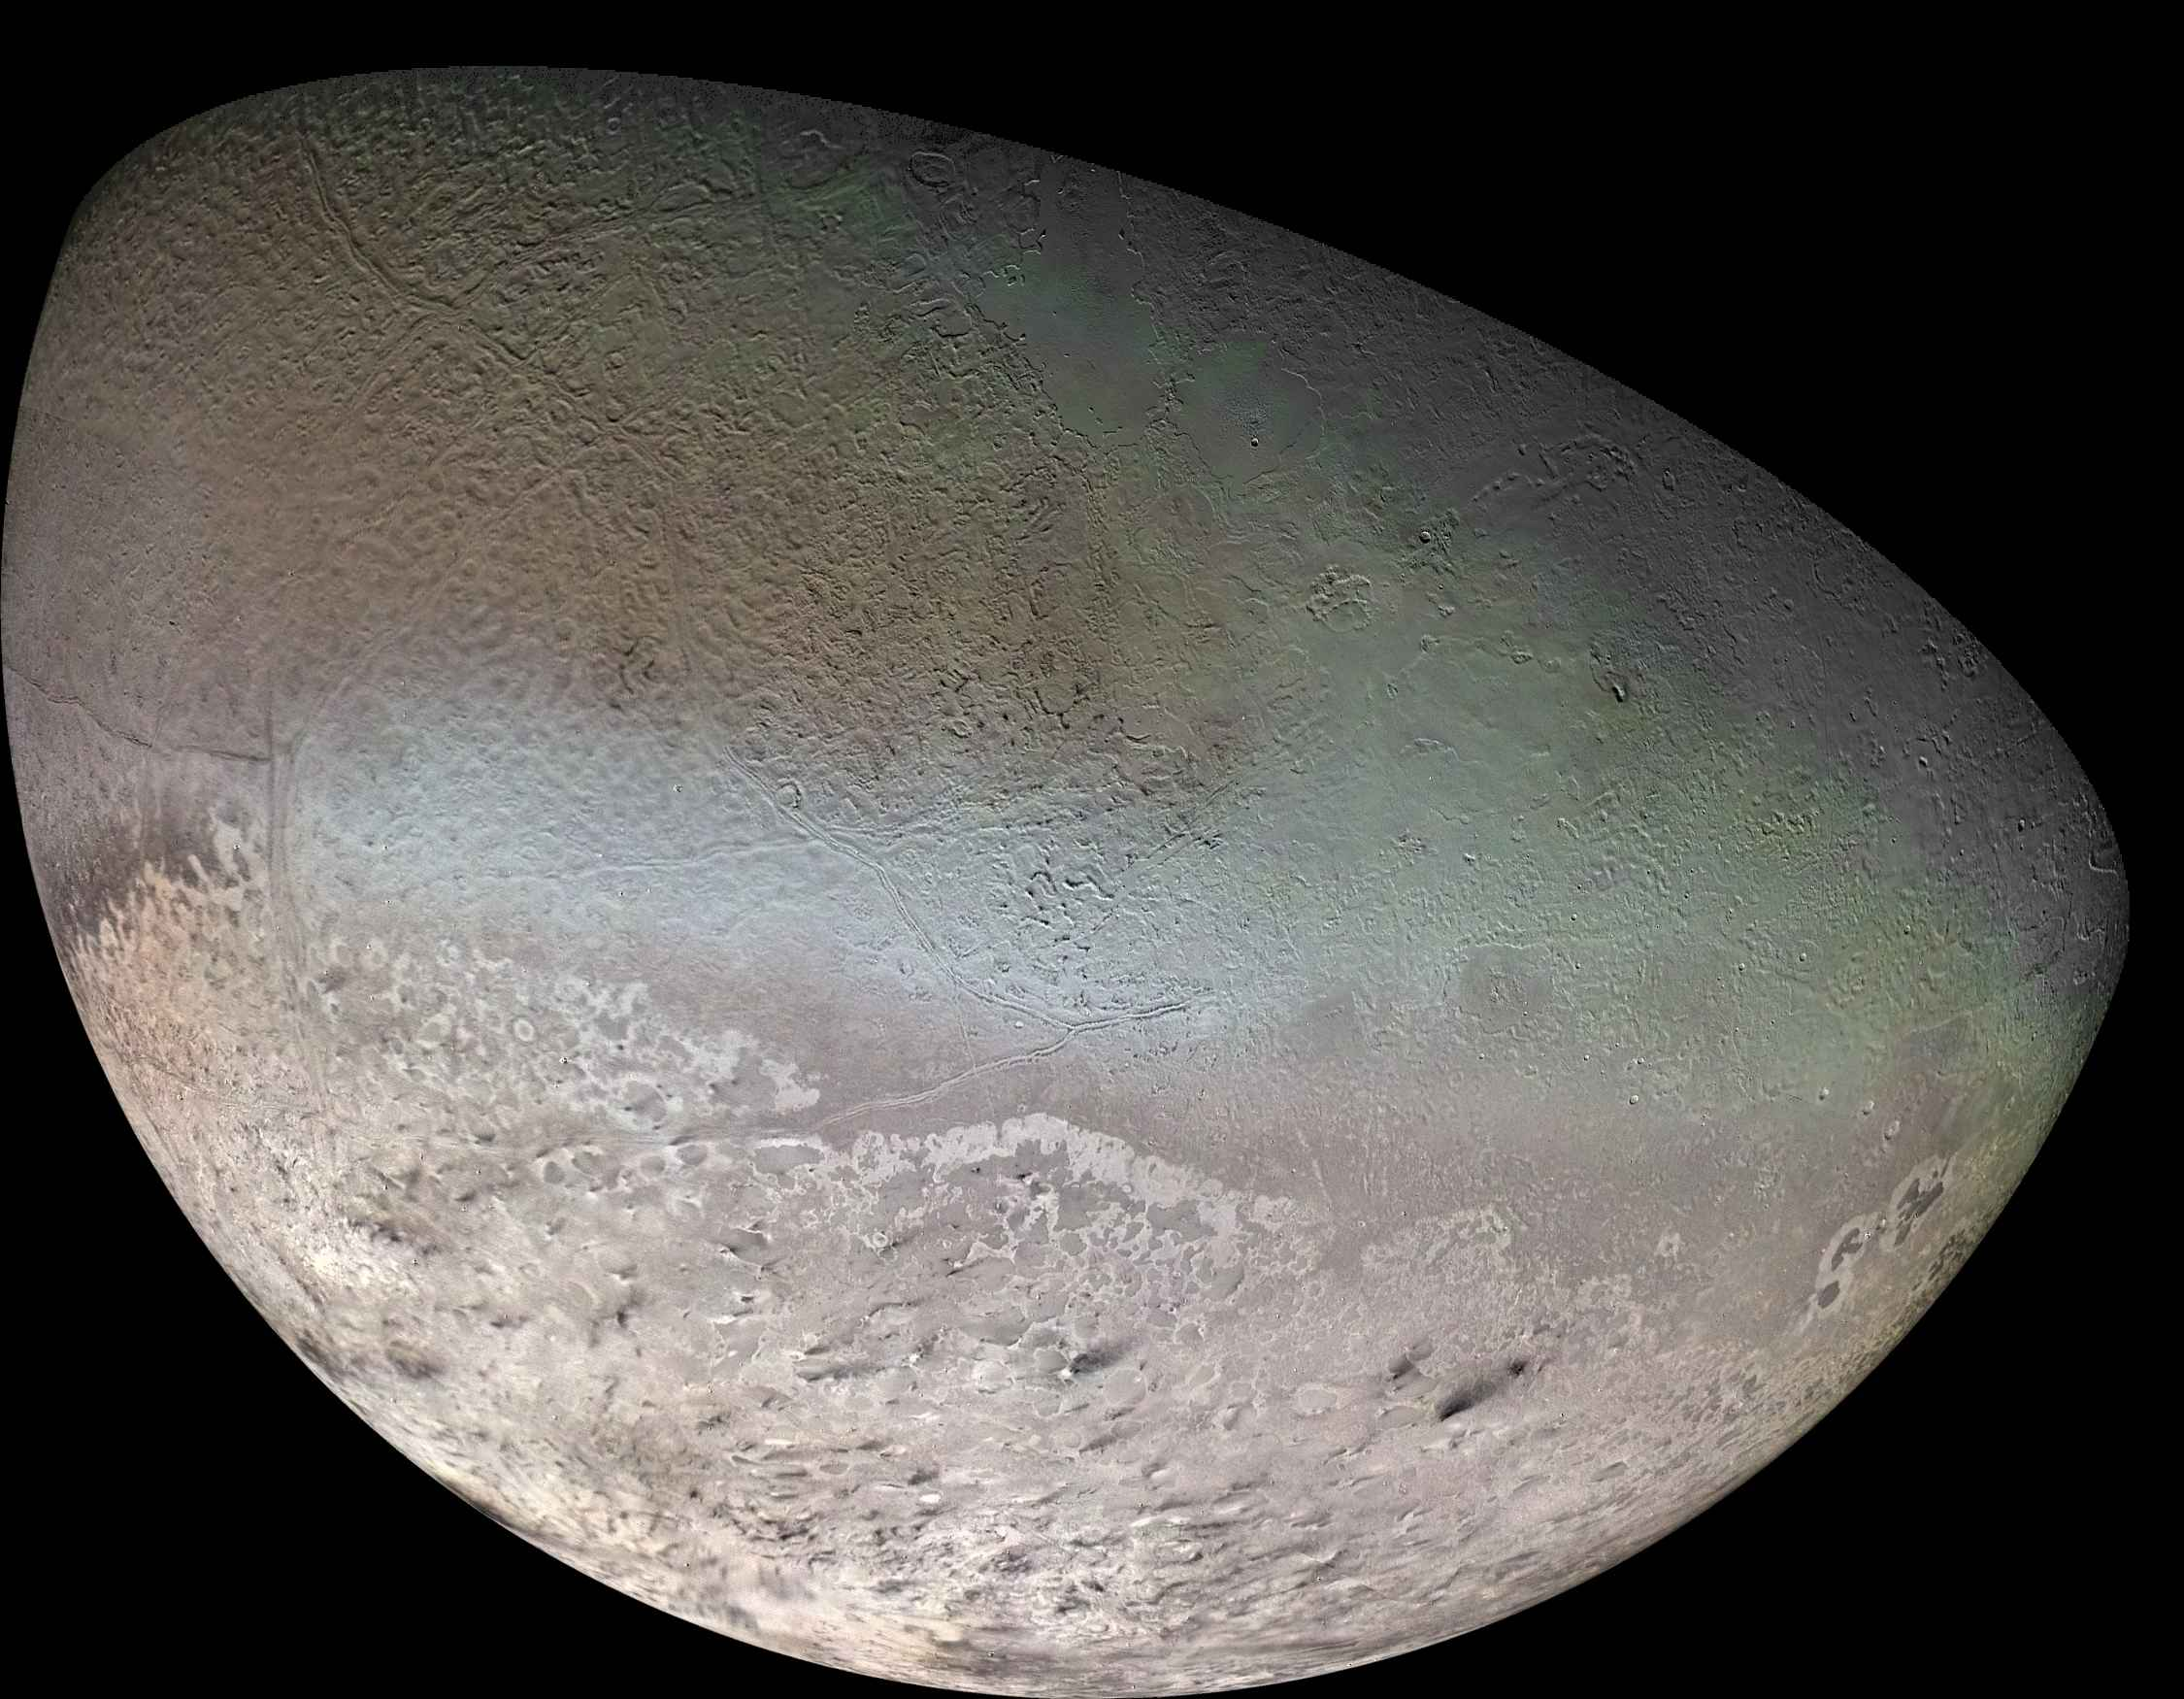
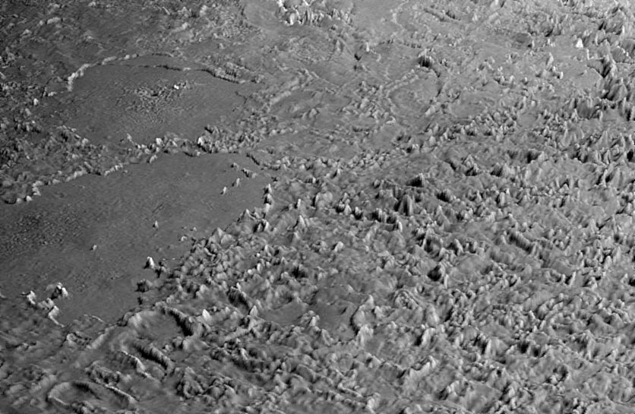
Triton

Slide 32
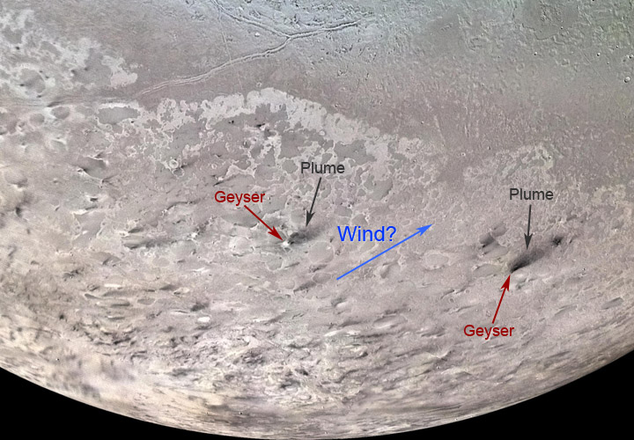
Ice Volcanoes

Slide 33


Slide 34

Ceres

Slide 35


Slide 36

Comets

Slide 37



Slide 38



Slide 39

The Oort Cloud

Slide 40

The Kuiper Belt

Slide 41

Part II:
History and process of formation for specific features

Slide 42


Mars

Slide 43


Titan
Europa

Slide 44

Remote Sensing, Imagery, Satellite Measurements of
Objects & Features

Slide 45







Slide 46

Physical, Thermal, and Chemical Properties of
Potential Habitats for life

Slide 47

EXTREMOPHILES
Psychrophiles, Thermophiles, Radioresistant, Alkaliphiles,
Acidophiles, Halophiles, Xerophiles, Barophiles, Endoliths
AND gravity!

Slide 48





Yellowstone National Park

Slide 49




Lake Untersee, Antarctica

Slide 50








Thermal Vents, Pacific Ocean
Mono Lake, California
CRREL, Alaska
The Crystal Cave, Mexico

Slide 51




The Most Extreme of the Extremophiles – Tardigrada

Slide 52




The Most Extreme of the Extremophiles – Tardigrada

Slide 53

Missions
http://www.nasa.gov/missions/index.html

Slide 54

Missions to Mars

Slide 55





Slide 56




Slide 57


Slide 58


Slide 59





chandra.harvard.edu
aavso.org
apod.nasa.gov
http://soinc.org

